Slide 1
NCFE Review
Units 4-6

Slide 2
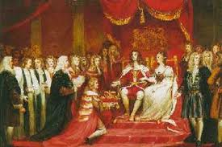
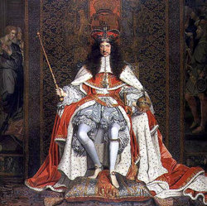
Absolutism (Monarchs have absolute Power)
- Divine Right - God gives kings power (Challenge King = Challenge God
- Kings fought over all sorts of things…but mostly RELIGION! (Catholics vs. Protestants)
- Spanish Armada failed to take England (booo Spain)

Slide 3
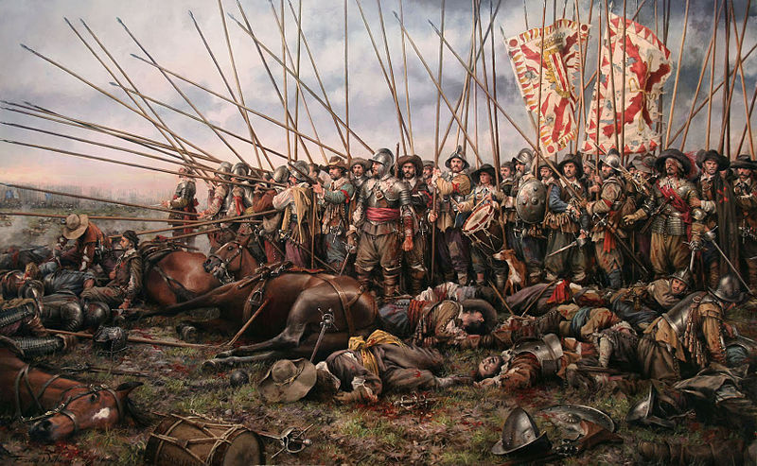
City-State – A city that controls the area that surrounds it
…Different from…
nation-state- country whose identity and authority comes from a people group

Slide 4
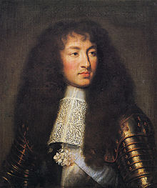
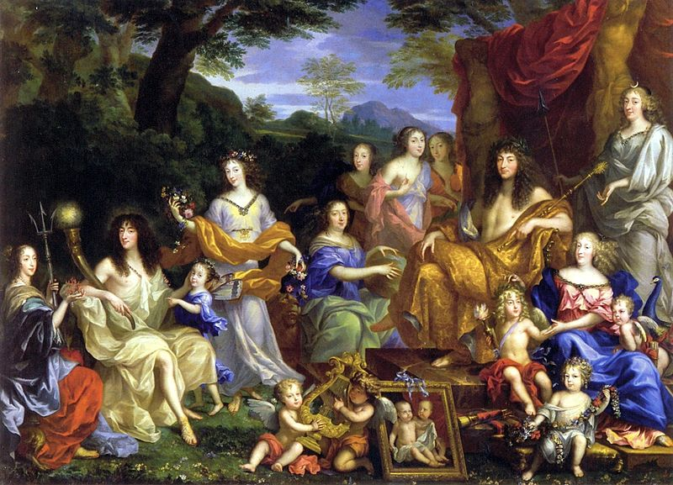
Absolute Monarchs
- Louis XIV – French King, built Versailles, divided rich and poor!
- Ivan the Terrible (bad Russian Tsar) Peter the Great (good Russian Tsar)

Slide 5
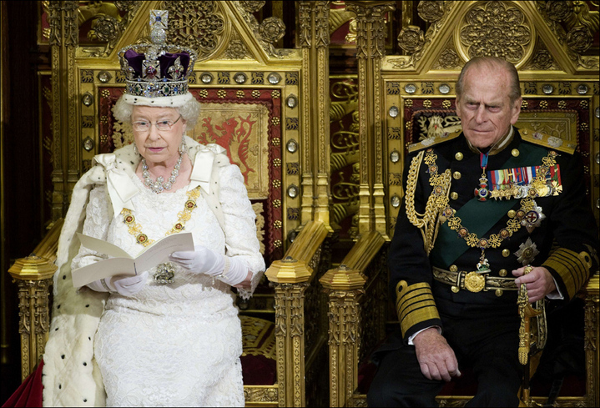
England has a Civil War and brings in William and Mary to save the day.
- This Glorious Revolution is bloodless, and establishes a constitutional monarchy and bill of rights

Slide 6
Scientific Revolution
1st theory = geocentric theory
Aristotle said earth was at the center of the universe (wrong!)
2nd theory - heliocentric theory- Copernicus said that the earth goes around the sun (correct!)
Kepler agreed! – ‘cept he saw planets move in ovals
Galileo also agreed! – Proved it with telescope (Church not happy…)
Francis Bacon used scientific method to prove theories!

Slide 7
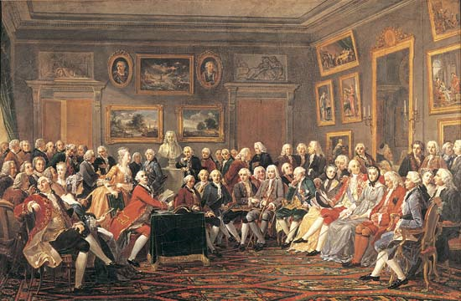
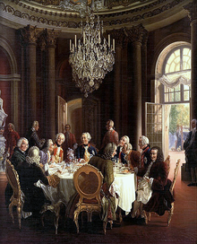
The Enlightenment
Salons – fancy gatherings that promoted the Enlightenment (like Starbucks, but people actually discussed important issues)
Social Contract - A social contract is an agreement b/w the people and their government to give up part of their freedom in exchange for protection for all (Hobbes)

Slide 8
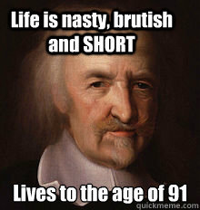
B. Thomas Hobbes- Humans were evil and need strong kings to keep them safe
C. John Locke- People were naturally good and born with rights the government should protect
D. Baron de Montesquieu- Government should be separated into branches

Slide 9
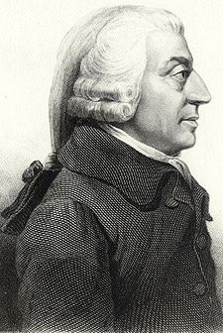
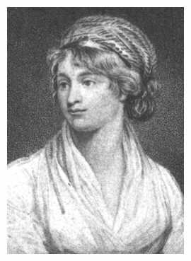
Mary Wollstonecraft- fought for social equality (esp. education) for women
D. Adam Smith
Believed in capitalism and laissez-faire- free market economy without government intervention
Enlightened Monarchs - Some strong monarchs (despots) tried to promote the Enlightenment but failed (Catherine the Great, Frederick II, Joseph II)

Slide 10
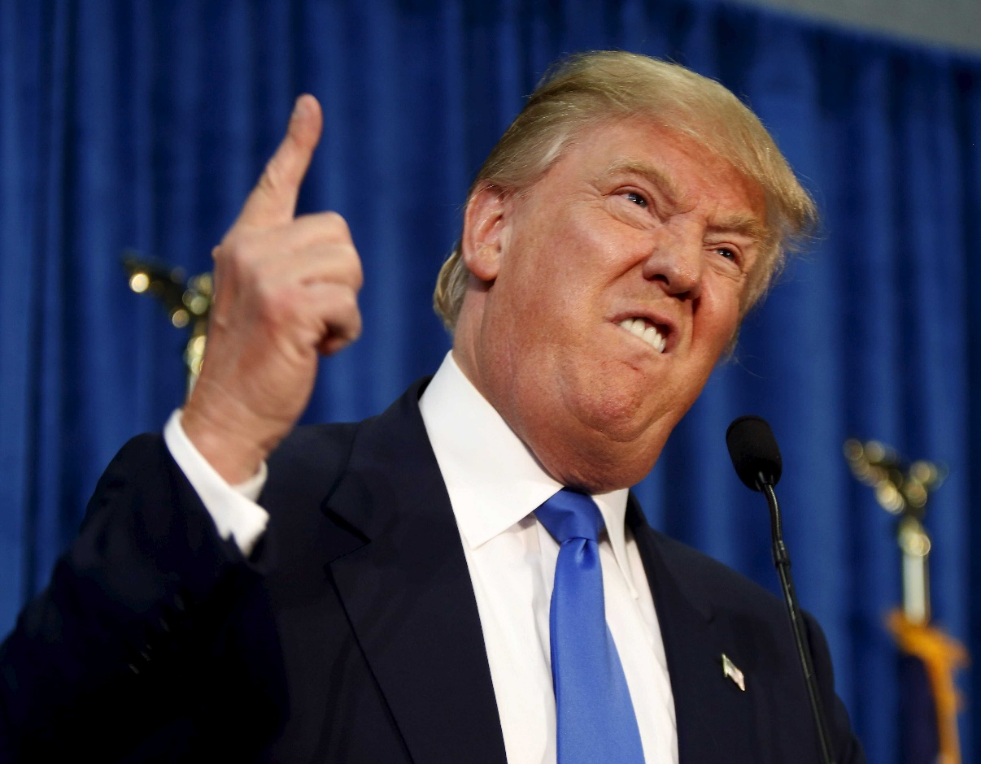
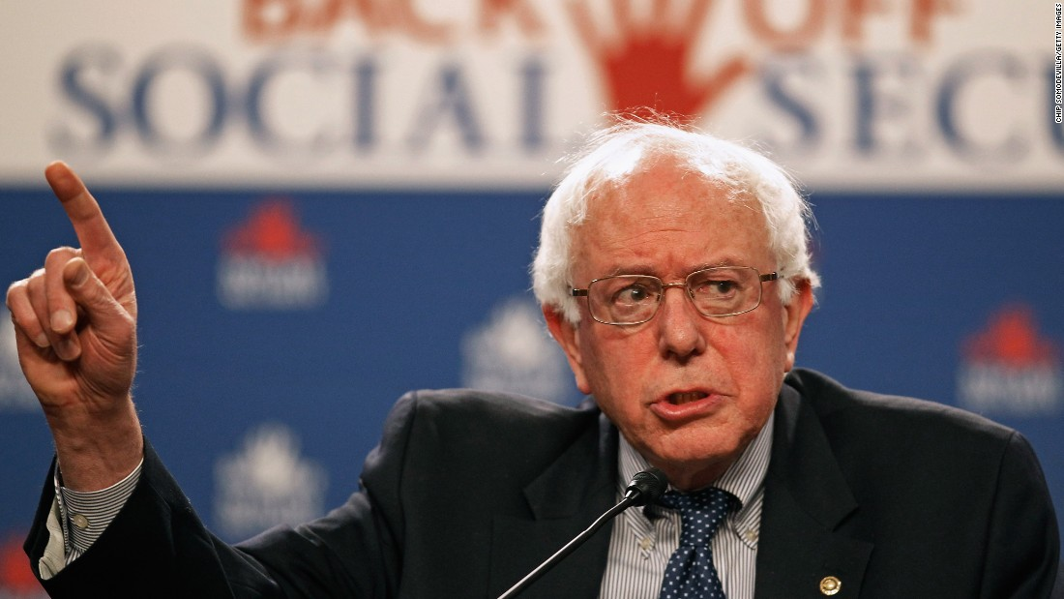
Question…
Which of these political candidates would agree with the economic policies of Adam Smith?

Slide 11
THE AMERICAN REVOLUTION
A. British set up 13 self-governing permanent colonies
B. French and Indian War - GB beats the French, but makes colonies pay the large wartime debt = Colonists NOT happy (Boston Massacre/Boston Tea Party)
July 4th 1776 – Declaration of Independence (greatest breakup letter of all time!) – Ideas from the Enlightenment

Slide 12
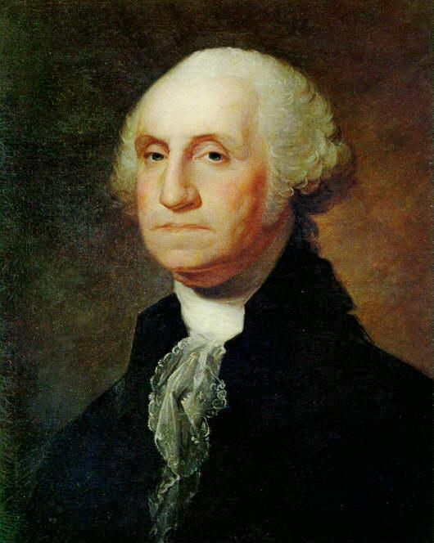
2. George Washington- led the Continental army; needed help from the French to win!
4. Treaty of Paris (1783)- Americans are Independent! We “get” all lands west to the Mississippi!
We write a constitution and a government with 3 branches! (not our idea)

Slide 13
Independence in the Americas
European countries still control American colonies… and those people want to be free!
Haiti : HUGE slave population revolts against French colonists
Mexico: Father Hidalgo leads Mexico to independence
Northern South America: Simon Bolivar helps unite N. South America
- Southern South America: Jose de San Marti helps unite S. South America

Slide 14
What about the United States?
New policy - Monroe Doctrine no more European colonization in Americas (which is cool, cause we aren’t European)
US won Mexican-American War and gained large territory (mostly Texas)
America wins the Spanish-American war! US controlled Cuba, Puerto Rico, and Panama, and the Philippines

Slide 15
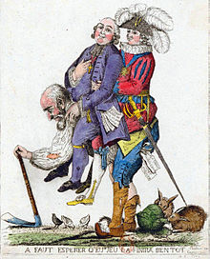
French Revolution
A. Three Estates
1. 1st Estate: Clergy (church)
2. 2nd Estate: Nobility
3. 3rd Estate: Everyone Else
B. France was in an Economic Crisis
1. Famine and inflation
2. Large war time debt
3. 1st and 2nd estates were not taxed much
Why revolt then? Um, America did it. Duh.

Slide 16
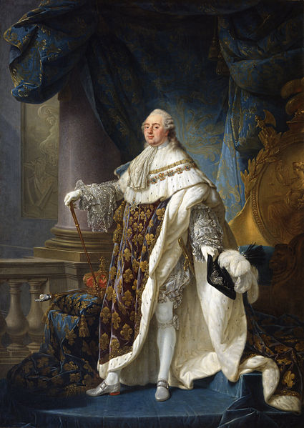
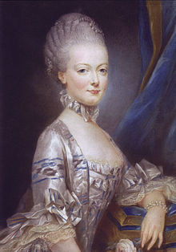
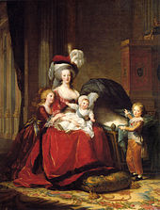
Louis XVI was a weak king (in more ways than one)
Marie Antoinette was awesome (but spent too much money)
French government = Estates General (all Estates had 1 vote) – not fair

Slide 17
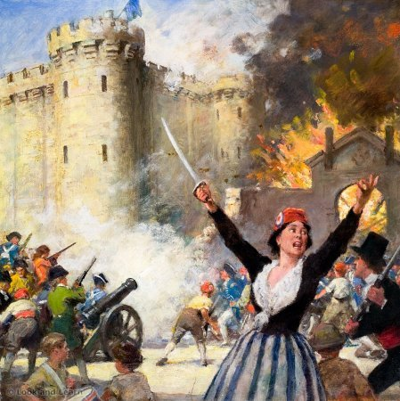
NAME CHANGE! Estates General renames itself the National Assembly – they represent the Nation!
Tennis Court Oath – keep meeting until a Constitution is written!
Storming of the Bastille – French citizens tore down the prison. Literal and metaphorical victory!
OH! Constitution – Declaration of the Rights of Man and Citizen (long title = equal rights)

Slide 18
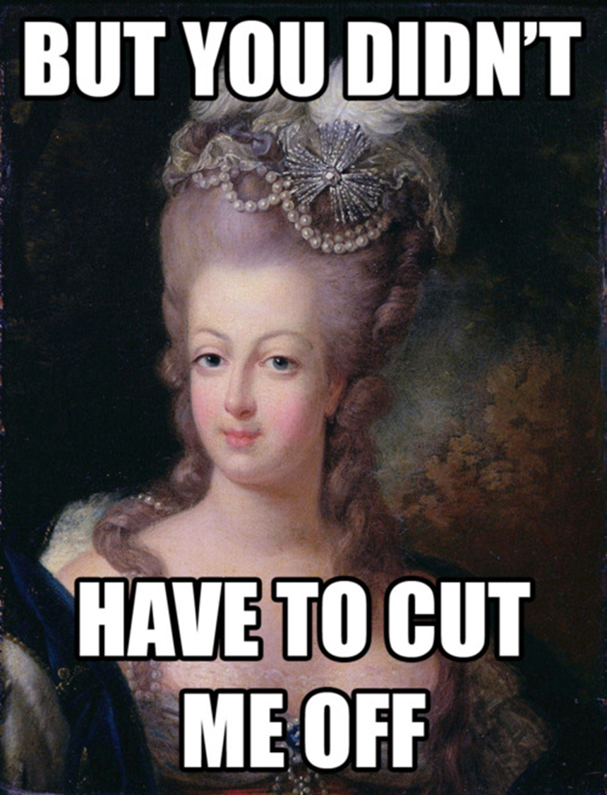
- France went to war because it wanted to spread the revolution
(Other countries fight back to prevent the revolution from spreading)
- King tried to run away…got caught! Punishment? Death!
- Queen still alive! What do we do with her? Death!
- Both killed by the guillotine. Equal deaths for equal rights! ☺

Slide 19
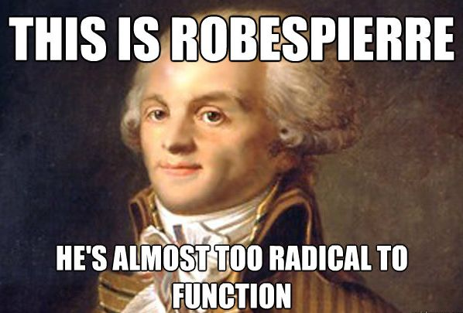
THE TERROR
Robespierre uses fear (and the guillotine) to spread the revolution
Outlaws religion, changes calendar, kills anyone who is disloyal.
Goes mad with power. Gets killed by the people he previously told to kill other people.

Slide 20
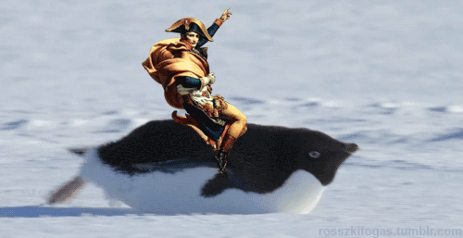
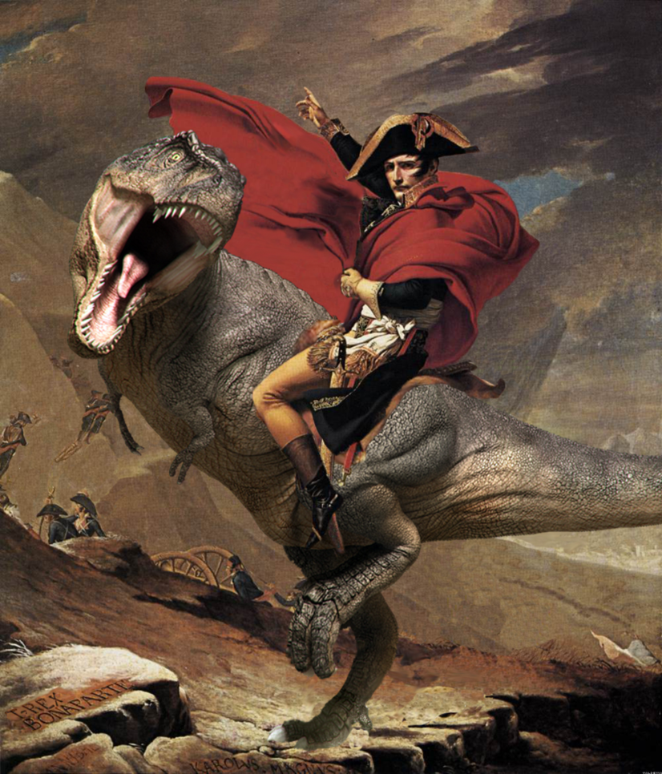
Napoleon!
Studied military strategy from an early age and took over France in a coup d'état. (Why did people allow this to happen)
Most of Europe was under his control…except for Britain, Russia, and Spain (they fought back)!

Slide 21
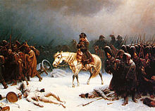
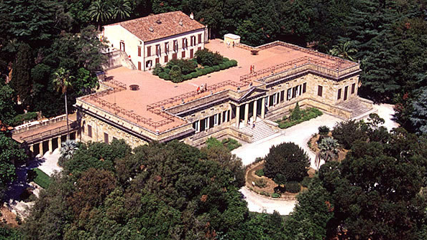
After losing to GB, Napoleon Developed the Continental system- no nation in continental Europe could trade with Great Britain
Russia defies, so Napoleon invades. Bad move. Lost about 500,000 troops
- Exiled to Elba. Comes back for 100 days. Loses at Waterloo. Exiled again at St. Helena.

Slide 22
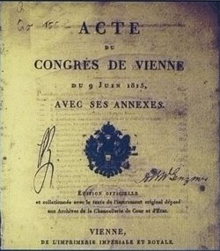
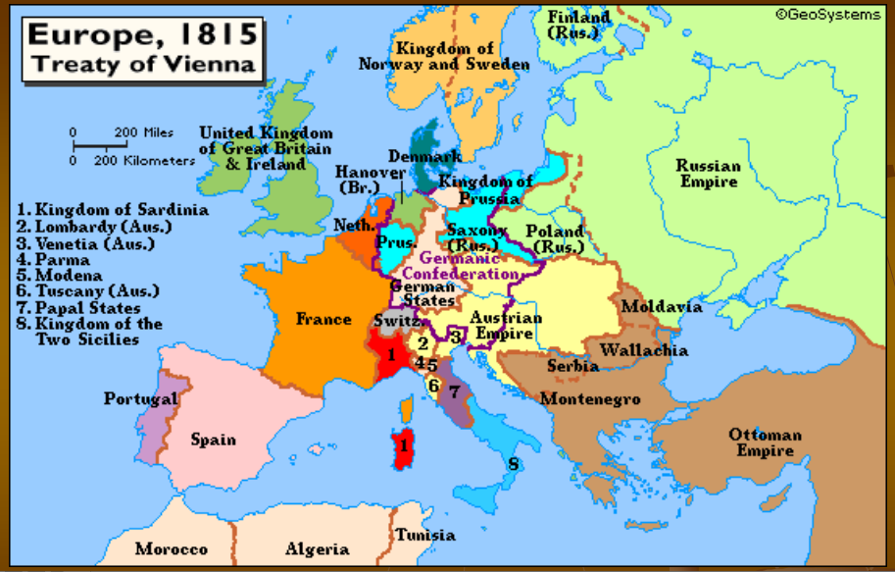
Effects of Napoleon
A. Congress of Vienna- first time major countries met to form a treaty
Created a balance of power system and peace for 99 years

Slide 23
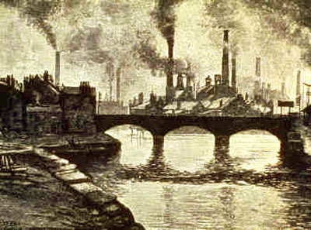
Industrial Revolution
- industrialization - work driven by machinery
- New farming techniques = more food = more people
- Land is valuable, enclosed by rich people. Farmers forced to move.

Slide 24
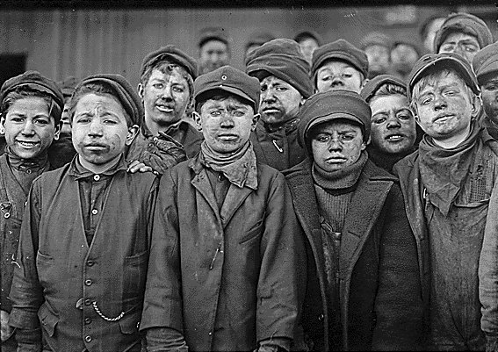
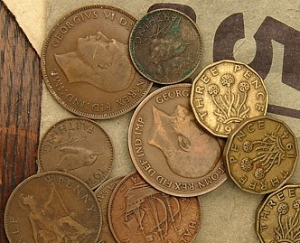
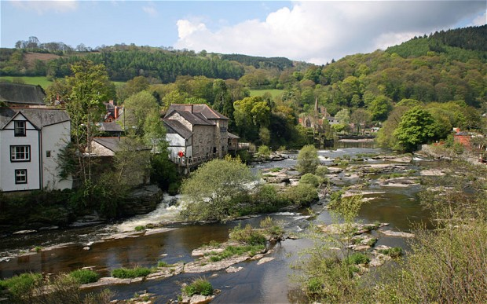
four factors of production:
Land
Labor
Capital
Entrepreneurs
- First textile industries were Cottage Industries
Cotton Gin – separated seeds/factories took advantage
First – powered by Watermills
THEN! – Steam engines!

Slide 25
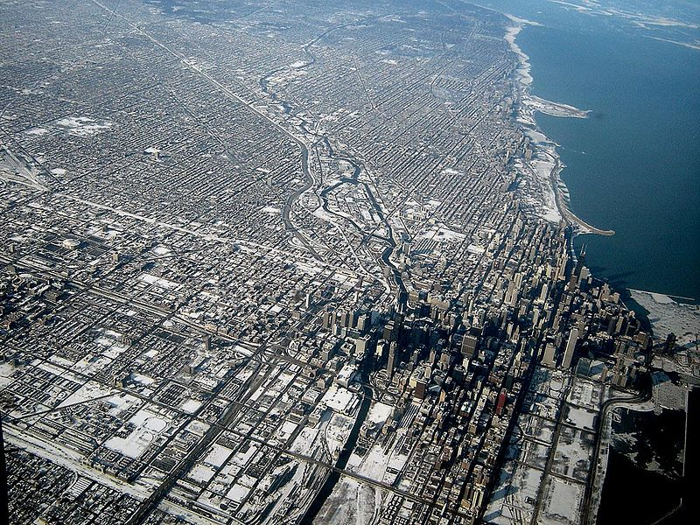
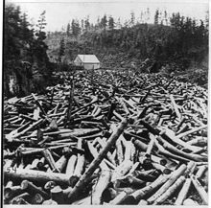
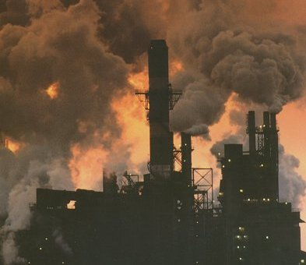
Urbanization- movement to cities (increase in pollution, disease, crime)
- Men, women, and children worked in factories
- Long hours and dangerous conditions
- labor unions formed to get better conditions and pay

Slide 26
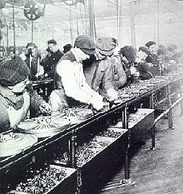
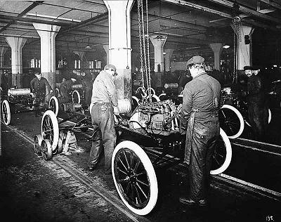
F. Mass Production- system of making many identical items using interchangeable parts; increased with the innovation of the assembly line
Telegraph- invented by Samuel Morse, allowed fast global communication
Telephone- invented by Alexander Graham Bell
Light bulb- “invented” by Edison

Slide 27
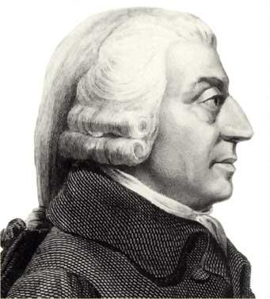
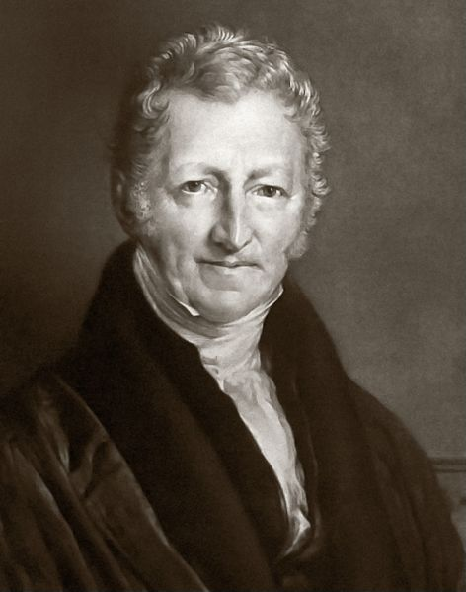
Economics
A. Capitalism- no gov’t intervention in the economy, people guided by self-interest
B. Socialism-
1. society/gov’t could help control economy in order to benefit all (esp. poor)
C. Communism (Karl Marx)
1. Proletariat would rise up in revolution against the (bourgeoisie)
2. The gov’t should control everything to create equality

Slide 28
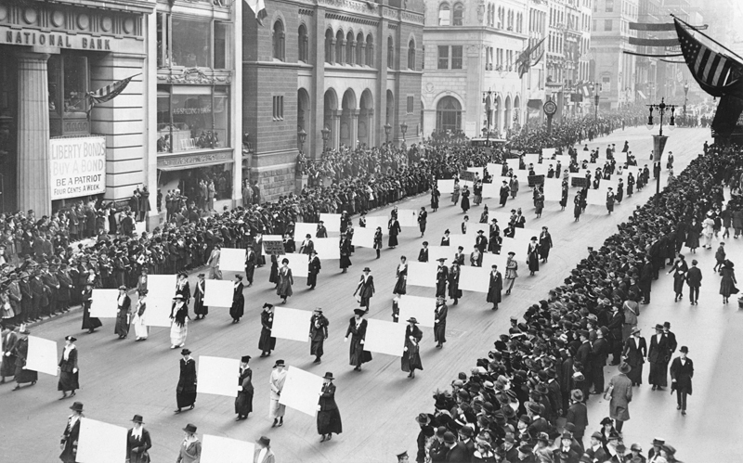
Changes in Society
Agricultural revolution: more food = more people (except Ireland)
Potato Famine led to 1 million deaths (more came to US)
- Voting Acts extended suffrage to most men
- Women did not gain suffrage until 1918
Factory acts made positive changes
(better rights, better pay, better conditions, better butter?)

Slide 29
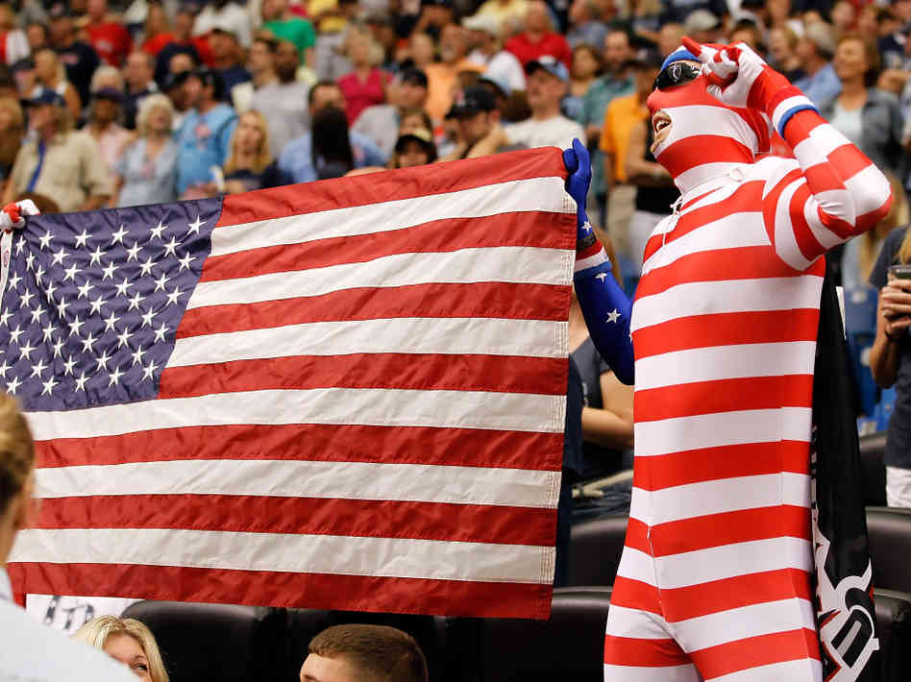
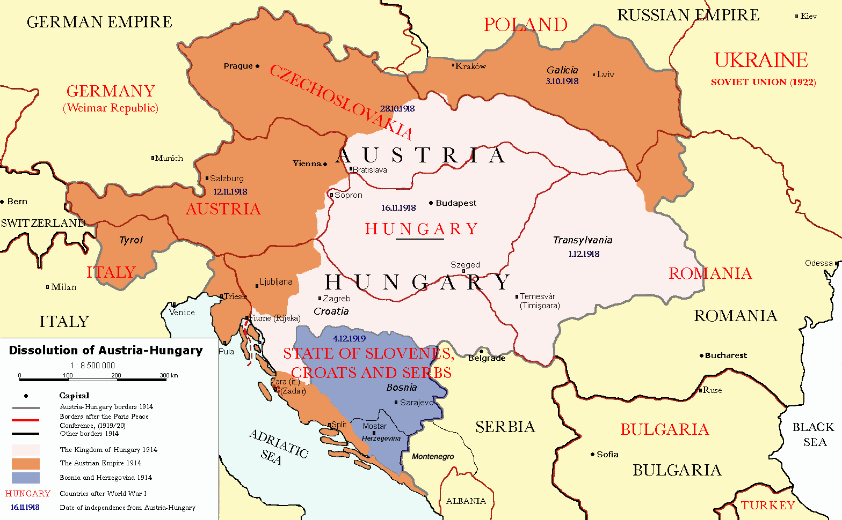
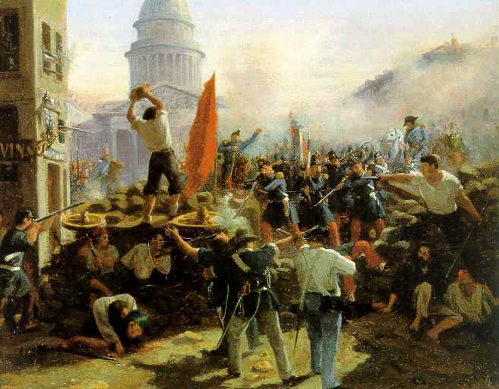
Nationalism
Nationalism – love of one’s people over others
Multi-National State: many ethnic groups in a defined region
Crimean War – Russia invaded the Ottoman empire (religious/territorial conflict)
Balkan Wars – Ethnic groups want independence

Slide 30
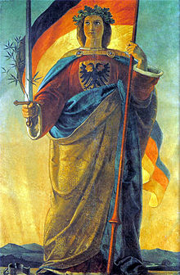
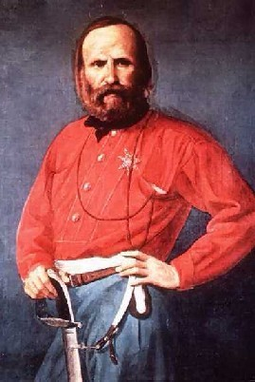
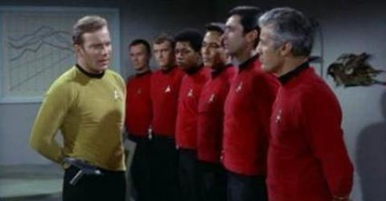
Creation of Italy and Germany
Italy:
Giuseppe Garibaldi took over southern Italy.
Victor Emmanuel of northern Italy- unified in 1870
Germany:
Otto von Bismarck united Germany through blood and iron
Wilhelm I – First German Emperor
(Germany’s all powerful and junk)

Slide 31
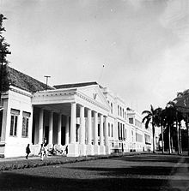
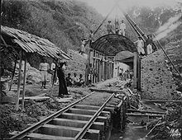
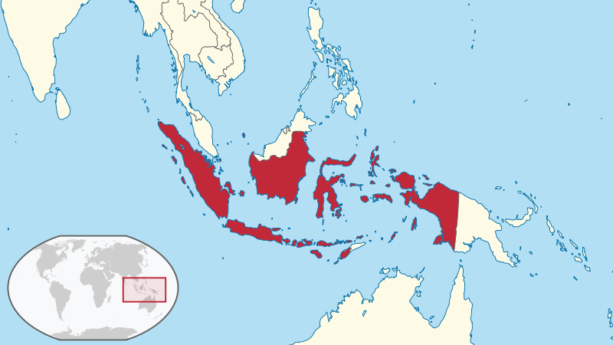
Imperialism in India
- British East India Company controlled trade
Sepoy Mutiny – Indian-born soldiers revolted (Crown took over)
India was the “jewel” of the empire
British – Controlled SE Asia trade
French – Controlled Vietnam until the war
Dutch – The nice guys

Slide 32
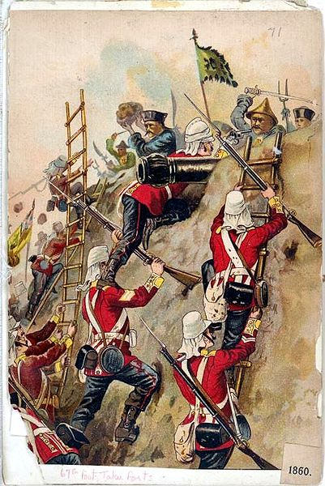
Imperialism in China
Opium War: British forced opium trade, gvt. said no, British Navy said YAAASSS
Spheres of Influence (areas of economic dominance)
Taping Rebellion (Civil war, emperor won, 20 mil dead)
Boxer Rebellion (Chinese fight Europeans…lose.)
Imperialism in Japan
US forced Japan to trade!! USA! USA!
Meiji Restoration – Japan matches European industrialization
Japan defeats Russia – big deal!

Slide 33
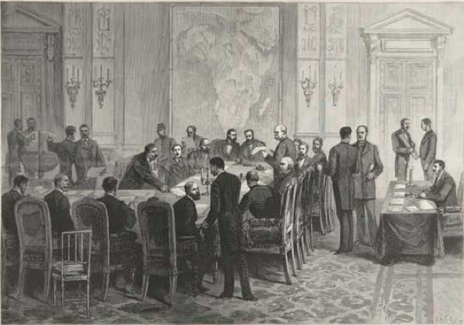
African Imperialism
Scramble for Africa (mad rush to colonize African territories in late 1800’s)
Justified through Social Darwinism : certain races are inferior to others
Jump started by the Berlin Conference

Slide 34
Effects of African Imperialism
King Leopold II- killed 10 million in the Congo
British take control of the Suez Canal
Tribes were split up/forced against each other
Boers were destroyed by the British

Slide 35
Colonize and Chill?

Slide 36
WWI
MAIN! = Militarism, Alliances, Imperialism, Nationalism
What was the “spark” to start the war? Assassination of Archduke Franz Ferdinand.
1. Triple Alliance (Central Powers)
a. Germany, Austria- Hungary
Ottoman Empire
2. Triple Entente (Allied Powers)
a. Great Britain, France, Russia, Italy (switched sides!), United States

Slide 37
- Von Schlieffen Plan – German plan to take Paris and then take Russia
- Germany pushed into France but failed to take Paris, dug trenches instead of retreating
- Austria-Hungary threatens Serbia
- Germany supports A-H
- France, Germany, and GB get involved (alliances)

Slide 38
Trench Warfare: leads to stalemate.
Weapons used to break stalemate = machine guns, barbed wire, artillery, Poison gas, Airplanes, Tanks
- Turned into a war of attrition- goal is not to defeat the enemy but just to wear them down
- Total war- all of a nation’s resources and civilians are used for war

Slide 39
The Russian Revolution
Russia still had a feudal system, led to political corruption and angry citizens
Government stopped following Tsar Nicholas (Russia was losing in WWI)
Bolsheviks took over (Communists led by Lenin
Russian Civil War
- Reds (communists) vs Whites (not communists)
- 15 million died, Reds won!

Slide 40
During the WWI…
Armenian Genocide- Armenian minority was removed from Ottoman Empire- 600,000 died
Treaty of Brest-Litovsk – Russia leaves the war (they have their own problems)
America joins the war! Why? – Sinking of the Lusitania and the Zimmerman Note

Slide 41
- Armistice (truce) was signed Nov. 11, 1918
- Treaty of Versailles – Blamed Germany for the entire war, Central powers disbanded
- League of Nations - Peace organization (No enforcement; US not member)
- Spanish Influenza- disease spread from returning soldiers, 50-100 million died

Slide 42
The Interwar PEriod
- American is #1 after WWI
- Great Depression - economy began to fail (stock market crash/bank runs)
- FDR elected – started to fix things through public projects!

Slide 43
- Gandhi led a nonviolent movement in India
- Chinese Civil War – ended Qing Dynasty, led to rise of Mao
- Japan wanted to expand (prove their strength)
- They invaded China in 1937 (killed over 100,000 in Nanking)

Slide 44
Poor economy led to a rise of dictators!
1. Mussolini ruled Italy through Fascism and totalitarianism
2. Stalin industrialized Russia and killed millions through the Great Purge
3. Hitler gained power – Make Germany great again!

