Slide 1
TaLking Heads
Create a scene with the thinkers where they are debating/talking about their philosophies on humanity and government.
(For instance, have them in a (hair) salon, Starbucks, at school, etc…)
You can create thought bubbles or quotes for each first then draw the bodies and clothes and finish by filling in the background and salon.
Grading:
1. The finished product should have little white or open space.
2. Each Philosopher should have at least one line of speech
3. Each Philosopher should be speaking in line with their beliefs

Slide 2
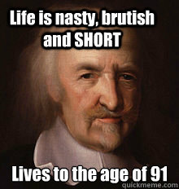
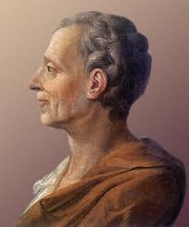
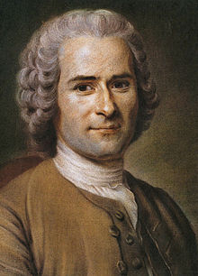
Hobbes Montesquieu Rousseau Locke
TaLking Heads

