Slide 1
Chapter 31

Slide 2
Warm-Up
http://www.youtube.com/watch?v=pCkL9UlmCOE

Slide 3
Group Activity
The class will be split into 8 groups by having students number off 1-4 (genius, I know)
1 – The Ottoman Empire
2 – Russia
3 – China
4 - Japan

Slide 4
GROUP ACTIVITY
Though you should have read the entire chapter, each group will function as the authority on its empire and lead a review on each empire.
Each group should produce the following items:
A chart or list of the problems, the proposed reforms, and the social classes involved
A list of significant terms to identify
Summary paragraph on the effects of western revolutions on the empire
(Create a rough draft, then come to me for chart paper)

Slide 5
Military confrontations. All four societies fought wars or engaged in military confrontations with industrialized nations. In each case, those confrontations brought the realization of military weakness in the face of these rising powers.
Internal weaknesses. All four societies’ internal weaknesses included declining agricultural productivity, famine, falling government revenue, and corrupt governments. With such internal turmoil, success against industrialized nations was practically impossible.
Reform movements. All four societies experienced reform movements, but in the Ottoman empire, Russian empire, and Qing China, the ruling classes viewed reform with suspicion; they were determined to keep their privileges. The result was that all three were on the verge of collapse by the turn of the century. The fall of the Tokugawa dynasty in Japan paved the way for reform efforts, which would result in Japan’s emergence as an industrial power.

Slide 6
Ottoman Empire
Territorial Losses
Economic Difficulties
The Capitulations
Reform and Reorganizations
Mahmud II
Legal and Educational Reform
The Tanzimat (reorganization)
Opposition and the Young Turks

Slide 7
Russia
Military defeat and social reform
The Crimean War
Emancipation of the Serfs
Political and Legal Reform
Industrialization
Repression and Revolt
Terrorism
Revolution of 1905

Slide 8
The Emancipation of the Russian Serfs
Why was Russia struggling with such an antiquated system when it had been phased out of most of the rest of Europe centuries earlier?
In what ways was the continuing existence of serfdom emblematic of other areas in which the Russians trailed the western Europeans?
Alexander II: “It is better to abolish serfdom from above than to wait until the serfs begin to liberate themselves from below”?
Why did it take the serfs so long to push for better conditions?
Why did both sides consider the emancipation incomplete, and what implications did this have for Russia’s future?
Compare the concurrent efforts to eliminate serfdom in Russia and abolish slavery in the United States and Brazil. Were there any similarities? What did the abolition of these systems eventually mean for the advancement of the three countries?

Slide 9
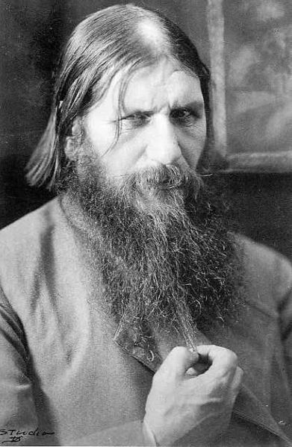
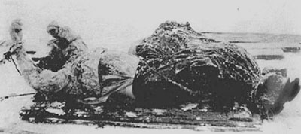
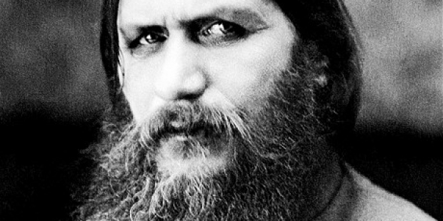
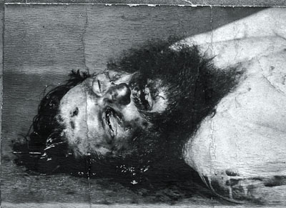
Rasputin

Slide 10
China
The Opium Trade and Opium War
Unequal Treaties
The Taping Rebellion
The Self-Strengthening Movement
“Spheres of Influence”
The Boxer Rebellion

Slide 11
The Taiping Rebellion
Certainly Hong Xiuquan’s Taiping rebellion is one of the most destructive, but also interesting, events in history. What were Hong Xiuquan’s inspirations and goals?
How was it possible for him to attract such a large following? It’s easy to assume that the Europeans or Americans were at the root of many problems in colonial or quasi-colonial areas in the nineteenth and twentieth century.
Instead, the Taiping rebellion fed off internal problems and discontent. Do the other countries have similar contemporary problems? Why was the situation in Japan so different?

Slide 12
Japan
Crisis and Reform
Foreign Pressure
End of Tokugawa Rule
The Meiji Restoration
Abolition of Social Order
Constitutional Government
Remodeling the Economy
Costs of Economic Development

Slide 13
The Meiji Restoration
Why was Japan able to turn the tide and begin to modernize successfully when the other states couldn’t?
Why did the Japanese cry of “Revere the emperor, expel the barbarians” draw so many more followers and inspire so much more success than did the Chinese Self-Strengthening Movement’s slogan of “Chinese learning at the base, Western learning for use”?
Think back on earlier sections on Japan and consider in what ways Japan was fundamentally different from the other states.
Was this westernization carried out because of a love of the western Europeans and Americans, or for other reasons?

