Slide 1
Monotheistic Religions

Slide 2
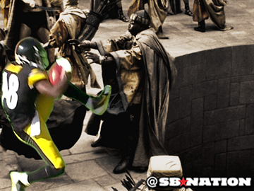
Warm - Up
How’d the test go on Friday?
Are there things that you could/should have studied more ahead of time?
What would help you prepare for tests better in the future?

Slide 3
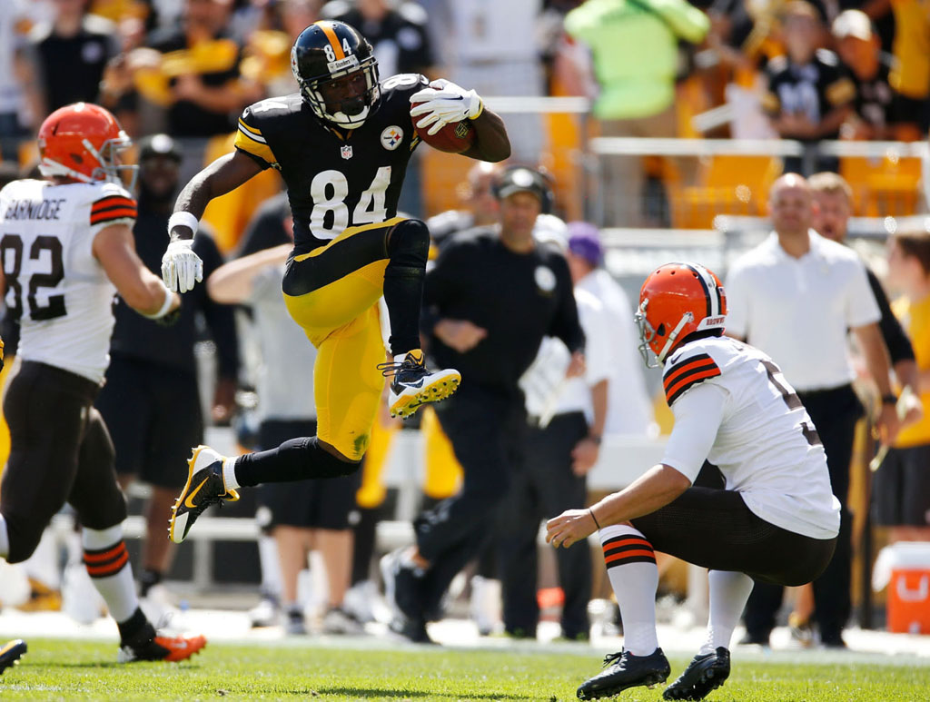

Slide 4
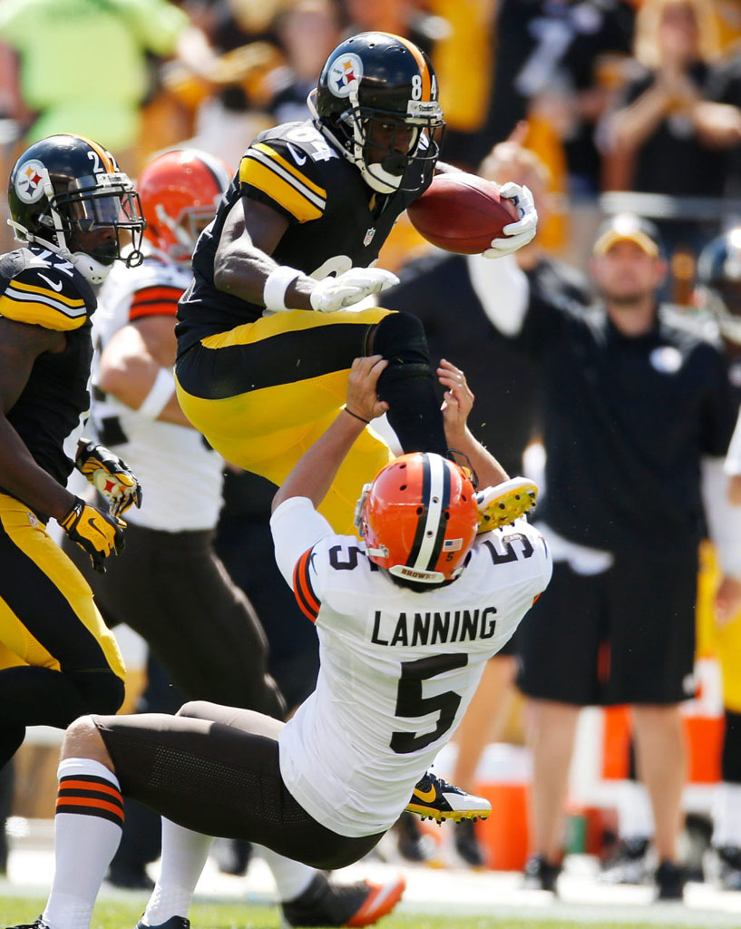

Slide 5
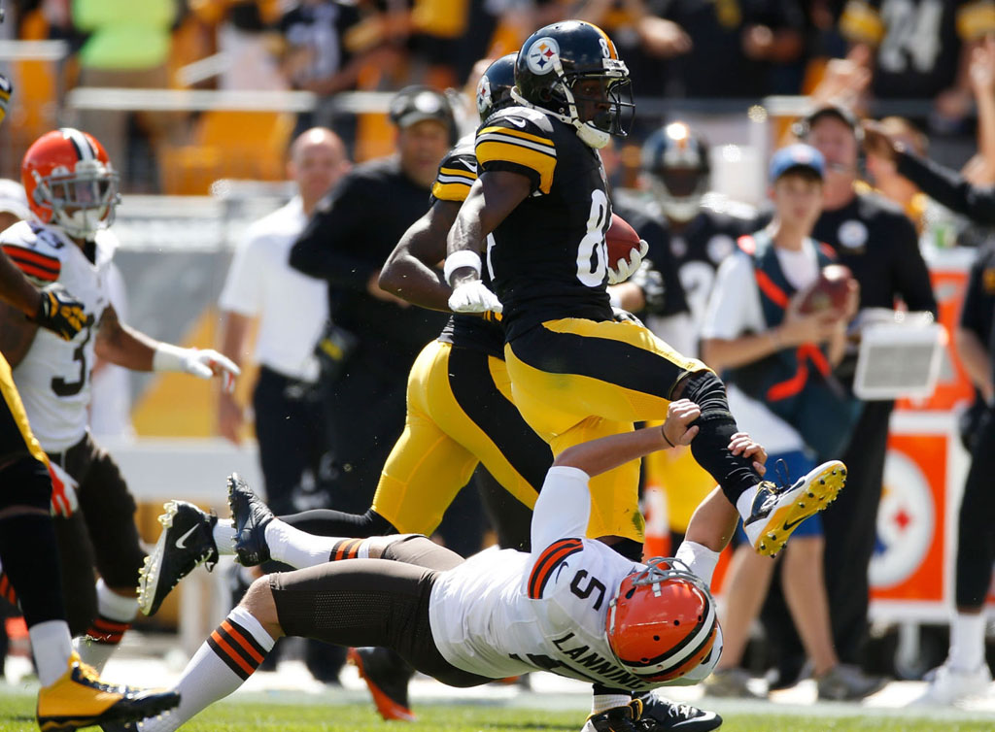

Slide 6
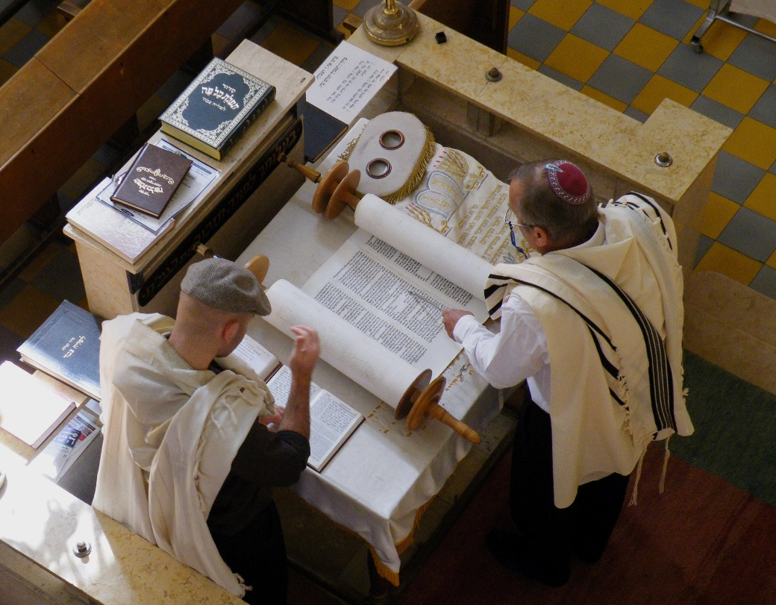
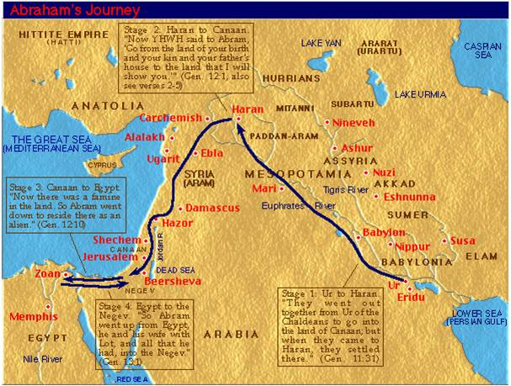
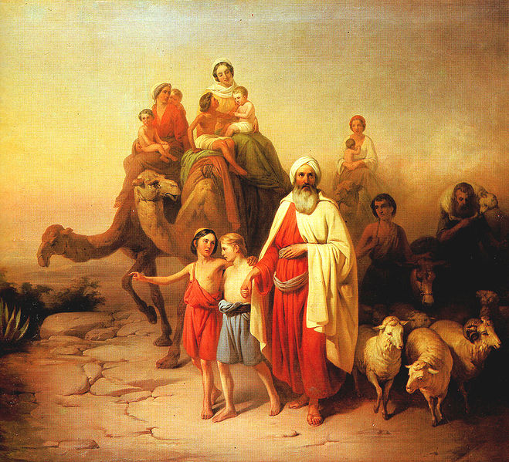
I. Judaism
Monotheistic (one God) that began in Mesopotamia
B. Holy book is the Torah which includes the 10 Commandments

Slide 7
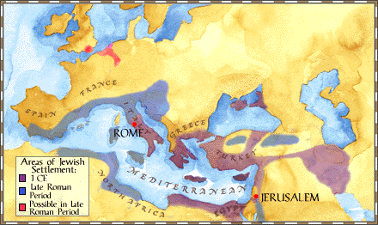
C. Jewish Diaspora- spread of Jewish people through the world
I. Divisions – Orthodox, Conservative, and Reform

Slide 8
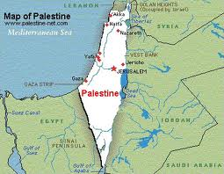
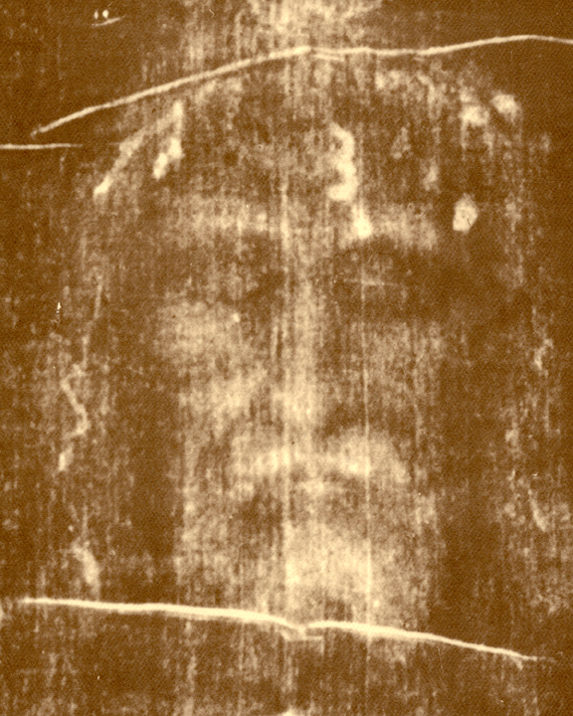
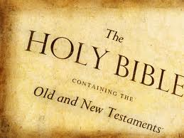
II. Christianity
A. Began in Palestine under Roman rule (1st Century AD) by Jesus
B. After Jesus’ death, religion spread in Roman Empire
C. Text: Bible, Old (from Judaism) and New Testaments- Gospels (stories of Jesus) and letters

Slide 9
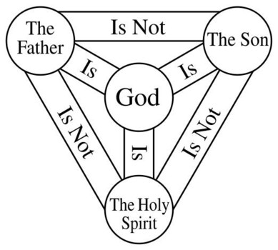
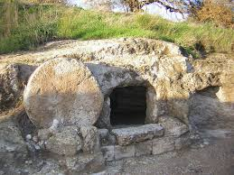
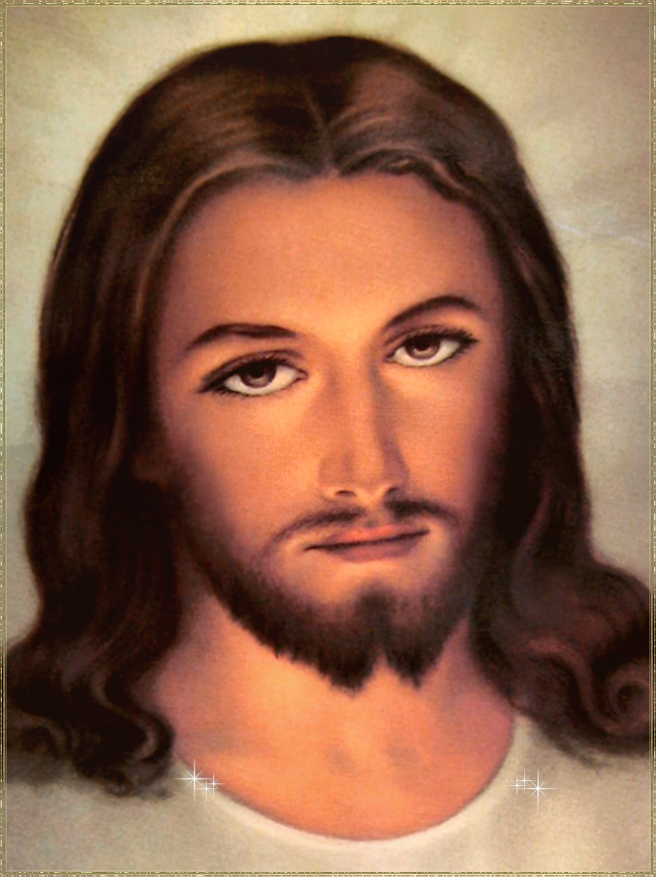
D. Beliefs:
1. Jesus is the Messiah (prophesied spiritual leader) and the son of God
2. Jesus died and was resurrected, has the power to forgive sins

Slide 10
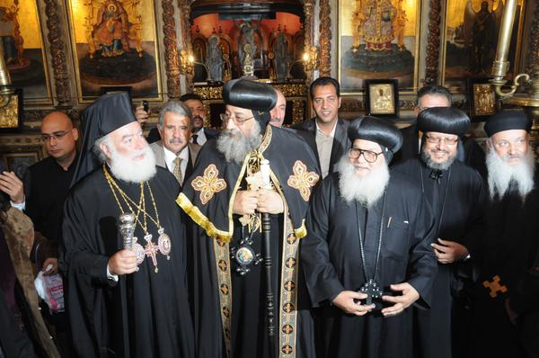
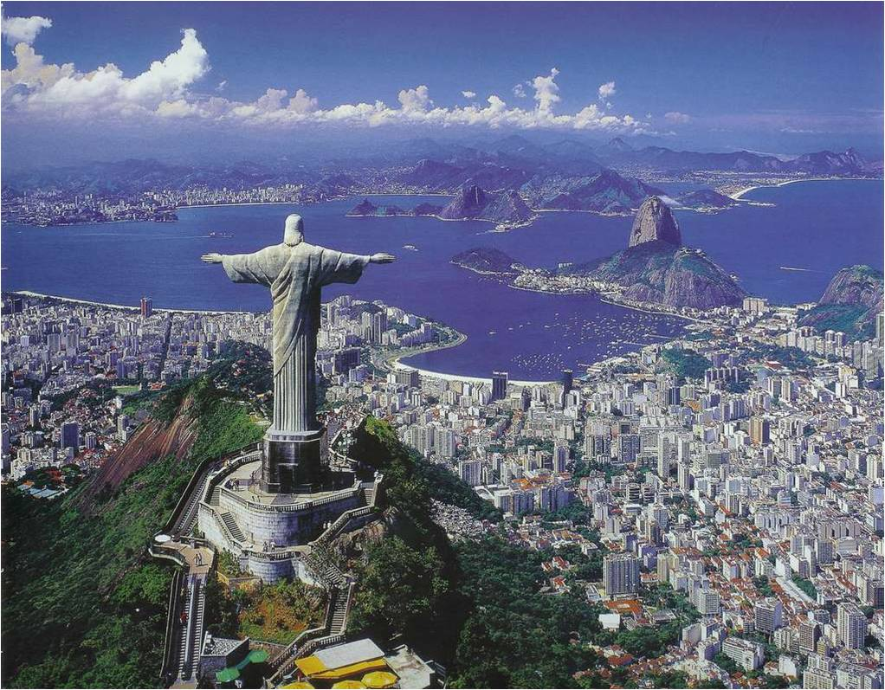
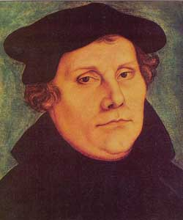
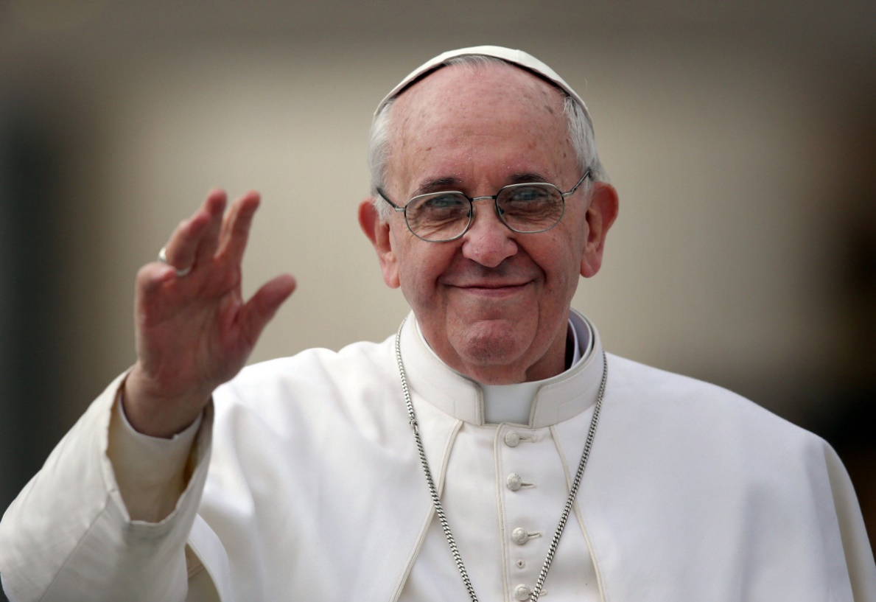
E. 3 major branches of Christianity: Catholic, Orthodox (split in the Great Schism), and Protestant (split in the reformation)

Slide 11
Religion Chart
Continue filling out your Religion Chart, this time focusing on Christianity and Judaism.
If you need information that is not in your notes, use your textbook on pages…

Slide 12
https://www.youtube.com/watch?v=TG55ErfdaeY

Slide 13
Primary Source Reading
In groups of 3, similar to what we did last week, we will be reading primary documents from early religions.
Each person in your group will be responsible for reading a document, summarizing it, and explaining it to the group.
Your individual summary should be written on a separate piece of notebook paper and then stapled together with the other summaries in your group.

Slide 14
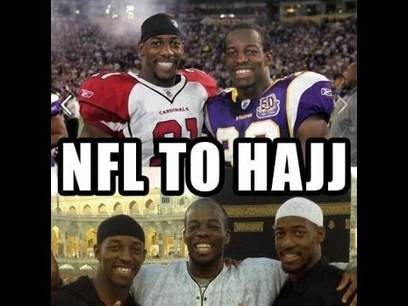
Warm-Up
https://www.youtube.com/watch?v=G-ZzQ7uwy34
As you come into class, pick up an article from the front of the room.
2. Read it over, answer the questions, and be prepared to discuss when you are finished!

Slide 15
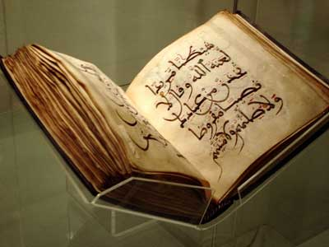
III. Islam
A. Began in the Arabian peninsula by Muhammad who had revelation
B. Holy book- Qur’an
C. Holy cities- Mecca, Medina, Jerusalem

Slide 16
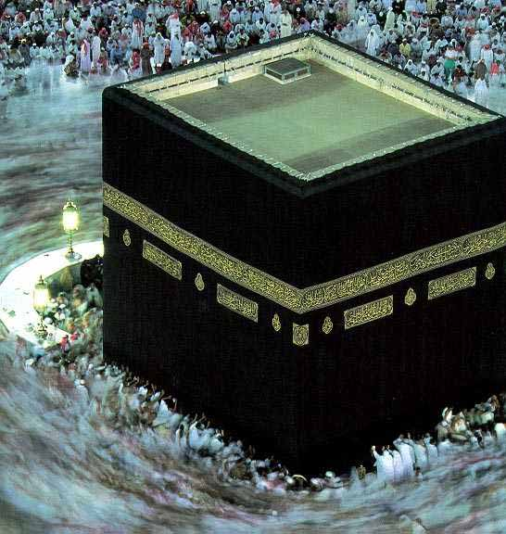

Slide 17
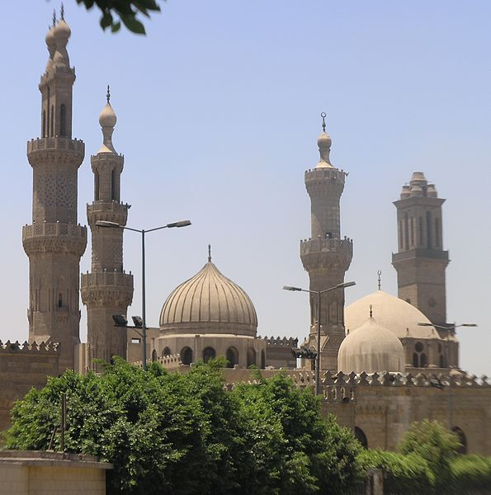
D. Split over who would be the caliph (leader) of Islam
Sunnis- wanted Caliph to be a political leader who was chosen by his ability (majority of Muslims)
2. Shi’as- wanted Caliph to be a political and religious leader and be descended from Muhammad

Slide 18
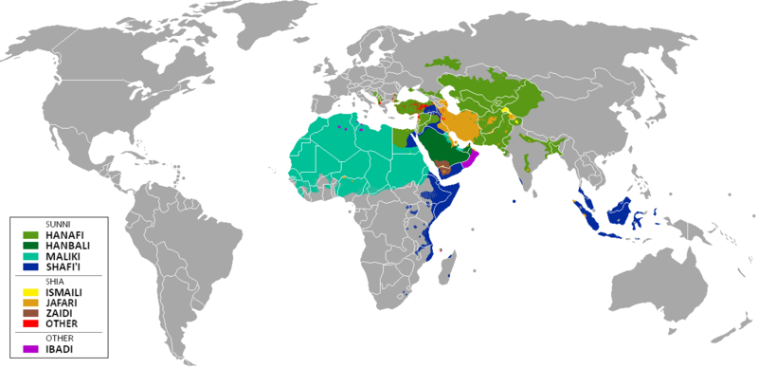

Slide 19
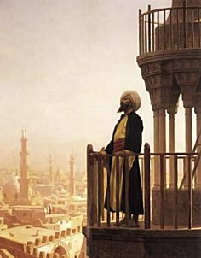
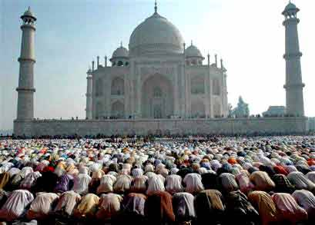
E. Five Pillars (Core beliefs) of Islam
Declaration of Faith (One God, Muhammad is prophet)
Prayer five times a day (facing Mecca)
Give alms to the poor (charity)
Fasting during the month of Ramadan
Make the pilgrimage to Mecca (hajj)

Slide 20
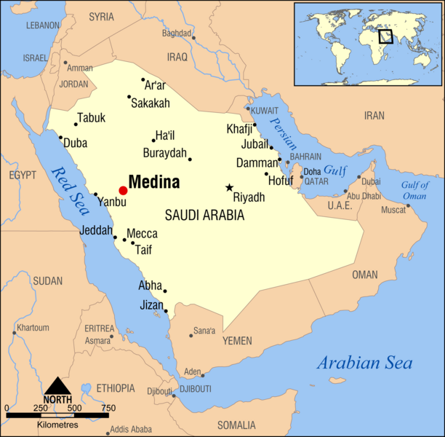

Slide 22
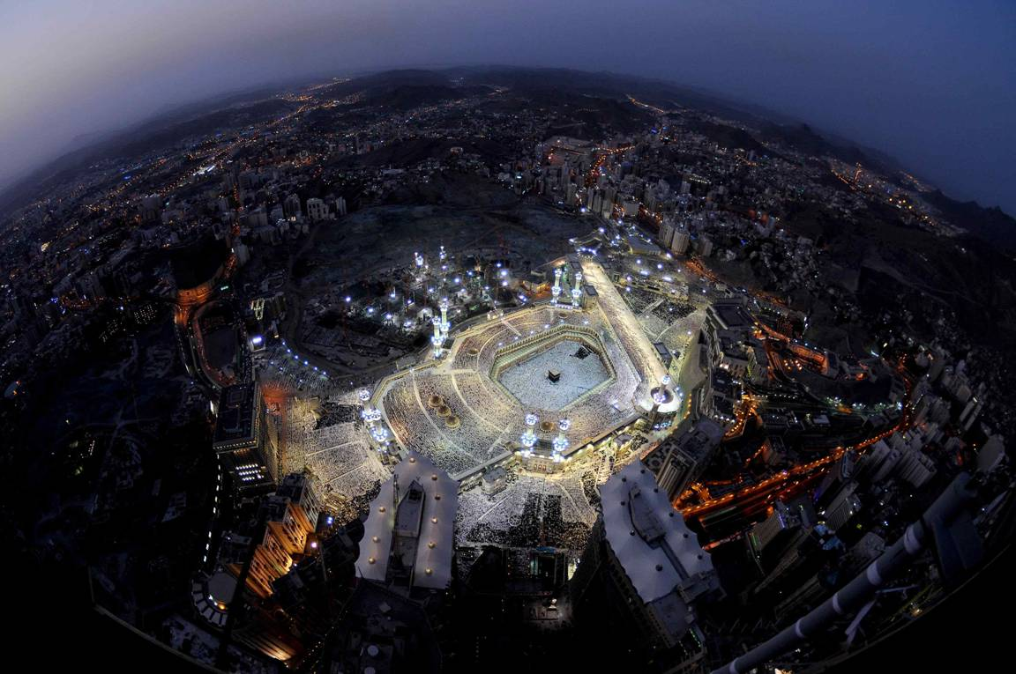

Slide 23
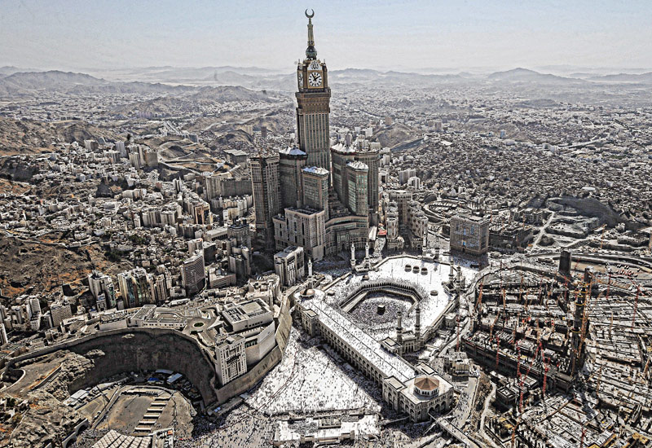

Slide 24
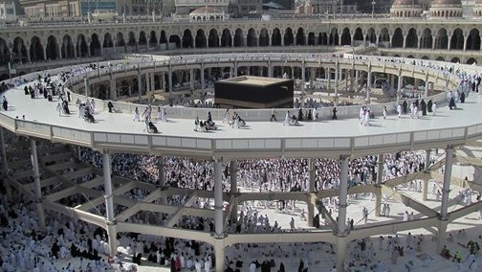

Slide 25
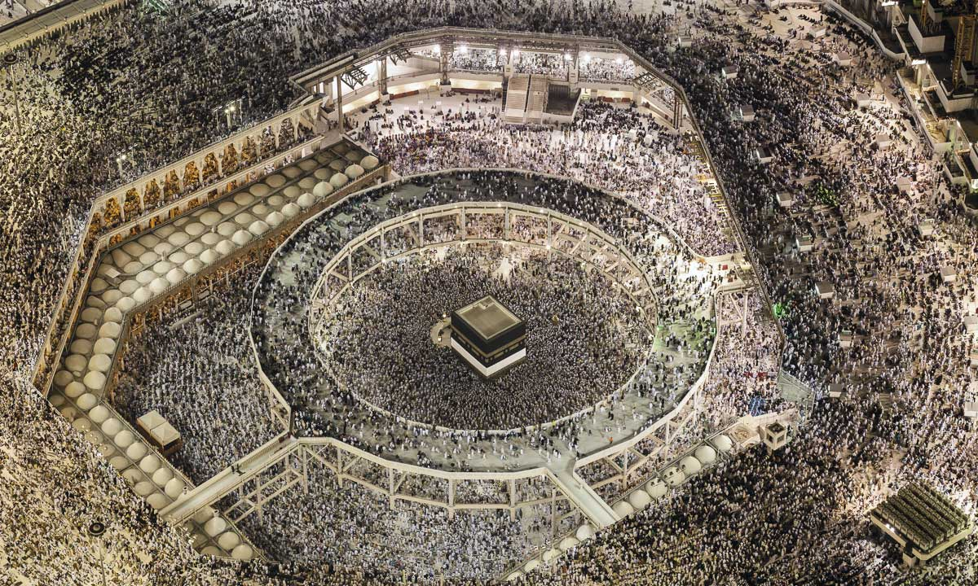

Slide 27
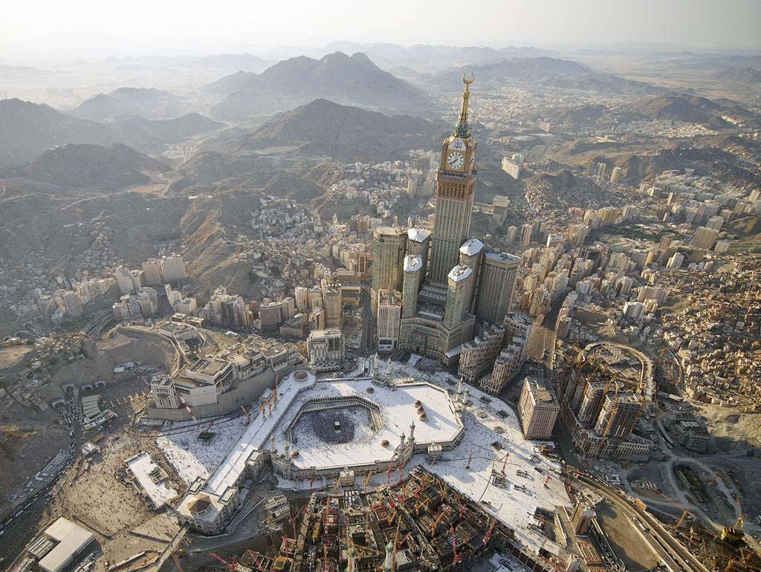

Slide 29
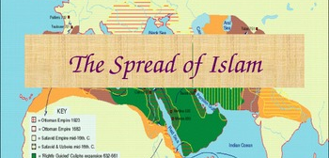
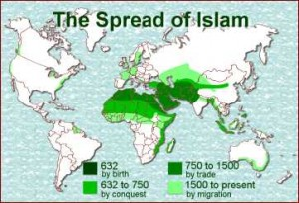
F. Spread of Islam
Expanded through military and by trade
2. Soon controlled Arabia, Persia, North Africa,
and Spain

Slide 30
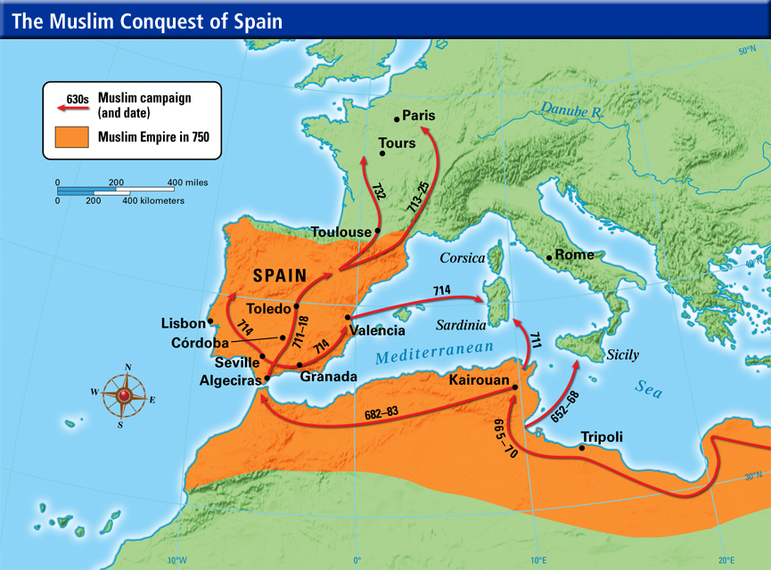
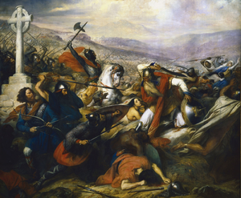
Moors, North African Muslims, invaded Spain but expansion in Europe stopped in Battle of Tours

Slide 31
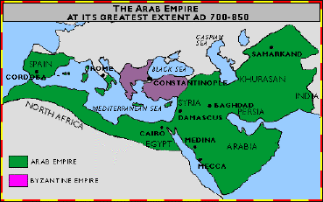
Abbasid Dynasty (750-1030)
a. Muslim kingdom, capitol was Baghdad
b. translated and studied Greek scientists and philosophers, preserved for Europeans
c. Achievements- number system, algebra, trigonometry, astronomy, medicine

Slide 32
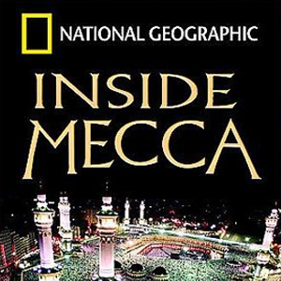
https://www.youtube.com/watch?v=KFQHgdmJqjo

Slide 33
Inside Mecca: Questions
Why do Muslims participate in the Hajj? What exactly is the Hajj?
2. Explain the basic traditions surrounding the Hajj.
How does the man from South Africa exhibit the true nature of the Hajj?
Why would the woman from Texas have a hard time traveling to Mecca? Why would she have a hard time getting into the city?
5. Explain some of the problems facing the Hajj in the modern world.

