Slide 1
Warm Up
Imagine that you are reading a chapter in a textbook that talks about the post Cold War Era (1989 to now).
Come up with three section headings that would describe this era and explain why that is important

Slide 2
Activity: News media, looking at how important that part is to US politics and democracy. (Can also talk about propaganda)
Group work: Democracy appreciation? Groups decide where they would like to eat. Agreement, consensus, deliberation, negotiation: show how they are all part of democracy.
https://www.youtube.com/watch?v=dDTBnsqxZ3k
https://www.youtube.com/watch?v=PDT-LN5-Edw

Slide 3
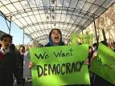
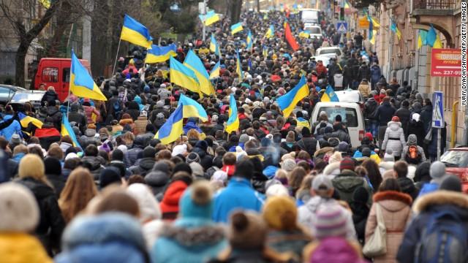
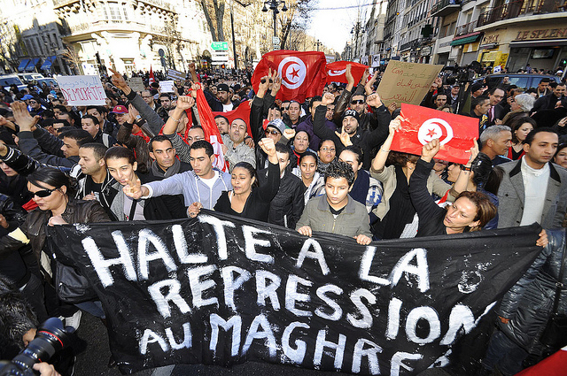
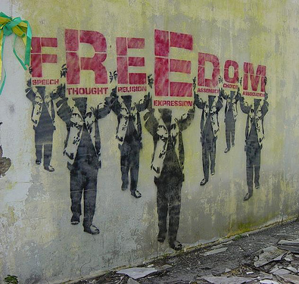
Democratization

Slide 6
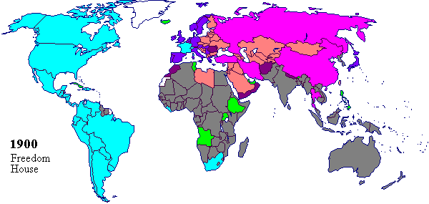
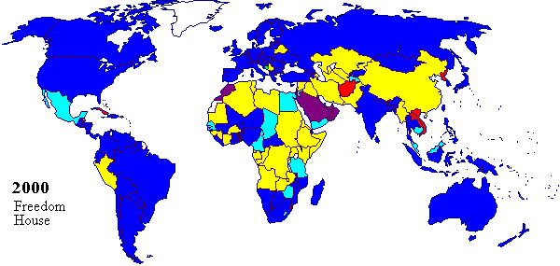
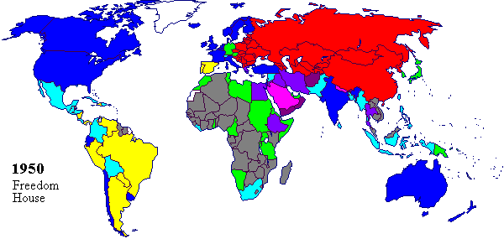
I. Changes to Democracy
After WWII, many countries embraced democracy

Slide 7
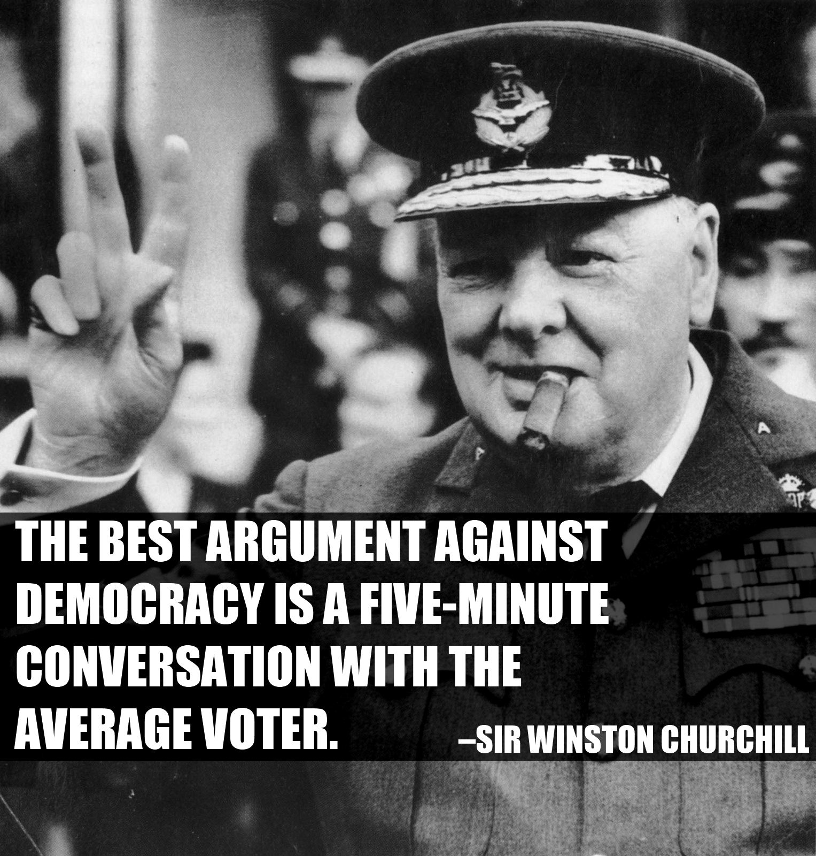
https://www.youtube.com/watch?v=fJ3t8qBrQTo
https://www.youtube.com/watch?v=rxXhB1J1-UU

Slide 8
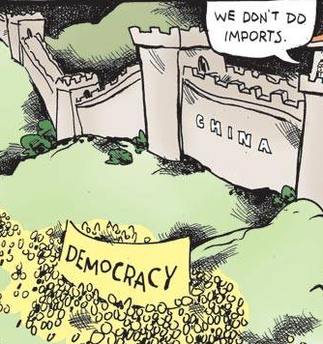
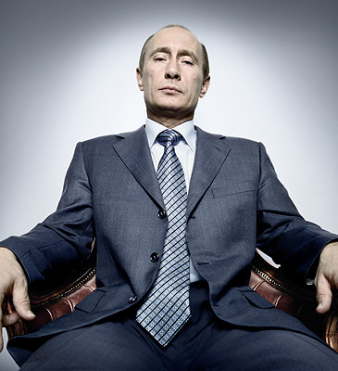
After the Cold War, most countries have some elections but not all have protected individual freedoms

Slide 9
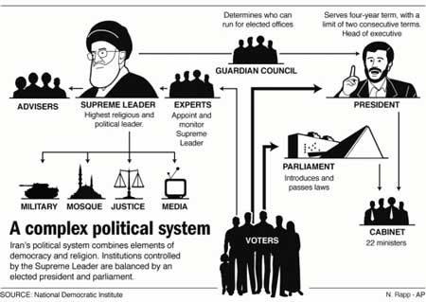

Slide 10
Many countries are struggling to become democracies by overcoming corruption and authoritarian leaders, and spreading new ideas

Slide 11
With the people around you, make a list of what it takes to make a fully functioning democracy.
Pick 3 things besides voting

Slide 12
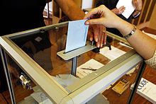
Elements of Democracy- Fair elections, political parties, accountable leaders, rights, and independent court system

Slide 13
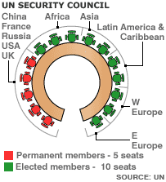
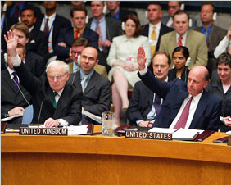
II. International Law
The United Nations has worked to spread democracy and rights
UN Security Council- has veto power, enforces UN resolutions

Slide 14
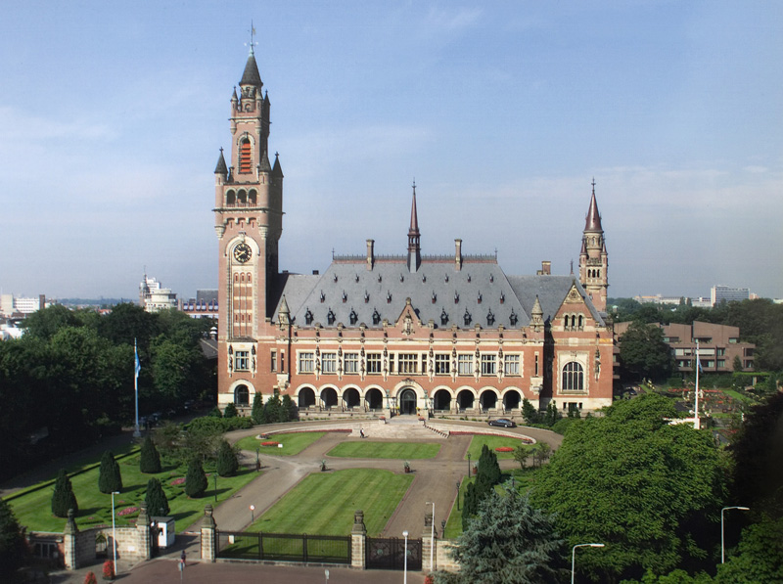

Slide 15
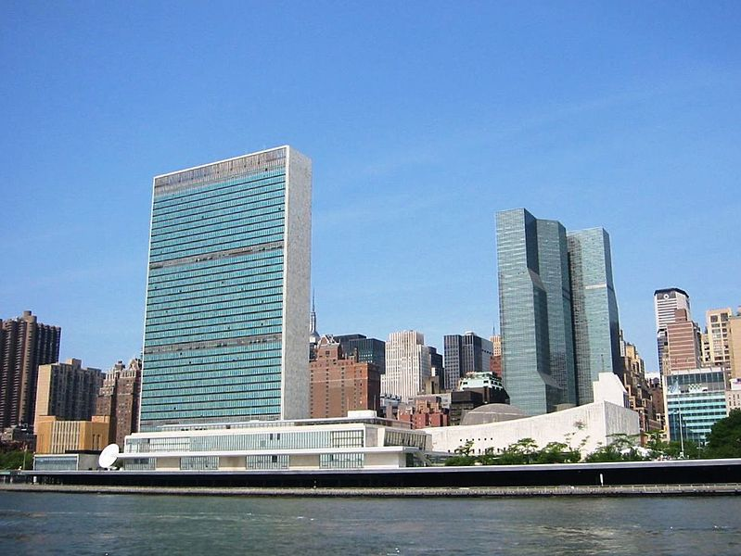

Slide 16
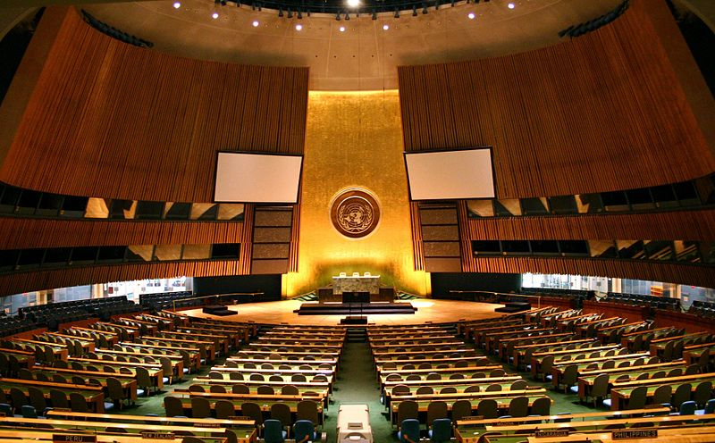

Slide 17
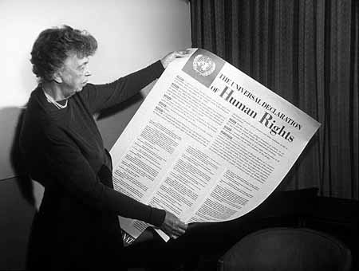
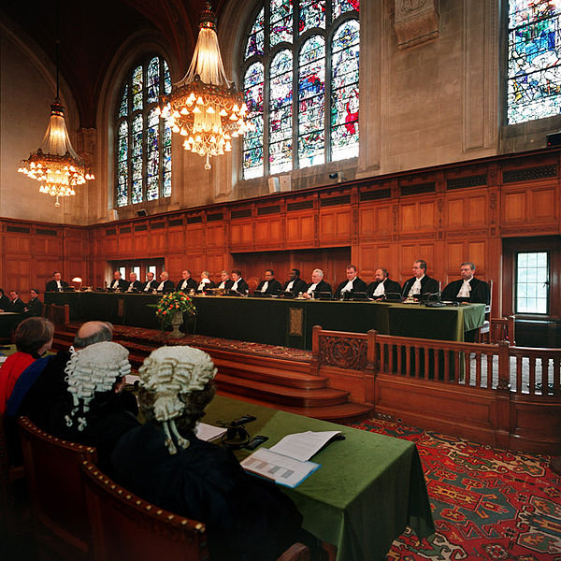
Universal Declaration of Human Rights- adopted by most countries, created international law protecting human rights
International courts have worked to try war criminals but have limited power

Slide 18
Closure
What are the elements of a fully developed democracy?
What are some positive changes due to the growth in international law?
Why would America choose not to obey the international court of justice?

Slide 19
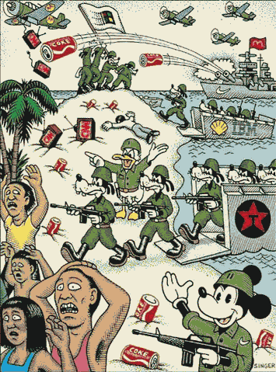
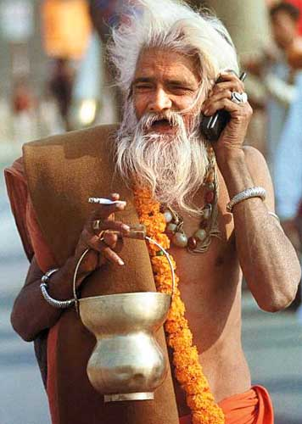
Globalization

Slide 20
Warm-Up Activity
Get out the worksheet that you picked up yesterday (graphic organizers)
Flip to the side that says “Law Codes”
Use your notes, the textbook, and the Law Codes hanging all over the room to fill in this review chart!

Slide 21
Planet Money Makes a T-Shirt
https://www.youtube.com/watch?v=r2Zod7Sd3rQ

Slide 22
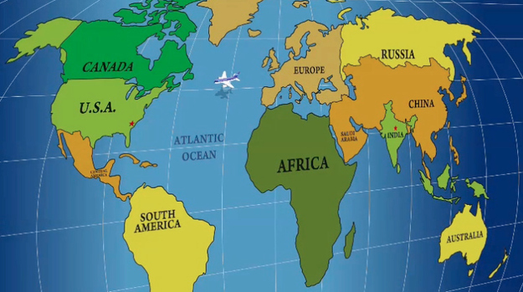
Warm-Up: What can we learn by watching the following clip?
http://www.buzzfeed.com/whitneyjefferson/south-park-takes-on-cash4gold-and-the-home-shoppin#.keJzkNNnm

Slide 23
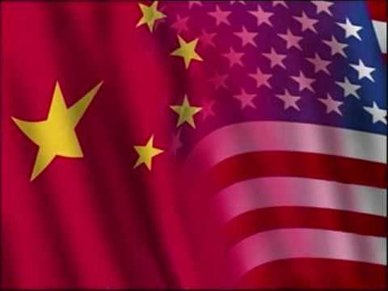
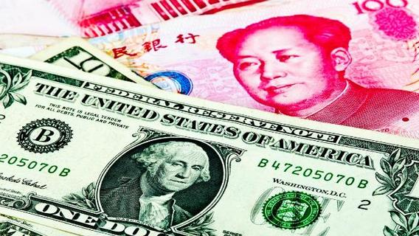
I. Economic Interdependence
A. Globalization – the integration of the world, culture, and ideas as countries rely on others for goods, resources, and services

Slide 24
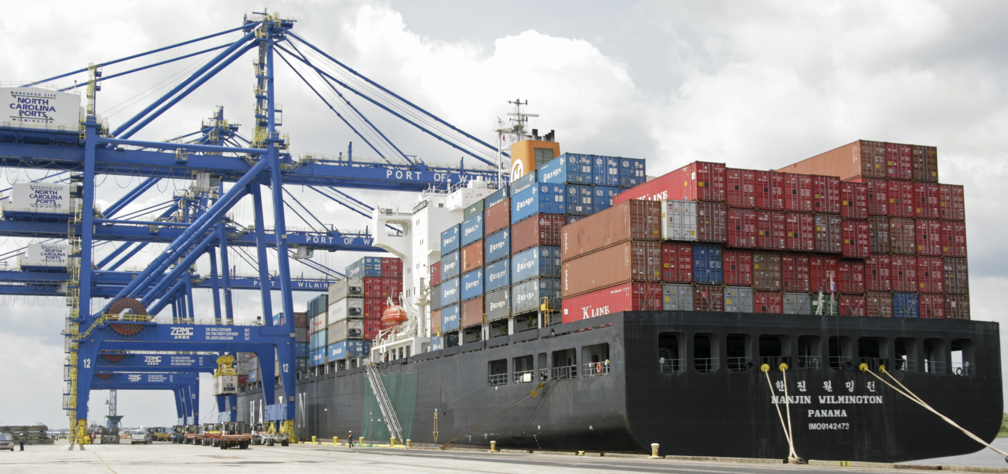
B. Hindrances to free trade: tariffs (taxes on imports), subsidies (assistance to domestic industries), government ownership of businesses

Slide 25
Globalization in a Bottle

Slide 26
When you hold a Coca-Cola bottle, is it art or is it commerce?

Slide 27
Thoughts or questions before we begin?

Slide 28
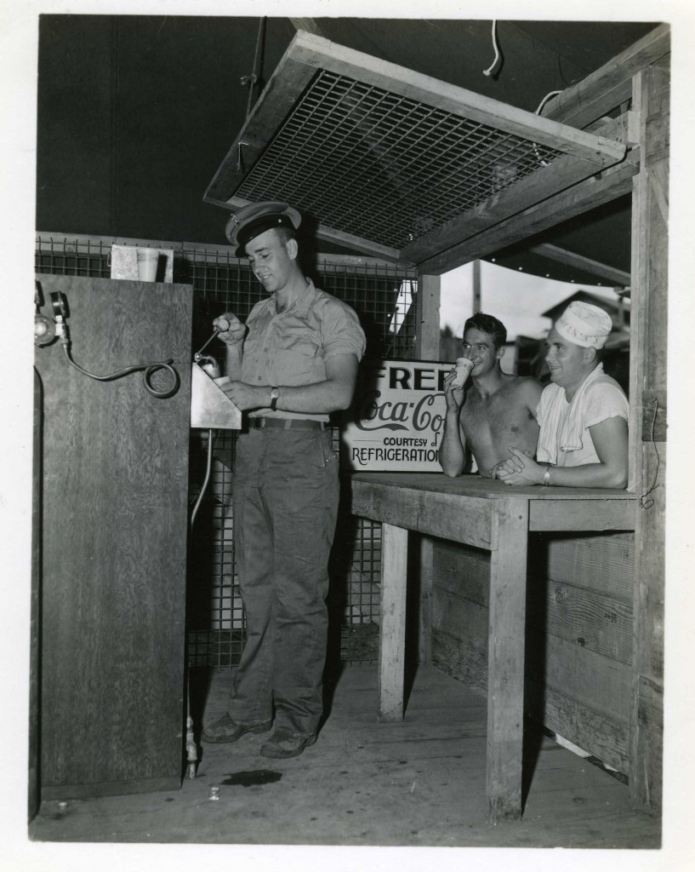
How did WWII enable Coca-Cola to globalize?

Slide 29
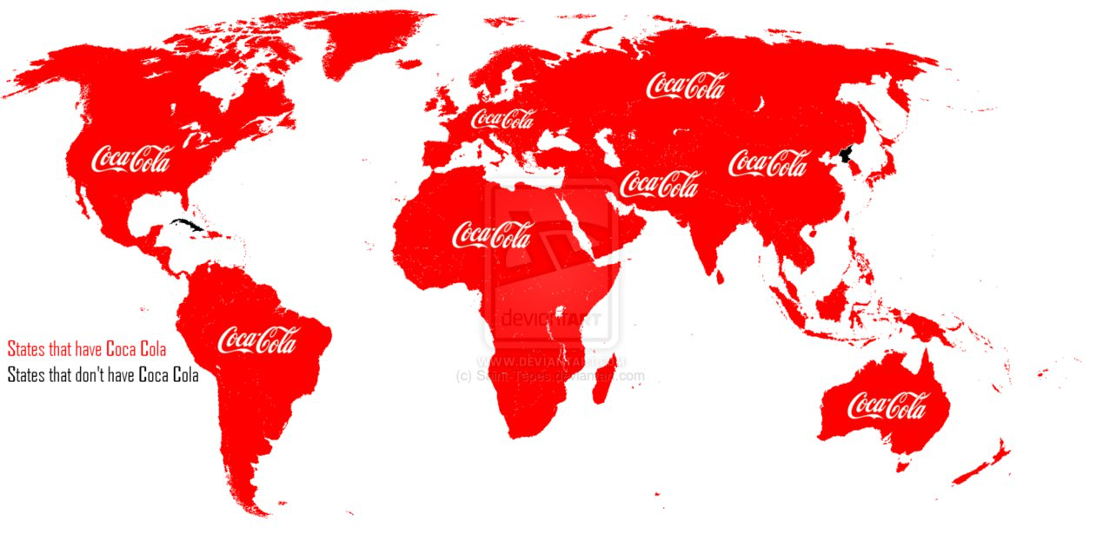
EQ: In what ways does a bottle Coca-Cola represent globalization? Keep in mind the definitions of globalization.
Connectedness
Influence
Politically
Economically
Culturally

Slide 30
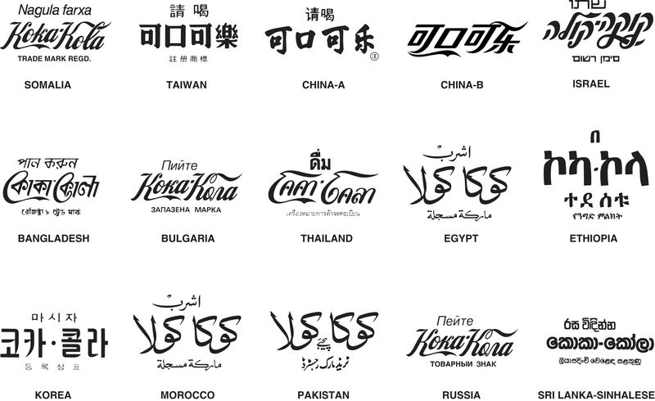

Slide 31
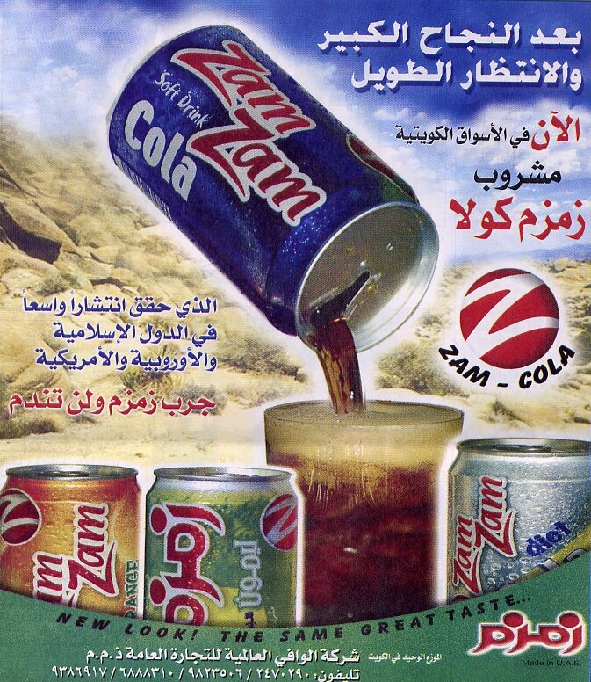
How was Coca-Cola a political/economic/cultural force in… Europe/The Soviet Bloc? The Middle East?

Slide 32
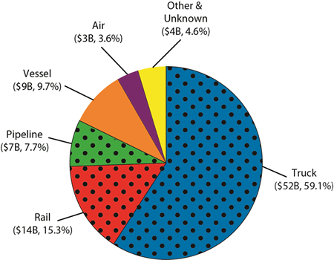
C. Free Trade Organizations
1. NAFTA - North American Free Trade Agreement between Canada, Mexico, and the United States

Slide 33
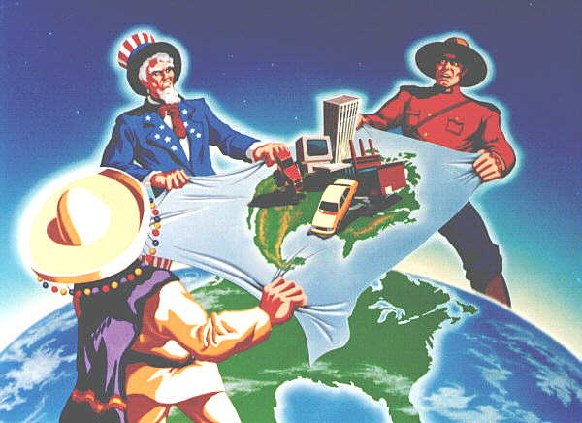

Slide 34
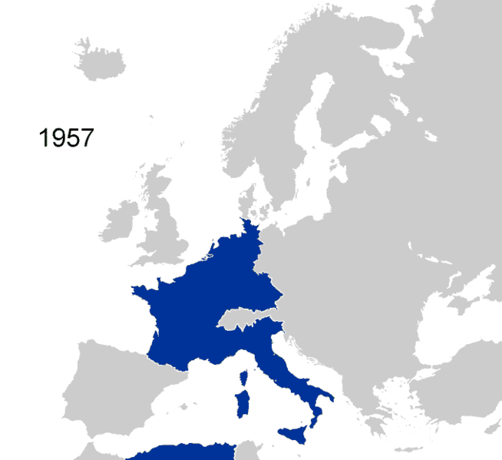
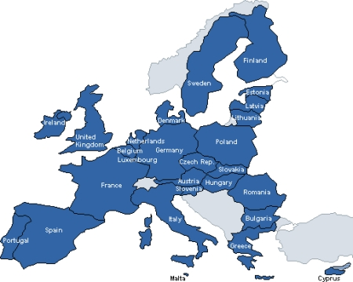
2. European Union
1. Goal to end wars through a “Common Market”
2. Most countries now have a common currency (Euro)

Slide 35
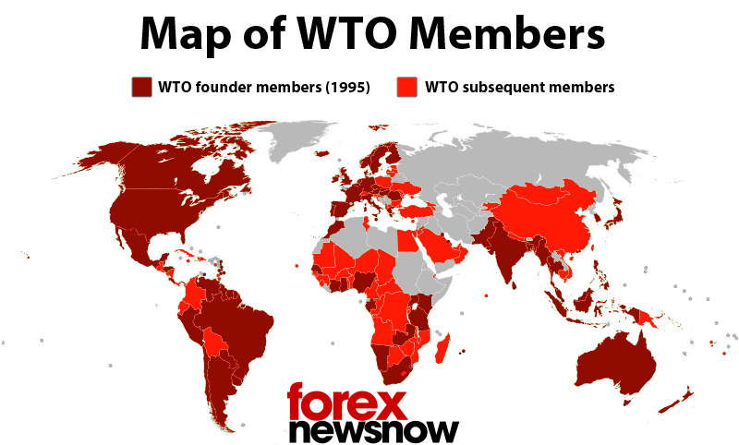
3. World Trade organization - Works to regulate global trade and break down trade barriers

Slide 36
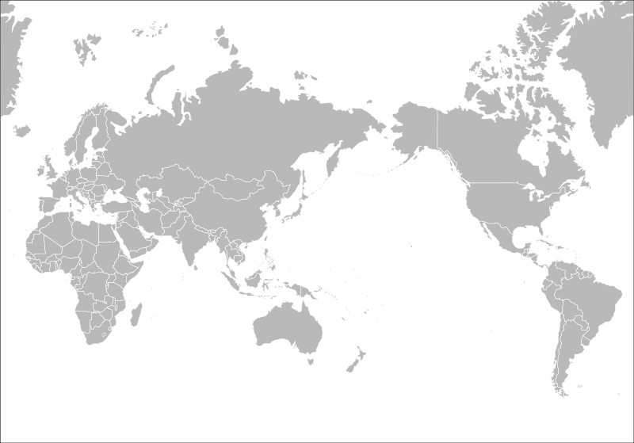

Slide 37
A/D of Globalization
Look at the following lists of the advantages and disadvantages of globalization
For each of the A/D, give it a point value between a 1 and 5
Add up the total points for each side to determine if Globalization is a Good/Bad thing!

Slide 38
Advantages of Globalization
Consumers to get much wider variety of products to choose from at lower prices.
Companies get access to much wider markets and opportunities for investment.
Stronger trade ties promote understanding and peace among different countries.
Reduces international poverty
Contributes to the spread of technology
Spreads Western values, culture, and democracy.

Slide 39
Disadvantages of Globalization
Economic depression in one country spread across the globe.
Stifle development of developing countries because they cannot compete with multinational corporations.
Makes world culture similar so there is less interest in local culture.
The environment gets damaged because of lower standards in developing countries.
Companies face much greater competition may go out of business or outsource labor to other countries.
Workers in poor countries have low wages and bad working conditions working for big companies

Slide 40
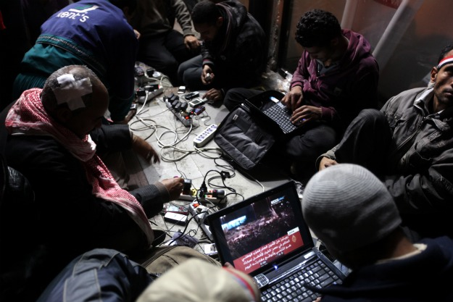
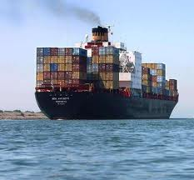
III. Positives vs. Negatives
Benefits of Globalization- Cooperation and competition, access to technology and information, Spread of democracy and civil rights

Slide 41
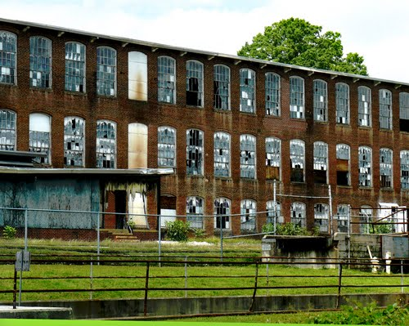
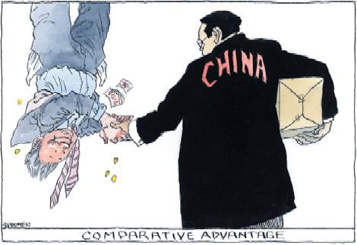
Costs of Globalization- Hurt domestic industries, economic vulnerability, exploitation in poor countries

Slide 42
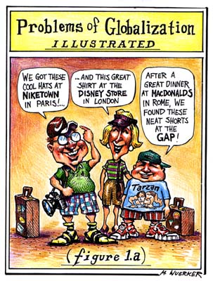

Slide 43
Closure
Describe two international free trade organizations
Describe one advantage and one disadvantage of globalization

Slide 44
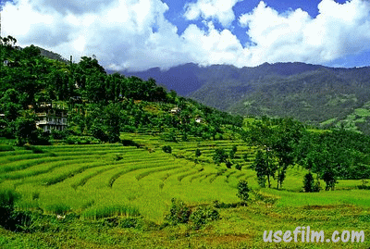
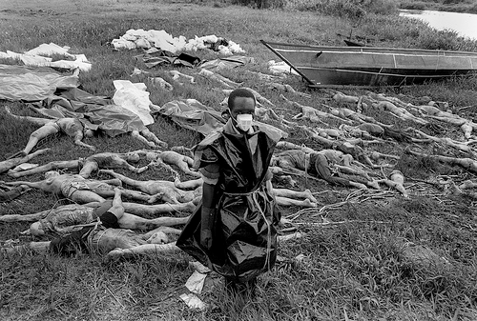
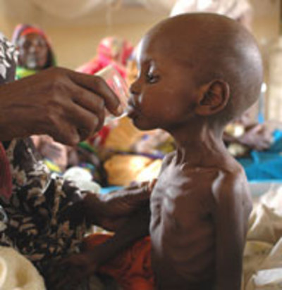
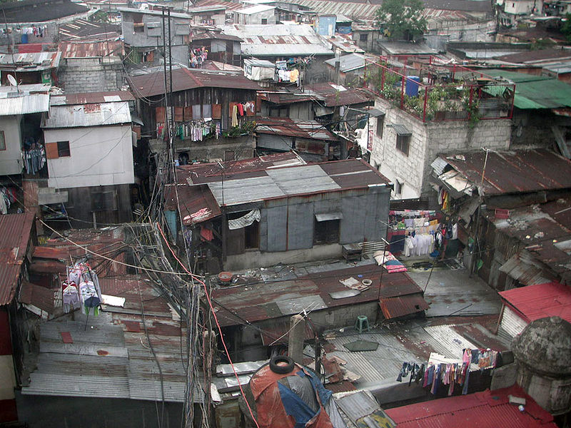
Developing Countries

Slide 45
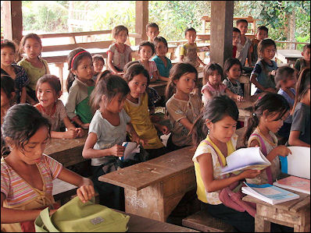
List in your notebook all of the countries in the world that you would consider to be part of the “Third World”.

Slide 46
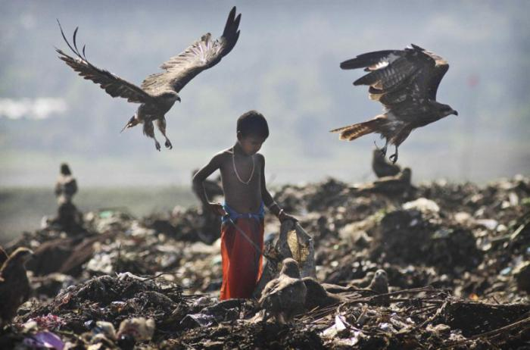
Third World??
https://www.youtube.com/watch?v=X1xBpBaBbrA

Slide 47
get out your cell phones!
2. Now, using what you just saw in the video (and your technology) to determine just how many countries that you listed would fall into the category of “Third World” as designated by the United Nations.

Slide 48
 | Afghanistan |  |  | Madagascar
 | Angola |  |  | Malawi
 | Bangladesh |  |  | Mali
 | Benin |  |  | Mauritania
 | Bhutan |  |  | Mozambique
 | Burkina Faso |  |  | Myanmar
 | Burundi |  |  | Nepal
 | Cambodia |  |  | Niger
 | Central African Republic |  |  | Rwanda
 | Chad |  |  | Samoa
 | Comoros |  |  | Sao Tome and Principe
 | Congo (Democratic Republic of the) |  |  | Senegal
 | Djibouti |  |  | Sierra Leone
 | Equatorial Guinea |  |  | Solomon Islands
 | Eritrea |  |  | Somalia
 | Ethiopia |  |  | Sudan
 | Gambia |  |  | Timor-Leste
 | Guinea |  |  | Togo
 | Guinea-Bissau |  |  | Tuvalu
 | Haiti |  |  | Uganda
 | Kiribati |  |  | United Rep. of Tanzania
 | Lao People's Democratic Rep. |  |  | Vanuatu
 | Lesotho |  |  | Yemen
 | Liberia |  |  | Zambia

Slide 49
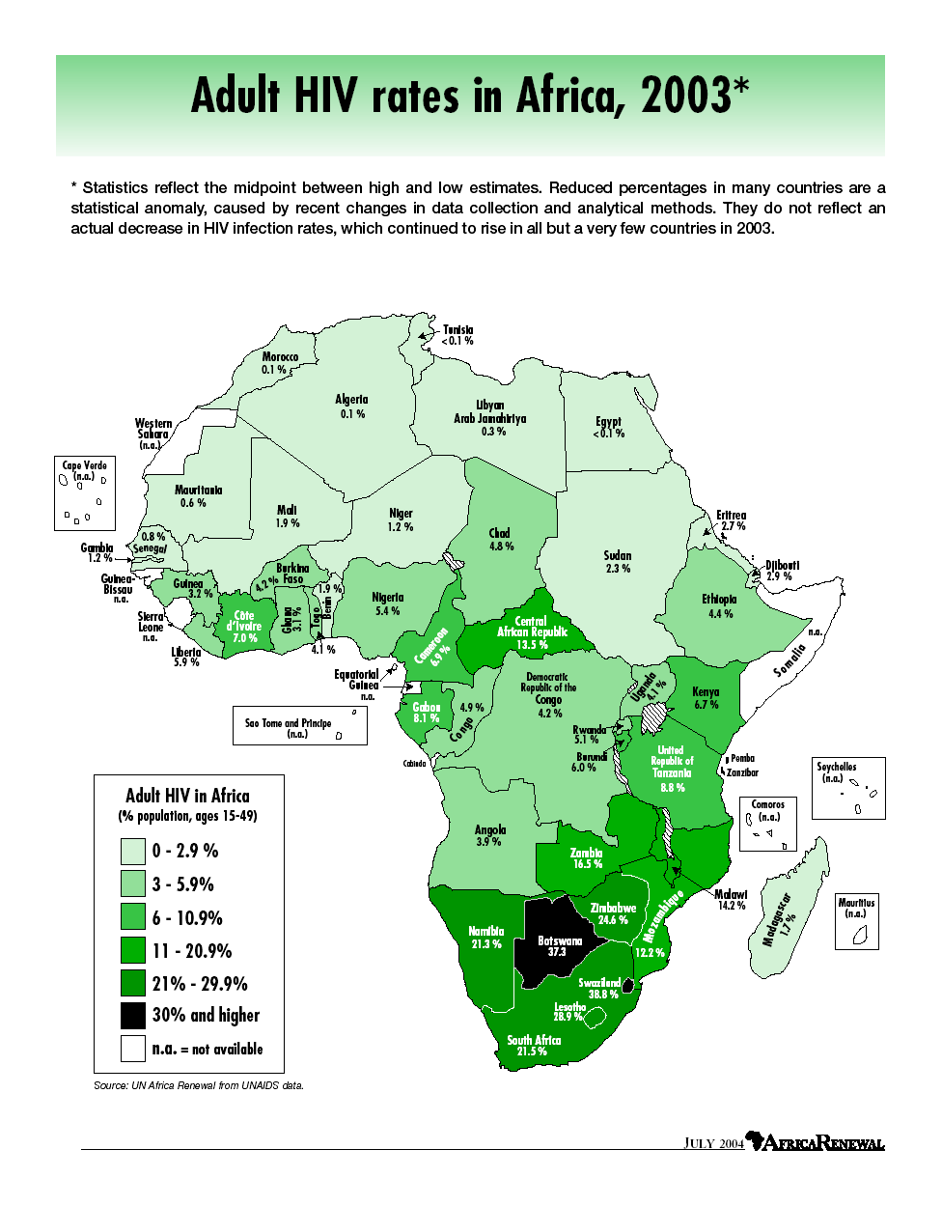
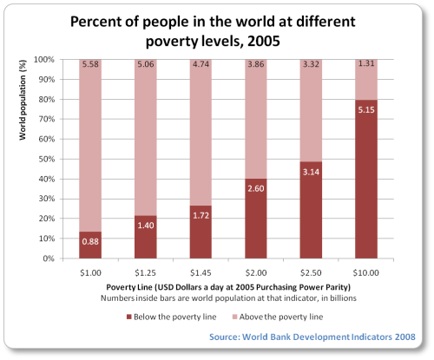
I. What is a Developing Country?
Developing Country- low standard of living with a low income, infrastructure, health

Slide 50
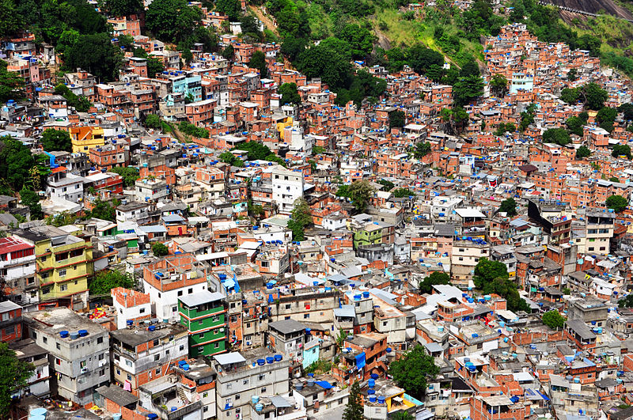

Slide 51
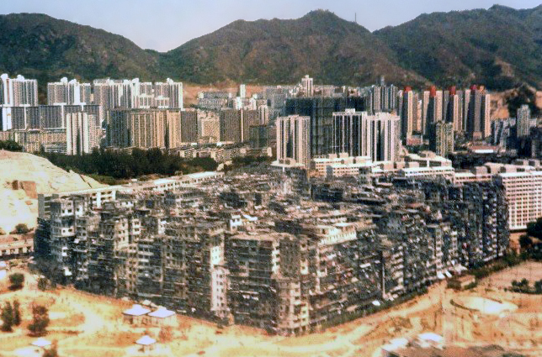
Kowloon Walled City

Slide 57
Most developing countries are in Africa, Asia, and South America and were once imperialized

Slide 58
Notes:
http://www.youtube.com/watch?v=fxyhfiCO_XQ
http://www.youtube.com/watch?v=D2p5svFJ9cQ

Slide 61
Developing counties are growing very rapidly

Slide 62
II. Conflicts in Developing Countries
Apartheid- racial segregation ended in 1994 in South Africa; sparked significant internal resistance and violence

Slide 63
Get out your article and questions about Nelson Mandela!

Slide 64
Rwandan Genocide (1994)- Ethnic conflict in which over ½ a million killed Tutsis by the Hutus
https://www.youtube.com/watch?v=SG9rpAY3ITc https://www.youtube.com/watch?v=6TOSq9a8Hc8

Slide 67
Genocide in Darfur (2003)- rebellion against the government, 2.5 million displaced and around 400,000 killed

Slide 70
Closure
What do you believe are long-term solutions to problems of poverty in developing countries?

Slide 71
Environmental Issues….

Slide 72
Warm Up….
1. What would happen if international trade and travel was cut off? How would this affect our economy and Environment?

Slide 79
https://www.youtube.com/watch?v=9u0EL_u4nvw

Slide 80
I. Environmental Problems
A. Over-Population – the world population has doubled in the last 50 years

Slide 84
https://www.youtube.com/watch?v=inA-36YRV0Y

Slide 85
B. Climate Change- burning of fossil fuels and forests causes greenhouse gases to be trapped in the atmosphere, leading to global warming
C. Pollution- air, water, and soil

Slide 86
http://southpark.cc.com/clips/103844/we-didnt-listen

Slide 87
D. Deforestation- clear-cutting of forests causes erosion and flooding
E. Desertification (desert spreading) is caused by overgrazing

Slide 88
F. Ozone Depletion- Ozone breaks down causing thinning in the Ozone layers causing UV to penetrate the earth’s surface

Slide 90
G. Plants and animals are becoming extinct at a faster rate
H. Commercial fishing destroys the ocean environment (overfishing)

Slide 106
Nasty Videos….
https://www.youtube.com/watch?v=qGoR4dbE1os
https://www.youtube.com/watch?v=27nX3Dsv9Xk

Slide 107
II. Possible Solutions
A. Reducing greenhouse gases and pollution
B. Renewable energy sources
C. Conservation of the natural environment
D. Technology and innovation

Slide 108
Closure…
1. Can you think of an example of cultural diffusion from the last 5 years?
2. Does America “export” or “import” culture more?

Slide 109
What do you know? – Bell Work
Write down words or phrases that YOU associate with: Terrorism
You can list causes, events, effects, names, feelings, etc

Slide 110
What Can I Bring on an Airplane?
Each row in the class is a separate “group”. If you are alone…join a row to your left or right
You will need to decide together which of the following items belong in the YES column or the NO column.
Each of these items can either be carried on an airplane with (some with specific rules) or cannot be carried on an airplane at all. Good luck and keep America TSAfe. (get it?)

Slide 111
Ice Skates
Perfume (4 oz.)
Knitting Needles
Pocket Knife
Scissors (the rounded tips kind)
Lighter empty
Corkscrew
Pot bellied pig
Fencing Sword
Tools (screw driver, wrench, pliers)
Water bottle (with water)
Parachute
Dry Ice
Sewing kit
Camp Stoves
Antiques
Fishing rods
Musical instruments
Monkey
Scuba masks
Compressed gas cylinder (like an oxygen tank)
Disposable razor
Baseball bat
Lacrosse stick
Brass knuckles
A coffin/ deceased remains of a loved one
Snow globes
A bomb.
Boogie Board
Amplifier

Slide 112
Fishing rods yes
Musical instruments yes
Scuba masks yes
Compressed gas cylinder (like an oxygen tank) yes
Disposable razor yes
Baseball bat (no)
Lacrosse stick (no)
Brass knuckles yes
Cremated body yes
Snow globes yes
A bomb. no
Boogie Board yes
Amplifier no
Ice Skates (Yes)
Perfume (4 oz.) No
Knitting Needles Yes
Pocket Knife no
Scissors (the rounded tips kind) yes
Lighter empty
Corkscrew
Pot bellied pig
Fencing Sword (no)
Tools (screw driver, wrench, pliers) (Yes)
Water bottle (with water)
Parachute yes
Dry Ice yes
Sewing kit yes
Camp Stoves yes

Slide 113
Before you were born…flying was easy….
There were no full body scanners…and you didn’t have to take your shoes off
You could smoke on the plane (
You had to CALL to book a ticket?!
You could carry pretty much anything onto the plane

Slide 114
Terrorism

Slide 115
I. History
Terrorism- using violence and the fear from threats to promote political, religious, or ideological goals

Slide 117
B. Methods have been used for hundreds of years and not limited to one region or religion

Slide 118
C. Separatist groups have used terrorism to get independence for their nationality
(for example: Irish Republican Army (IRA), Basques in Spain, Chechens in Russia, PLO (Palestinian Liberation Organization)
https://www.youtube.com/watch?v=csr9TPGPoxs

Slide 120
D. State terrorism- governments use terror to promote a political goal
(ex: Syria – currently in a Civil War; government attacking the people)
(ex

Slide 123
Some useful definitions…
Separatists – want to “separate” from their country or other identified group
ETA – Basques from Spain
IRA – Irish Republican Army
Tamil Tigers – Sri Lanka
Chechens – Russian, Islamic Separatists
Al qaeda – Osama bin Laden, Pakistan
Taliban - Afghanistan

Slide 126
Notes:
http://www.youtube.com/watch?v=csr9TPGPoxs

Slide 127
E. Religious- Hamas and Hezbollah have used terrorism to attack Israel

Slide 128
Boko Haram- Nigerian group attacking Western values, Al Qaeda, ISIS- want to create a religious state in Iraq/Syria

Slide 131
ISIS

Slide 132
https://www.youtube.com/watch?v=bsCZzpmbEcs

Slide 133
Discussion Questions – Answer on a separate sheet of paper to turn in.
#1 of 3:
Over the past several months, young men and women from all over the world have been apprehended attempting to flee their home countries to join ISIS (some fled without being apprehended). In all honesty, why would people join ISIS? Why, even though the majority of the world is against them, does this terrorist group continue to have so much success?

Slide 134
Discussion Questions – Answer on a separate sheet of paper to turn in.
#2 of 3:

Slide 136
II. War on Terrorism
September 11, 2001-
al Qaeda, a terrorist organization, hijacked 4 U.S. planes

Slide 137
War in Afghanistan (2001-2015?)- US invaded Afghanistan to force out the Taliban government which had supported members of al Qaeda

Slide 138
War in Iraq (2003-2011)- US invaded Iraq, targeting Saddam Hussein, because believed to have WMDs (weapons of mass destruction)

Slide 140
Closure
1. Compare periods in history (when they tortured people and their tactics) to terrorism today. What is different? Same?
2. How can we (Maybe not this class…but the World) stop terrorism?

Slide 141
Technology
Rank the top 5 technologies that have been created in the last 25 years
Come up with one or two technologies that will be developed in the next 25 years

Slide 142
I. Communication
New technologies: computers, the internet, cell phones
Year | Price/Megabyte
1957 | $411,041,792
1979 | $10,528
1990 | $72
1997 | $2.16
2003 | $0.166
2010 | $0.0190
2012 | $0.0049

Slide 144
Impact: access to information, social networking, brings world together, increases production, raises standard of living
https://www.youtube.com/watch?v=ts_4vOUDImE
Notes:
K,

Slide 147
II. Medical
A. Innovations: Vaccinations, genetics, child and maternal care, Pharmaceutical advancements, Transplants and artificial organs

Slide 148
B. Impact: Global life expectancy has grown from 48 years in 1950 to nearly 70 years

Slide 149
III. Transportation
A. Innovations: Inexpensive cars and planes, high-speed rail, space exploration
B. Impact: interconnected world, new understanding of the solar system

Slide 150
Riders per day: 15.600 Max speed: 55mph total length when completed: 31 miles

Slide 151
Riders per day: 175,000+ Max speed: 156 mph total length when completed: 413 miles

Slide 152
Ticket Out
Pick three terrorist groups and explain what their cause is.
Why did America go to war in Afghanistan? Why did America go to war in Iraq?

Slide 153
Extra Credit
What does ISIS stand for?

Slide 154
This is a Model U.N. Summit…
On Monday, each group will be responsible for presenting a SHORT (30 seconds – 1 minute) speech on how their country would handle a world-wide outbreak of Zombies.
To get credit for this mini-project…
Each group must present a minimum 3-sentence resolution.
Your resolution must be catered specifically to YOUR COUNTRY! If it is not, you will not receive full credit.
After presenting, your “country” must turn in the resolution to me with ALL of your names on the paper and your country name on the top.

Slide 155
Zombies desire human flesh; they do not eat other zombies
Zombies cannot be killed unless their brains are destroyed
There is no cure for zombies.
The zombie virus causes 100% infection and 100% death.
If you get bitten, you become a zombie. The virus is spread through bodily fluids
Zombies do not retain human emotion, memories, and cannot be trained.

Slide 156
Your task: Create a resolution, put forth by your country, that explains how your country would handle an outbreak of the Zombie virus!

Slide 157
Planet Money Makes a T-Shirt
https://www.youtube.com/watch?v=r2Zod7Sd3rQ

Slide 158
https://www.youtube.com/watch?v=bsCZzpmbEcs

Slide 159
BINGO
Primary source/Secondary source
History/Prehistory
Paleolithic Era
Hunter-gatherers
Neolithic Revolution
Domestication
Pastoralists
Division of Labor
Civilization
Early Civilizations
Cultural diffusion
Delta
Monsoons
City-state
Dynasties
Pharaohs
Mandate of Heaven
Theocracy
Bureaucracy
Caste system
Polytheistic
Confucianism
Hammurabi’s Code
Phoenicians
Ziggurat
Pyramids
Patricians/Plebeians
Law of Twelve Tables
Republic
Veto
Consul
Legion
Aqueducts
Latin
Julius Caesar
Augustus
Pax Romana
Constantine
Inflation
Monotheistic Religions
Monotheism
Torah
Diaspora
Bible
Protestantism
Catholicism
Orthodox
Muhammad
Qur’an
Caliph
Sunnis/Shias
Karma
Reincarnation
Dharma
The Buddha
Nirvana
Confucianism/Legalism
Qin/Han/Tang/Song
Shi Huangdi
Bureaucracy
Great Wall
Terra Cotta Army
Civil Service
Silk roads
Filial Piety
Foot binding
Polis
Monarchy
Direct democracy
Oligarchy
Homer
Socrates/Plato/Aristotle
Alexander the Great
Hellenistic World

