Slide 1
The Enlightenment

Slide 2
1. Come in and grab a review Chart, an Objective Sheet, and a Notes Sheet from the Cart. 2. Fill out your objective, then Take everything off of your desk except for a pencil/Pen and put your other papers under your desk. 3. Talk to a neighbor for 1 minute about the quiz (that you will claim you didn’t know about)

Slide 3
When done with your Quiz…… Review Chart!
Following the directions on your review chart, ILLUSTRATE and CAPTION 6 different people or ideas (yes, even vocabulary terms) from our notes on Absolutism. You will have 15 minutes to complete this assignment ☺
What is this an example of????

Slide 4
“Man is born free, but everywhere he is in chains”
Please take 3 minutes to write down your initial responses to this quote.
Hypothesize who wrote it, when it was written, and where it was printed.
Essentially, what does the quote mean?

Slide 5
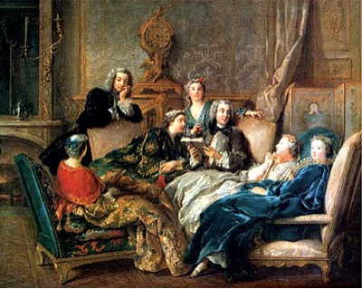
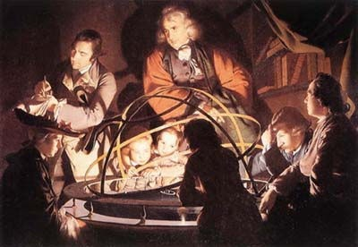
I. Ideas of the Enlightenment
A. The Scientific Revolution convinced people in the power of reason
B. The Enlightenment was a philosophical movement that promoted the power of human reason to make change

Slide 6
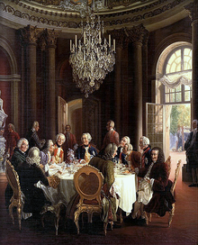
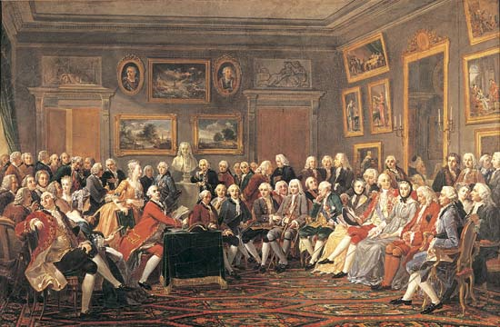
C. Paris was the center, salons were upper class social gatherings that promoted Enlightenment philosophers, artists, and writers

Slide 7
II. Ideas of Government
A. A social contract is an agreement b/w the people and their government to give up part of their freedom in exchange for protection for all (Hobbes)

Slide 8
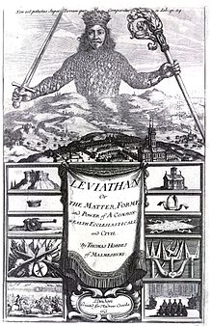
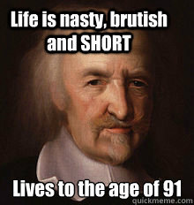
B. Thomas Hobbes- Humans were evil and need strong kings to keep them safe

Slide 9
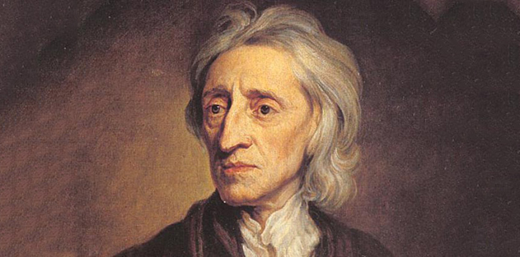
C. John Locke- People were naturally good and born with rights of life, liberty, and property that the government should protect
You’re welcome America.
Inspiring revolutionary ideas since 1700…

Slide 10
“If the government does not protect you or your rights, you have a right to overthrow the government and install one that will protect your rights”

Slide 11
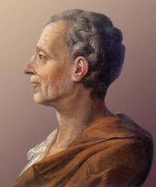
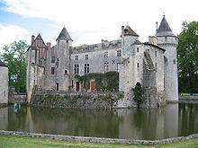
D. Baron de Montesquieu- Government should be separated into branches to prevent one part from getting too much power

Slide 12
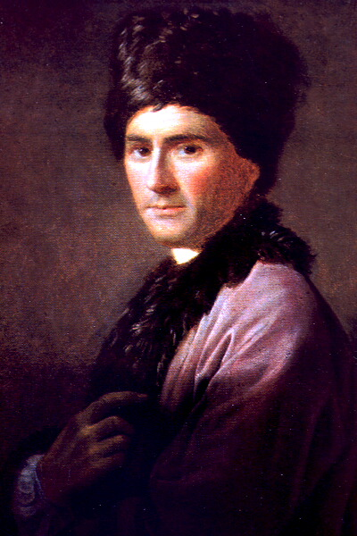
E. Jean-Jacque Rousseau- People were good but society can corrupt people

Slide 13
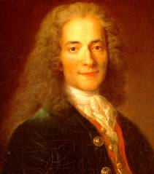
III. Ideas of Society
A. Voltaire
1. Believed in freedom of religion and separation of Church and State
2. Advocated liberty and freedom of speech

Slide 14
Bell-Work
Who believed that the mind was a “blank slate”?
Who believe that people were born evil?
In your warm up, answer these questions in preparation for our debate.
Are men good….or are men evil?
Is the social contract always a good thing to be a part of?

Slide 15
Let’s Make This Relevant!!
Take 5 minutes to write down some thoughts about an individual from popular culture that you feel can compare to the life of our philosophers such as John Locke or Voltaire.
You can choose anyone that you wish, as long as you can justify how their life mirrors the life of an 18th century philosopher.
…how about an example….

Slide 16
18th Century European Philosophes and Popular Culture
LOST

Slide 17
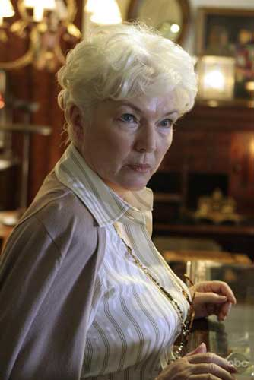

Slide 18
Miley CYrus
Men (and women..and Miley) are born with a blank slate but their lives are shaped by their experiences
Who would agree with this statement?

Slide 19
Still Making It Relevant!!!
Does your person express their ideas openly, or through private/secretive mediums?
Has this person ever received a punishment for voicing their opinion about an issue?
What direct comparisons can you draw between the individual that you chose and the philosophers of the Enlightenment?
(Just answer these on the side/bottom of your notes)

Slide 20
Review Activity - Stoplight
Using your objective sheets (yay, finally!) I want you to go back through our previous units to find the ones that you ….
GREEN – Totally understand and have no questions about
YELLOW – Kind of understand but might have a question about
RED – Have almost completely forgotten or you never really understood it in the first place
Take three sticky notes, and write ONE UNIT on each note and place it on one of our three stoplight sheets around the room.

Slide 21
CLOSURE
Do you feel that these objective sheet have helped you stay organized?
Does it help you to look back at the sheets to figure out which objectives you remember and which ones you do not?

Slide 22
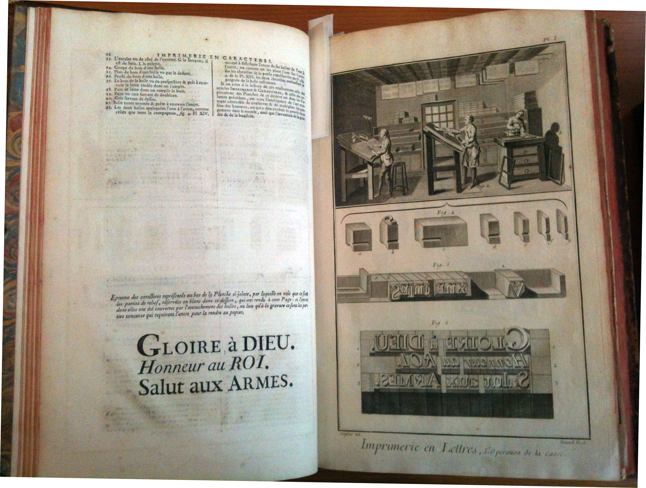
B. Diderot’s Encyclopedia- collection of Enlightenment writings into 28 volumes

Slide 23
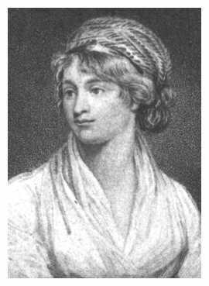
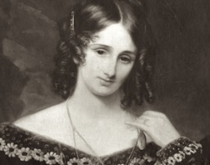
C. Mary Wollstonecraft- fought for social equality (esp. education) for women

Slide 24
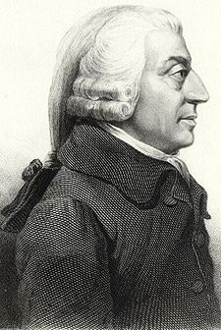
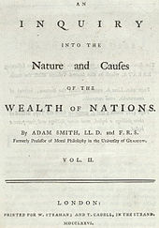
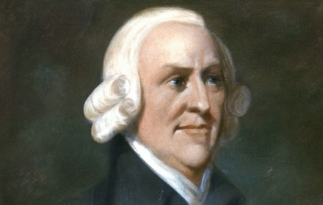
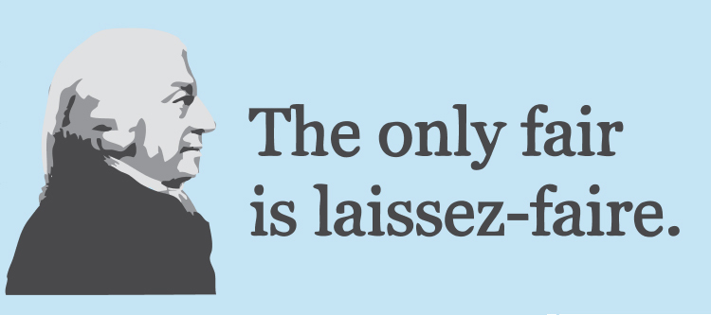
D. Adam Smith
1. Wrote The Wealth of Nations (1776)
2. Believed in the laissez-faire- free market economy without government intervention

Slide 25
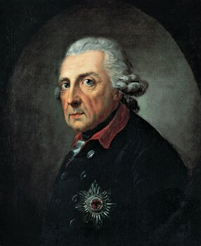
IV. Enlightened Despots
A. Some strong monarchs (despots) used their power to promote Enlightenment ideas but fell short of those ideals
B. Fredrick II (the Great) of Prussia-
1. Promoted education, religious tolerance, and freedoms
2. Ruled with absolute power, fought many wars

Slide 26
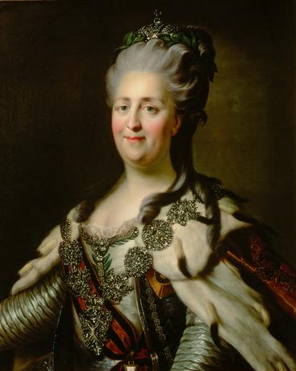
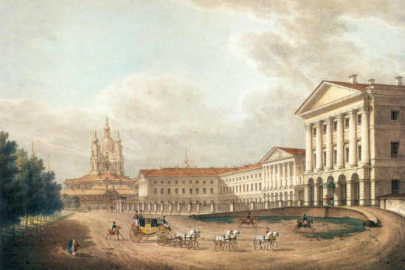
C. Catherine II (the Great) of Russia-
supported philosophers,
education, culture
2. limited the rights of serfs

Slide 27
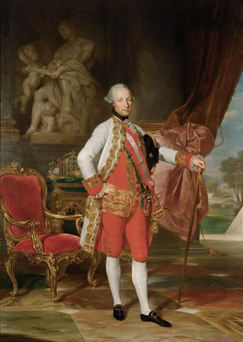
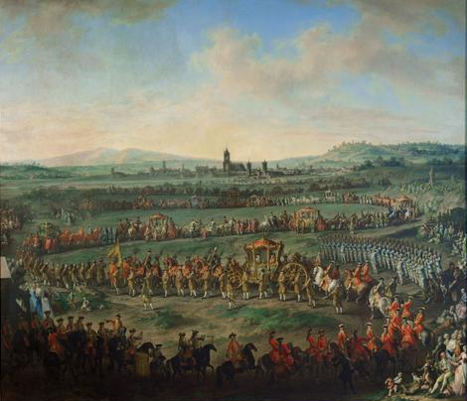
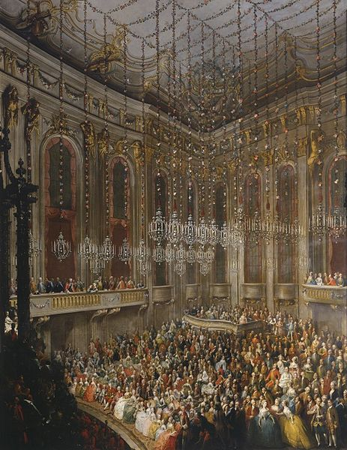
D. Joseph II of Austria-
1. abolished serfdom and torture
2. allowed freedom of religion

Slide 28
TaLking Heads
Create a scene with the thinkers where they are debating their philosophies on humanity and government.
For instance, have them in a (hair) salon.
You can create thought bubbles or quotes for each first then draw the bodies and clothes and finish by filling in the background and salon.
The finished product should have little white or open space.

Slide 29
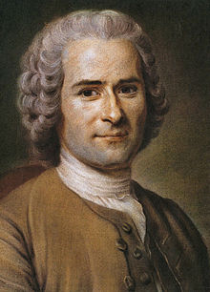
Locke Hobbes Rousseau Montesquieu

Slide 30
Closure…..

