Slide 1
Colonization and Slave Trade

Slide 2
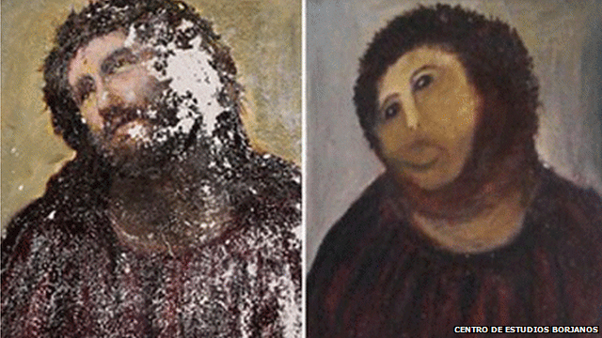

Slide 3
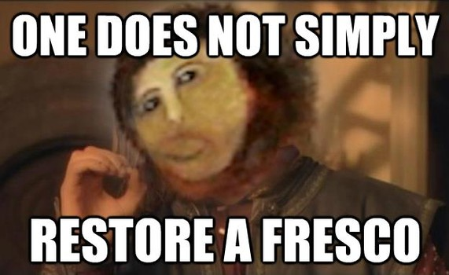

Slide 4
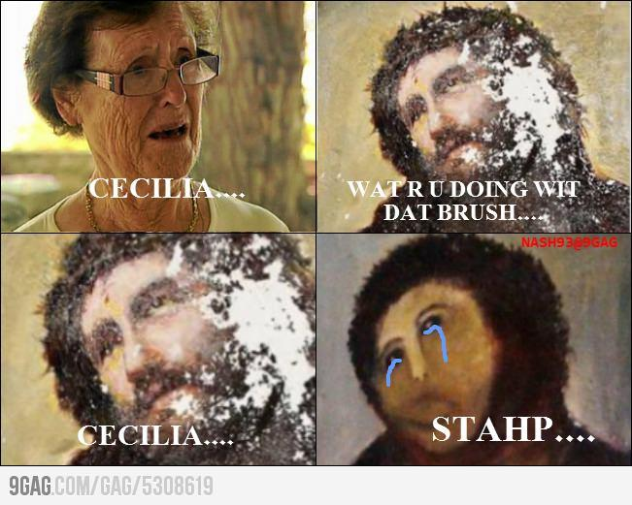

Slide 5
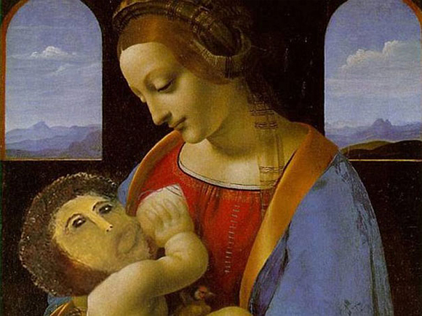

Slide 6
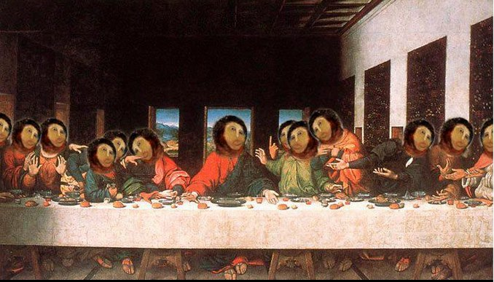

Slide 7
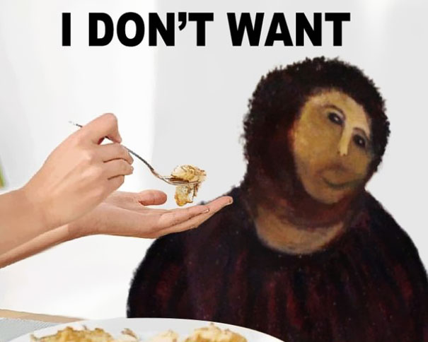

Slide 8
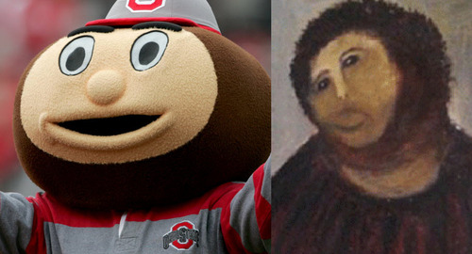

Slide 9
UNIT 3
CREATE NEW COVER PAGE!!!!
Unit 3 : Early American Civilizations – Japan
Pick up Vocab Sheets/Study Guides
Listen for instructions…since y’all are still having problems with your notebooks ☹

Slide 10
02/27 – Analyze the rise and fall of Early American societies
03/03 - Describe the impact of European explorers and Conquistadors

Slide 11
Bell-Work
Which explorer was famous for conquering the Incas? Who conquered the Aztecs?
Which country had more success in exploration…Spain or Portugal?
What was the most interesting thing that you learned yesterday?

Slide 12
Clash of Civilizations Worksheet
1. Fill in the worksheet that you JUST picked up from the front of my room.
2. Fill in the sheet using your notes from the past few days and your textbook (page numbers are located on the sheet for your convenience).

Slide 13
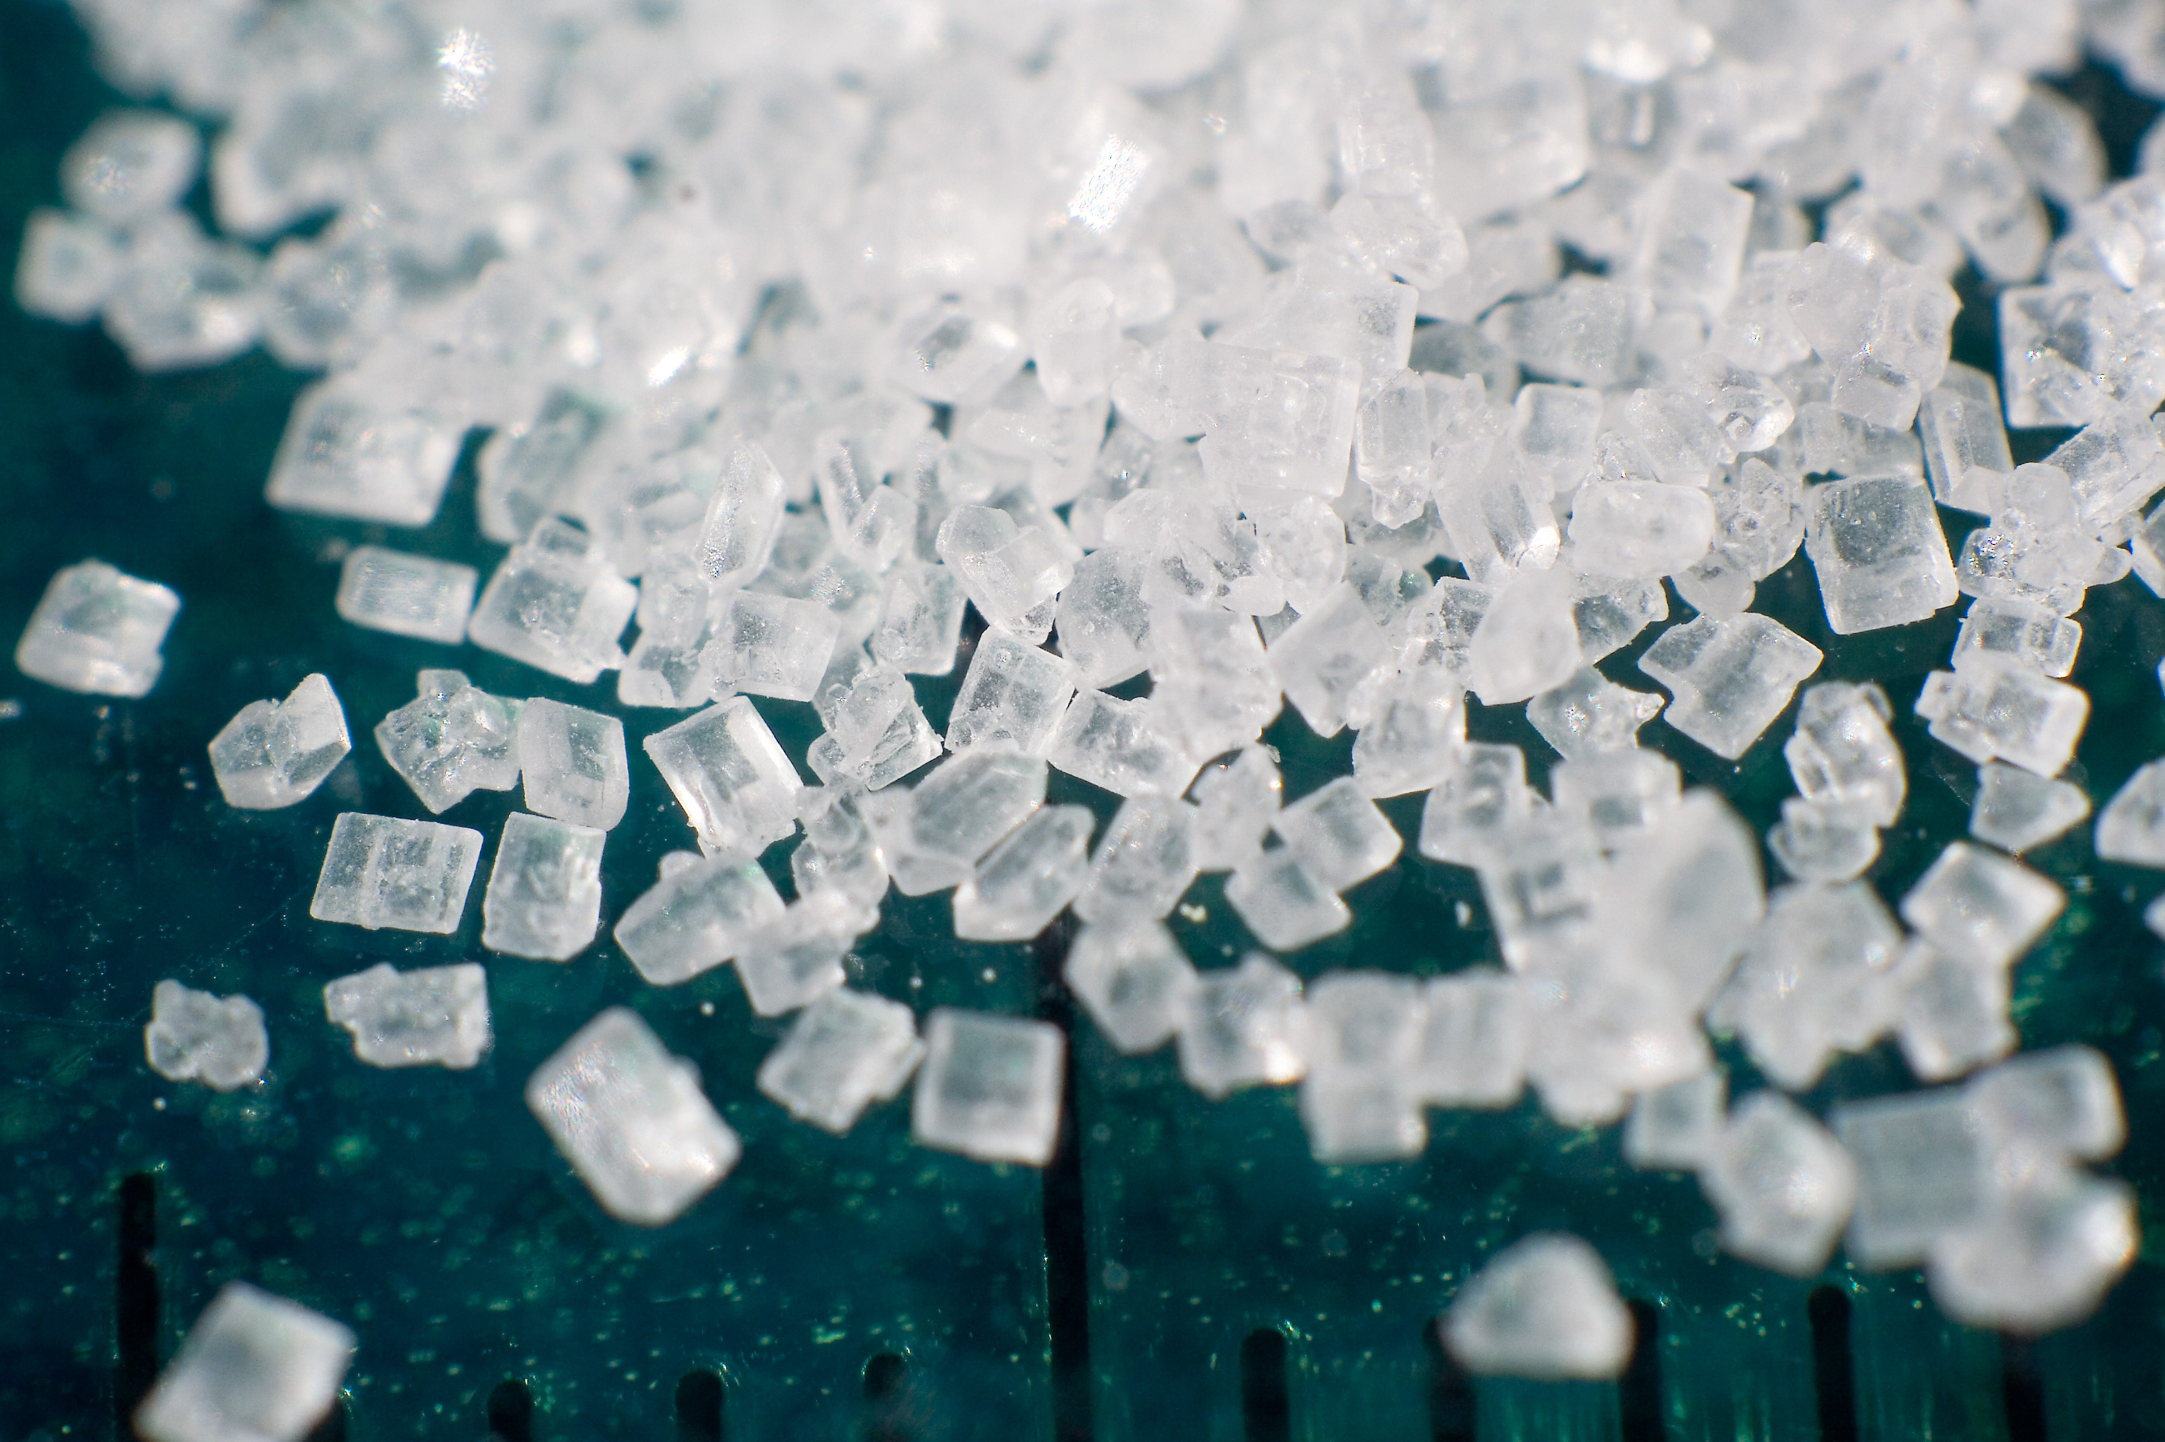
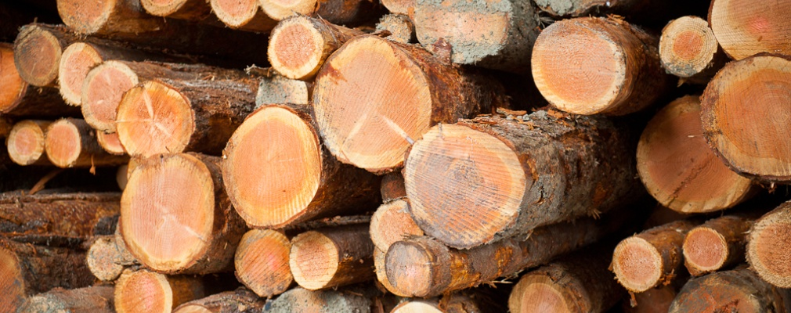
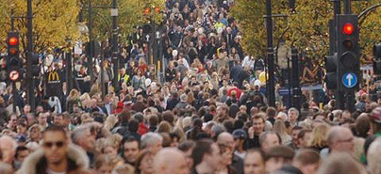
I. Why Colonize?
A. Europe was overcrowded- new land and opportunities for all
B. Great source of wealth from raw goods
C. European powers competed with each other

Slide 14
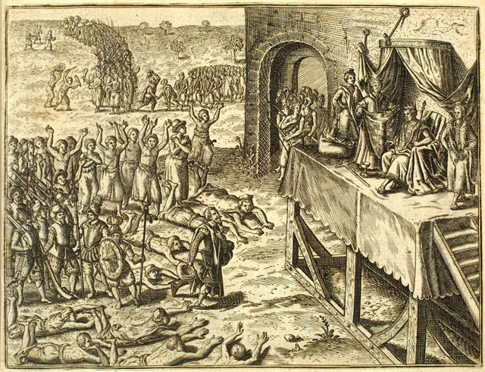
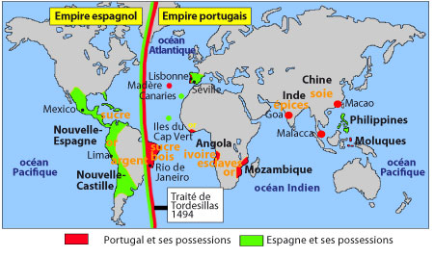
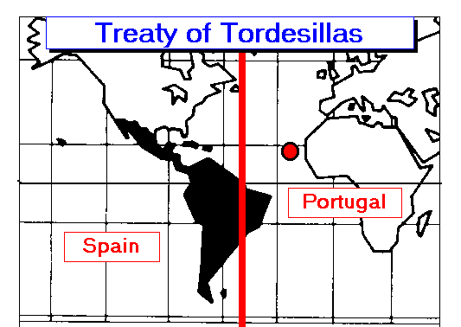
II. New colonies
A. Portuguese and Spanish
1. Portugal gained slave ports in Africa, Spain gained colonies in SE Asia
2. Split South America with the Treaty of Tordesillas

Slide 15
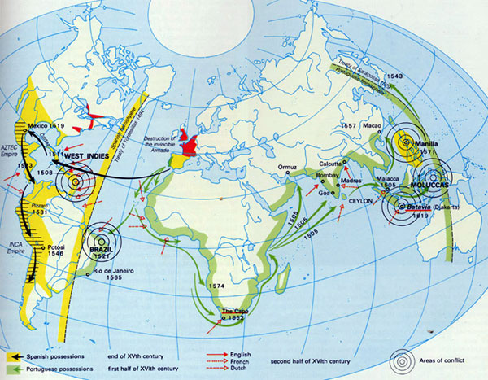

Slide 16
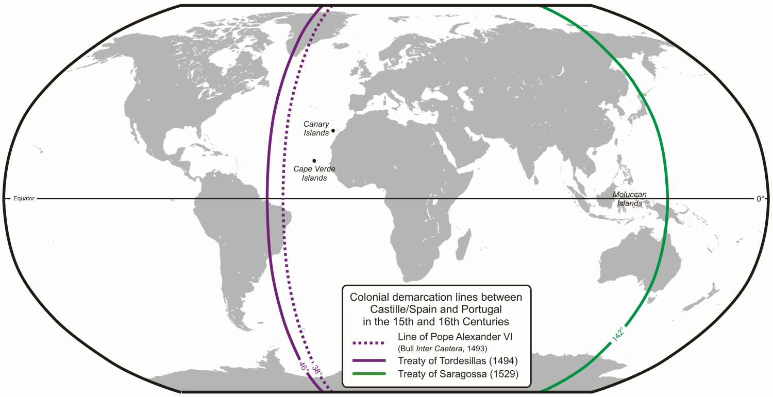

Slide 17
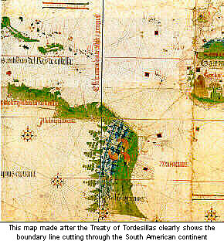
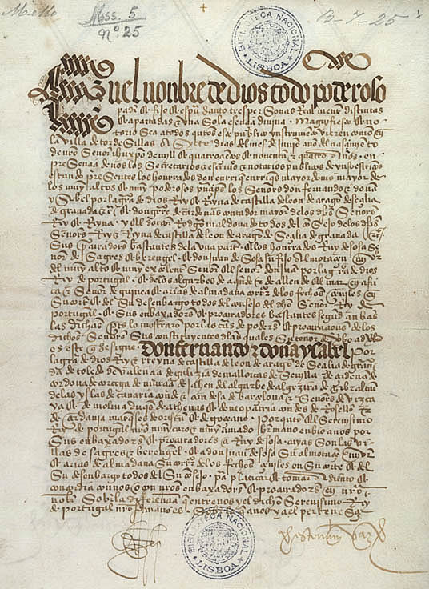

Slide 18
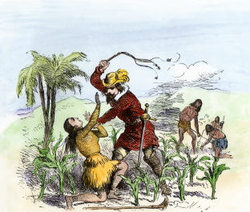
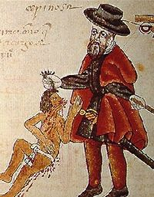
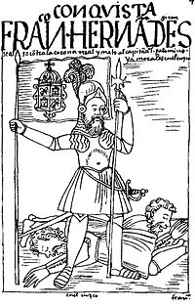
3. Wanted gold and silver, created plantations for cash crops
4. Encomienda system- colonists created a feudal system in which natives worked the land and were taught Christianity

Slide 19
Story Time with Mr. Marwitz…. and Bartolome de Las Casas
We can estimate very surely and truthfully that in the forty years that have passed, with the infernal actions of the Christians, there have been unjustly slain more than twelve million men, women, and children. In truth, I believe without trying to deceive myself that the number of the slain is more like fifteen million.
After the wars and the killings had ended, when usually there survived only some boys, some women, and children, these survivors were distributed among the Christians to be slaves.
With my own eyes I saw Spaniards cut off the nose and ears of Indians, male and female, without provocation, merely because it pleased them to do it. ...Likewise, I saw how they summoned the caciques and the chief rulers to come, assuring them safety, and when they peacefully came, they were taken captive and burned.

Slide 20
They laid bets as to who, with one stroke of the sword, could split a man in two or could cut off his head or spill out his entrails with a single stroke of the pike.
They took infants from their mothers' breasts, snatching them by the legs and pitching them headfirst against the crags or snatched them by the arms and threw them into the rivers, roaring with laughter and saying as the babies fell into the water, "Boil there, you offspring of the devil!
They attacked the towns and spared neither the children nor the aged nor pregnant women nor women in childbed, not only stabbing them and dismembering them but cutting them to pieces as if dealing with sheep in the slaughter house.
They made some low wide gallows on which the hanged victim's feet almost touched the ground, stringing up their victims in lots of thirteen, in memory of Our Redeemer and His twelve Apostles, then set burning wood at their feet and thus burned them alive.
With still others, all those they wanted to capture alive, they cut off their hands and hung them round the victim's neck, saying, "Go now, carry the message," meaning, Take the news to the Indians who have fled to the mountains.

Slide 21
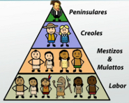
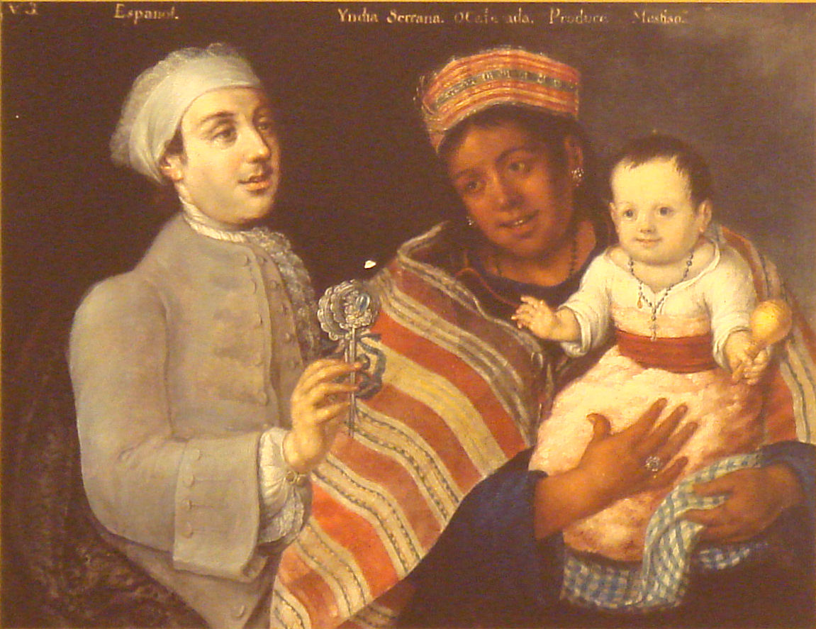
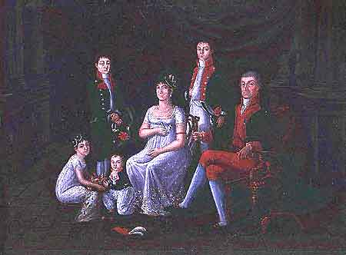
5. Class system
based on race
a. Peninsulares (Spain-born)
b. Creoles (white, American born)
c. Mestizos and Mulattoes (mixed)
d. Indians
e. African slaves

Slide 22
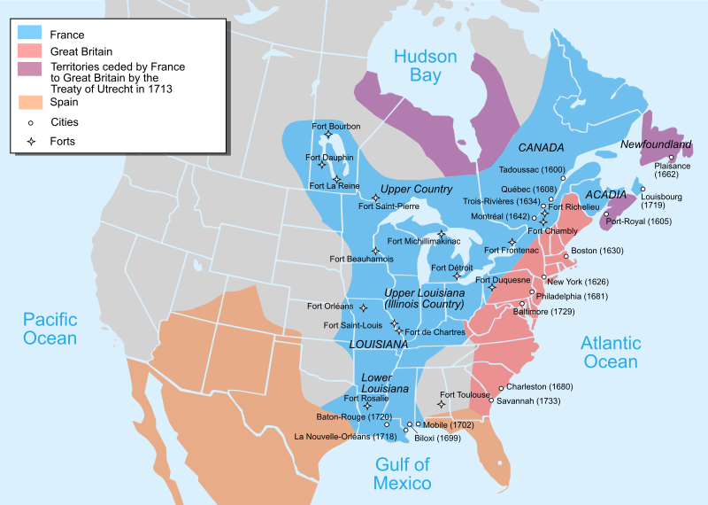
B. French
1. Settled in Quebec, and some Caribbean Islands (Haiti)
2. Good relations with natives, wanted fur

Slide 23
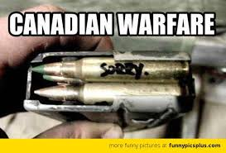

Slide 24
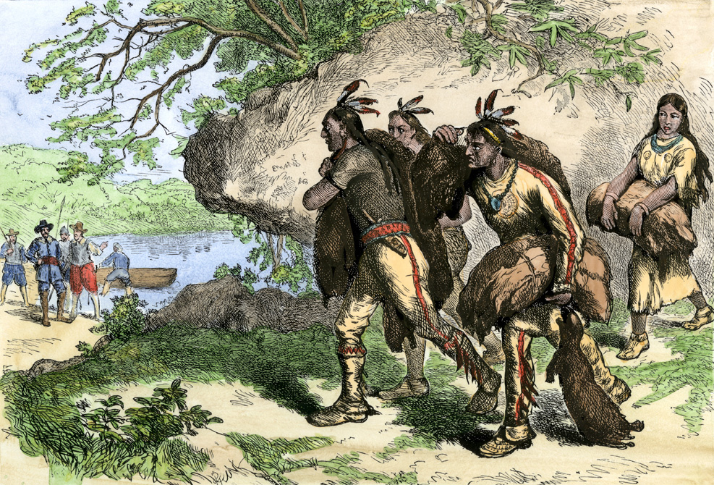

Slide 25
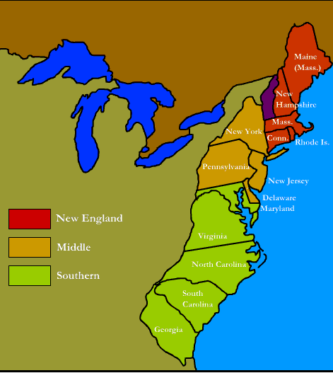
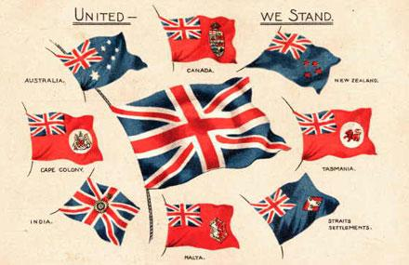
C. English
1. Settled east coast of North America, Canada, Oceania and India
2. 13 Permanent colonies (Jamestown was the first)

Slide 26
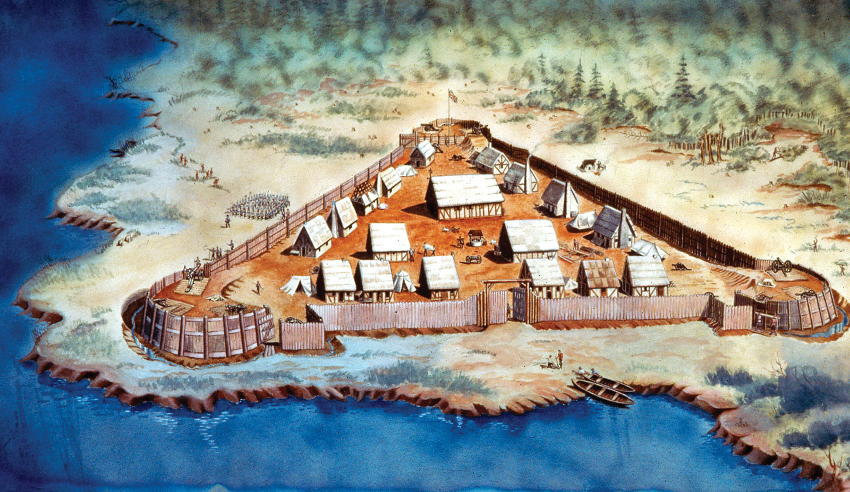

Slide 27
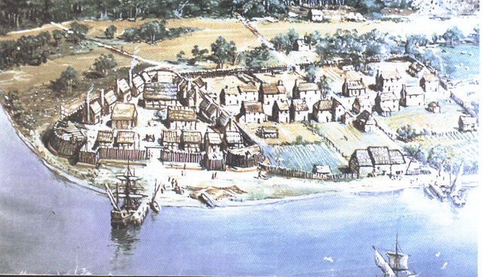

Slide 28
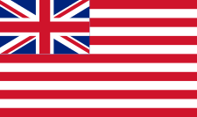
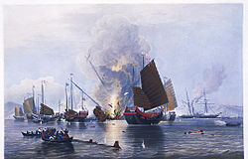
3. Some colonies were run by individuals or joint-stock companies
a. group of people invest to make a profit
b. British East India Company monopolized trade in Asia

Slide 29
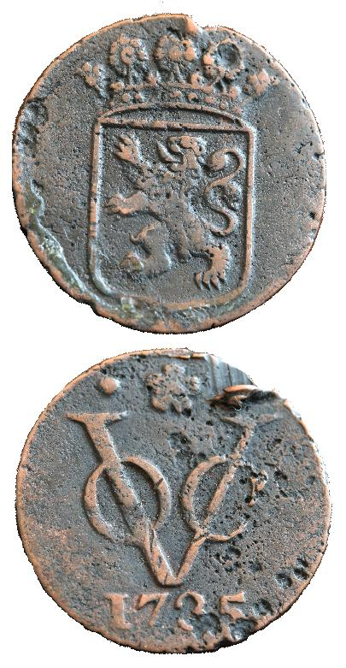
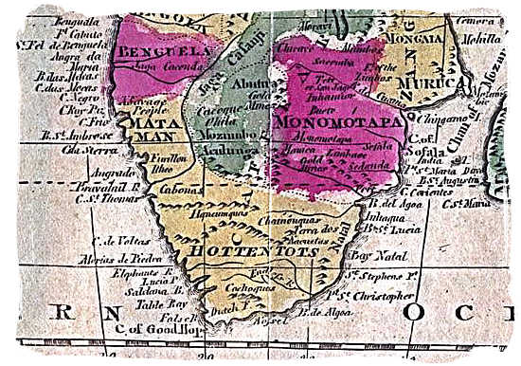
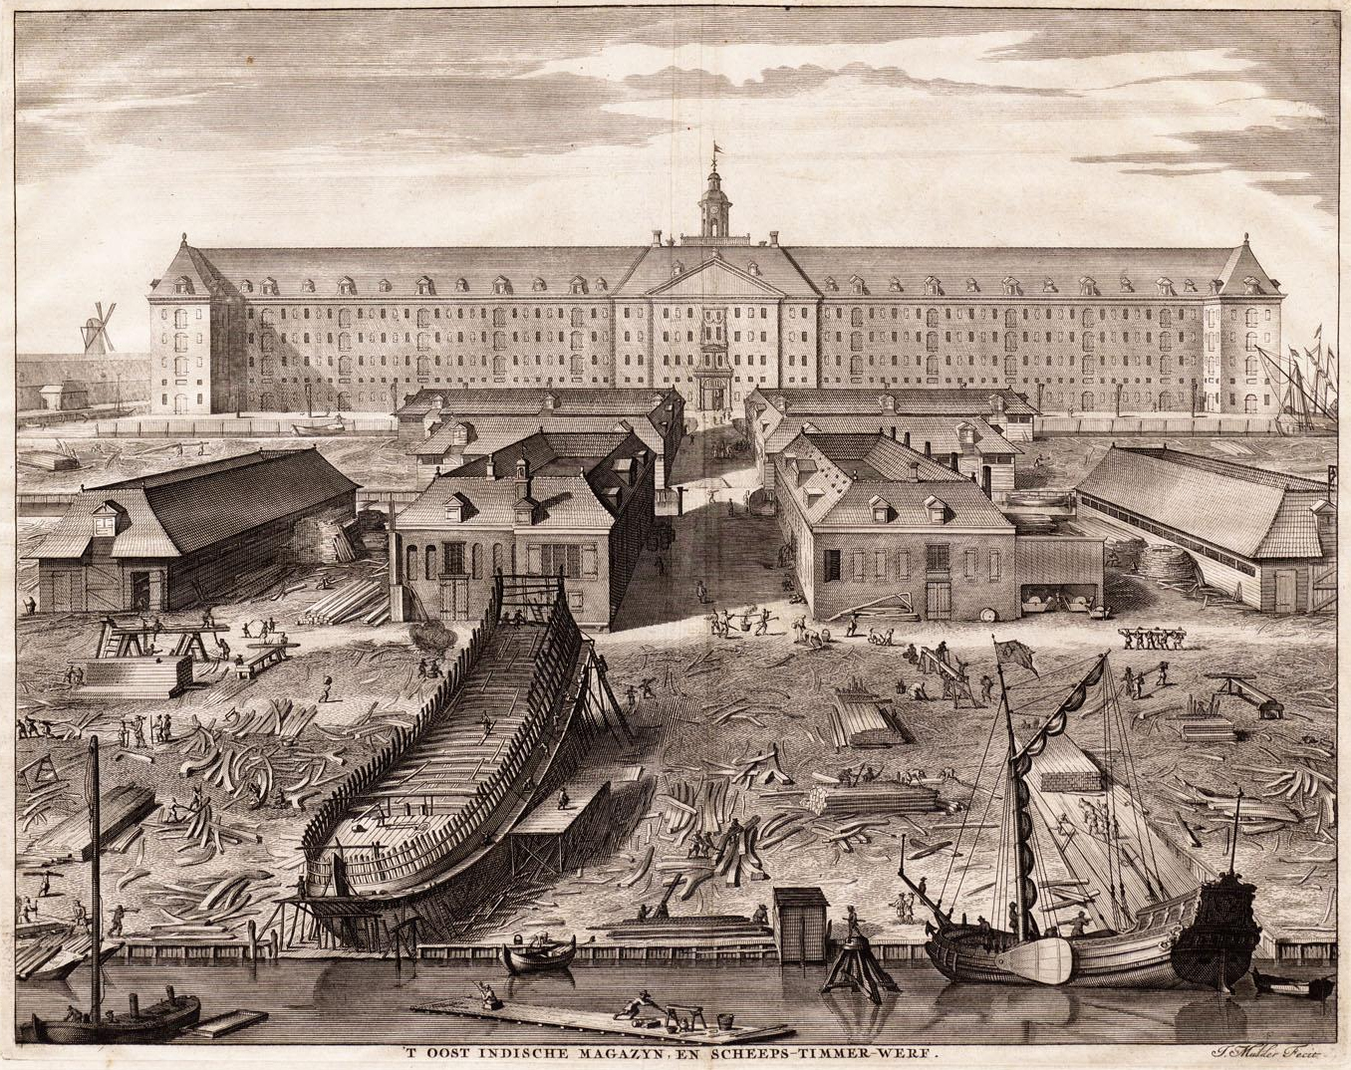
D. Dutch
1. Settled in S. Africa (Boers) and Indonesia
2. Joint-stock companies also controlled trade

Slide 30
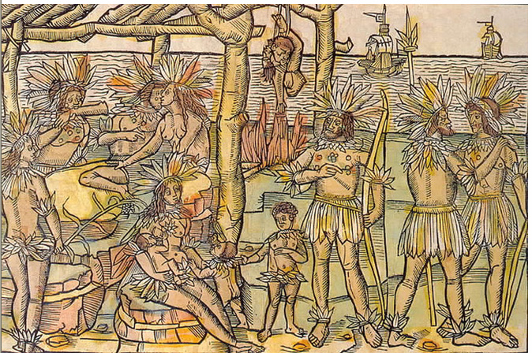

Slide 31
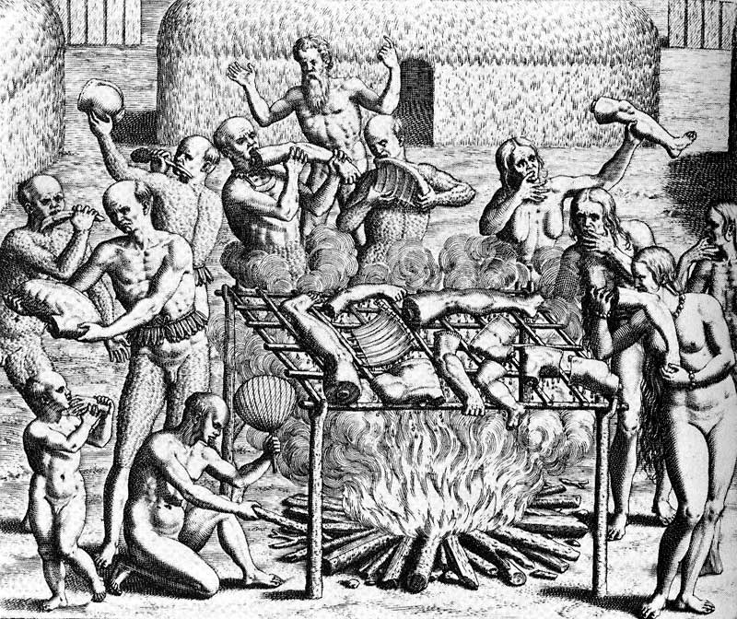
Warm-Up
What can these pictures teach us about the feelings of Europeans towards Native Americans?
Why are images like these so important to explaining the events of Conquest and Colonization?

Slide 32
Colonization in the New World
Using the notes that we just went over, fill in the worksheet about the countries that colonized the new world.
Pay close attention to how the different countries interacted with the Native Americans

Slide 33
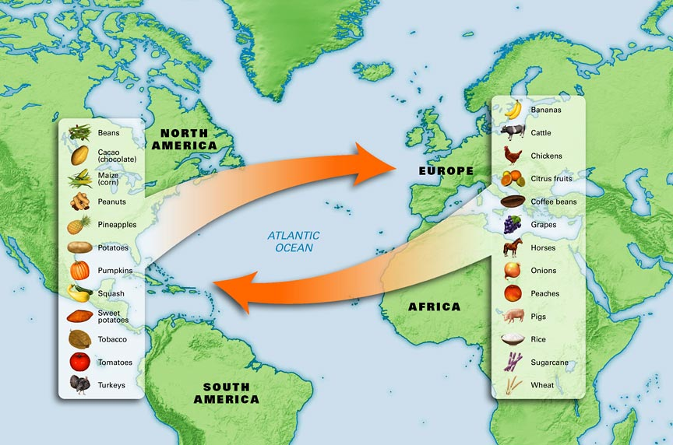
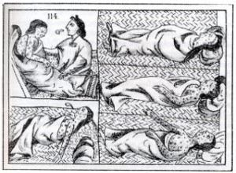
III. Columbian Exchange –
The exchange of goods between the Americas and Europe

Slide 34
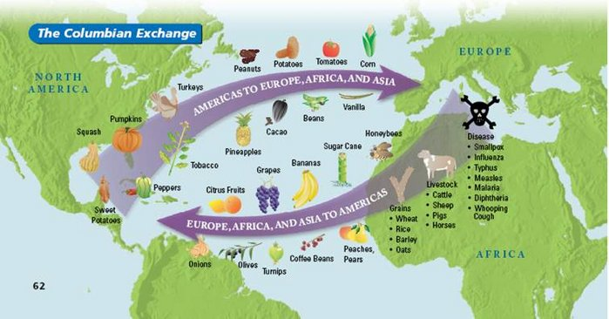
OLD WORLD
NEW WORLD

Slide 35
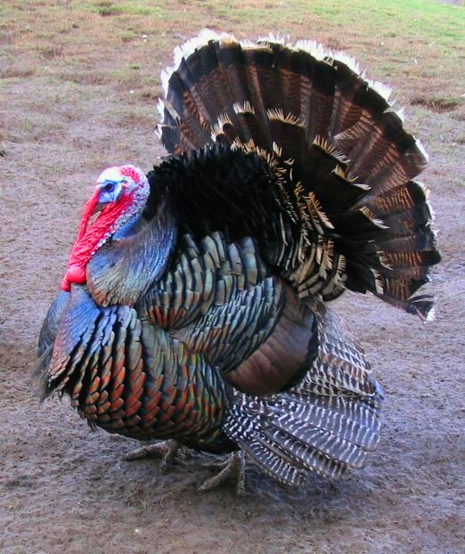
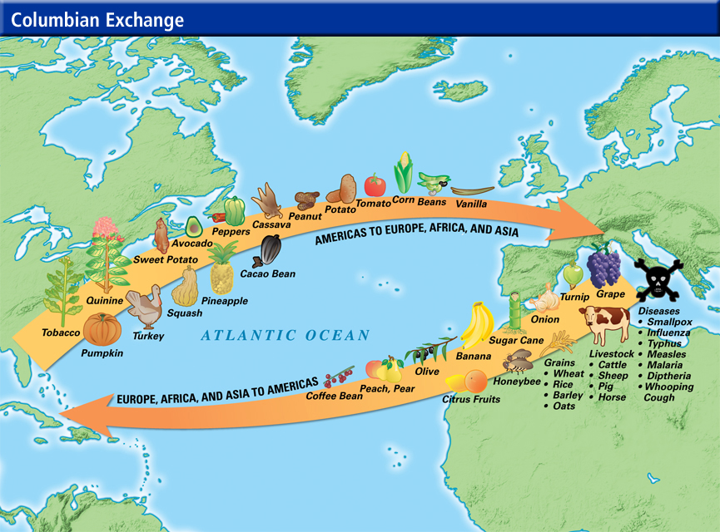
A. Americas to Europe
1. Animals: turkeys, fur from wild animals
2. Plants: potatoes, corn, chocolate, beans, peanuts, rubber, tomatoes, tobacco

Slide 36
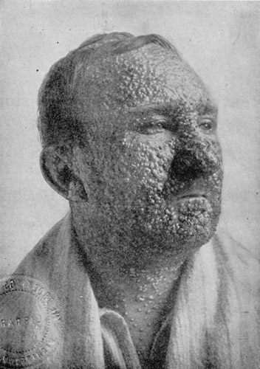
B. Europe to Americas
1. Animals: cattle, chickens, horses, rats, pigs, sheep
2. Plants: garlic, wheat, oats, sugar, lettuce, coffee
3. Diseases: influenza, malaria, smallpox

Slide 37
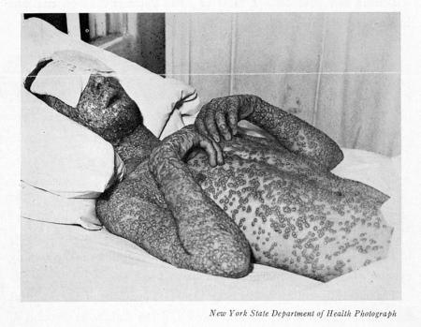

Slide 38
Columbian Exchange Map
With a partner, create a map of the Columbian Exchange covering the entire paper! Your map must include
- Both the New World and the Old World
- Arrows signifying the trade of goods between the continents
- Full lists of goods/disesases traded
- Color! (This is an “art” project after all)

Slide 39
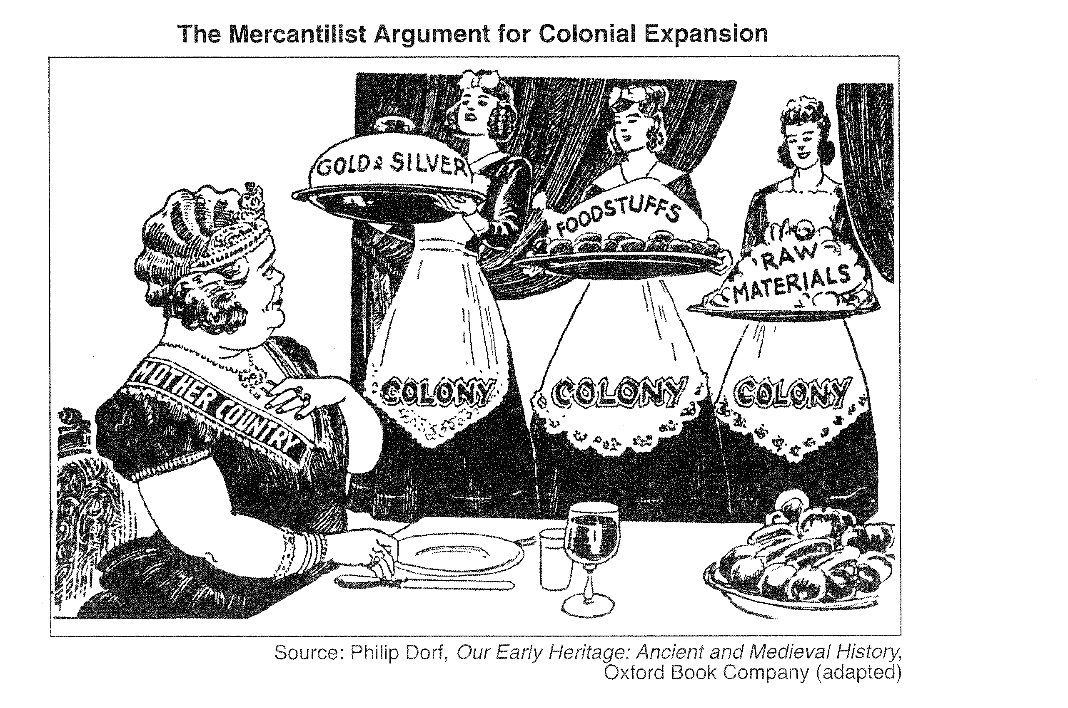

Slide 40
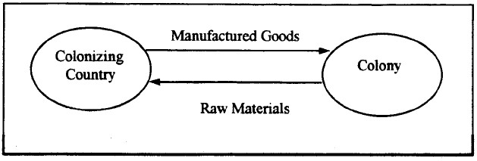
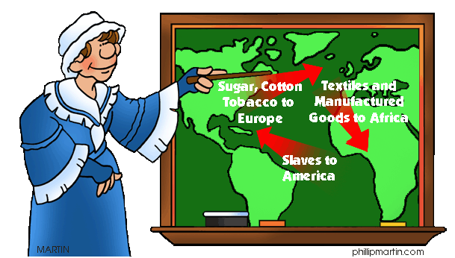
IV. Mercantilism
A. Economic philosophy that a nation’s strength depended on its wealth
B. Nations sought to export more than it imported and compete with other countries
C. Used colonies to get raw goods and turn into manufactured goods

Slide 41
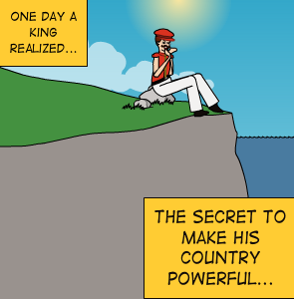

Slide 42
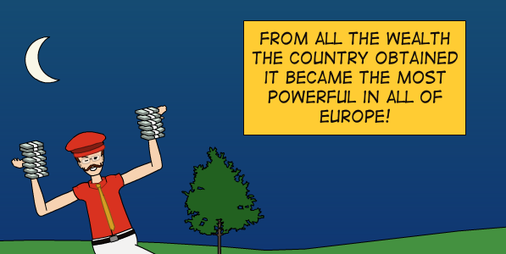

Slide 43
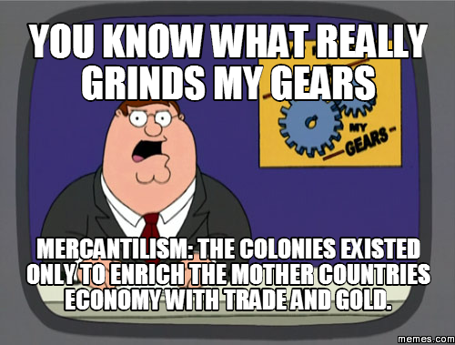

Slide 44
V. Origins of the Slave Trade
A. Colonies needed plantation workers but natives died of disease and indentured servants were temporary
B. Slave trade already in Africa, Europeans created a new market

Slide 46
C. Europeans set up slave ports in Africa to send to the Americas
D. Portuguese controlled then eventually British

Slide 49
VI. Triangular Trade - trade between Europe, Africa, and Americas
A. Europe to Africa: gave guns, manufactured goods
B. Africa to Americas:
1. Middle Passage- slaves harsh passage to the Americas
2. Most slaves taken to South America or Caribbean
C. Americas to Europe: raw goods (ex. Sugar and tobacco)

Slide 55
VII. Effects of the Slave Trade
A. Africa lost many strong youths and divided African tribes against each other
B. African Diaspora- spread of African peoples and culture throughout the world

Slide 56
C. Extremely harsh conditions for slaves in New world
D. Many slaves resisted rule in many ways- sabotage, running away, or rebellion
E. Created strong American economies

Slide 57
Triangle Trade Map
With a partner, create a map of the Triangle Trade ON TOP of the Columbian exchange map that you just did! Your map must include:
- Both the New World and the Old World
- Three Arrows signifying the trade of items between the continents (Hence TRIANGLE TRADE)
- Full lists of items traded
- Different colors than you used before

