Slide 1
NCFE Review
Day 3 - Units 7-8

Slide 2
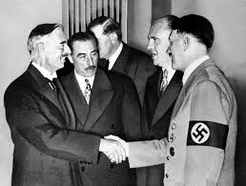
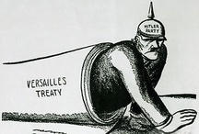
Causes of WWII
Appeasement – “Let’s give Hitler what he wants so he doesn’t start a war!”
Lesson from Kindergarten: if you give a mouse a cookie…he will invade Poland and launch a second World War
Hitler and Stalin’s Non-Aggression Pact – Keeps Soviet Union out of war (temporarily)

Slide 3
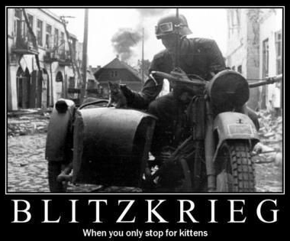
WWII
Blitzkrieg – “Lightning Warfare”
Hitler conquers France in 6 weeks – tries to invade Britain (Battle of Britain) but then someone got in the way….

Slide 4
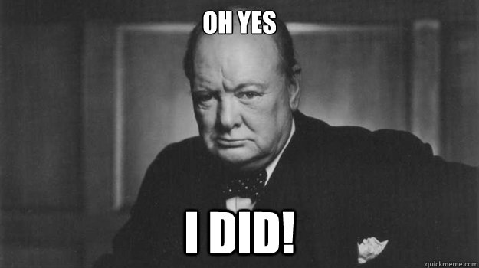

Slide 5
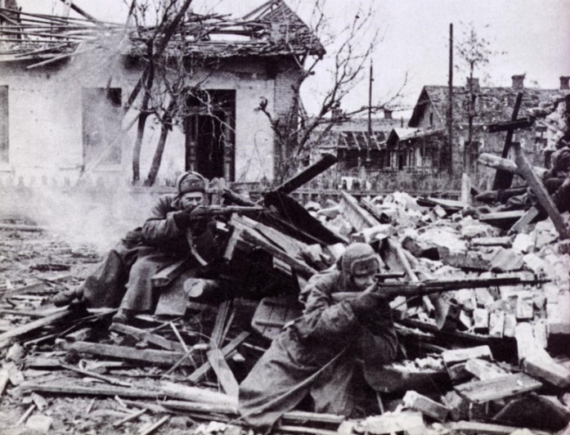
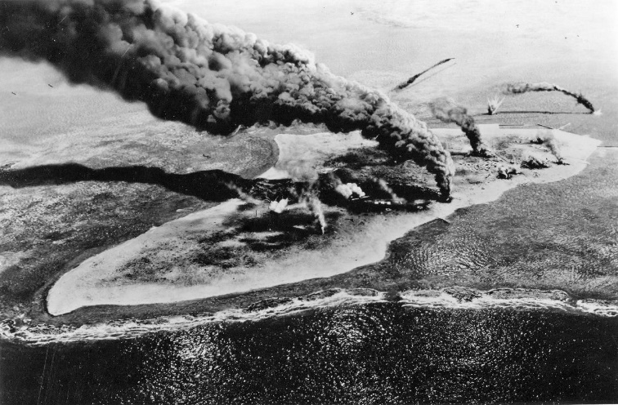
WWII
Stalingrad – turning point in the European war, Germans begin to retreat
Americans join war after Pearl Harbor
Midway – turning point in the Pacific war, Japanese begin to retreat
Island hopping towards mainland Japan

Slide 6
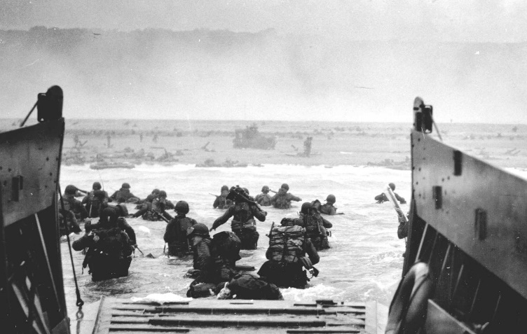
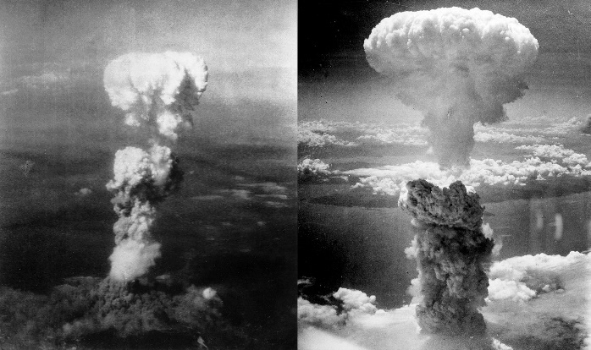
End of WWII
D-Day: Allies open up the western front after landing in France
(Germany is sandwiched again! GASP!)
Soviets reach Berlin first, Hitler kills himself
US uses A-bomb on Hiroshima and Nagasaki, Japan surrenders in August 1945
UN is created (League of Nations - new and improved!)

Slide 7
So war is over...everyone can be friends now, right?

Slide 8
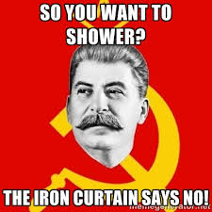
Stalin says…NO

Slide 9
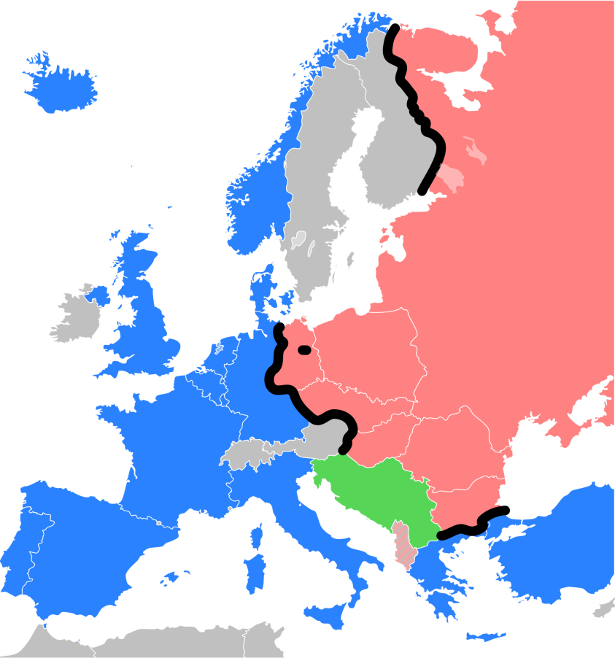
Beginning of Cold War
“Iron Curtain” = division between communist E. Europe and democratic W. Europe

Slide 10
Cold War in Europe
Opposing policies
Truman Doctrine - US will give money and military aid to stop spread of communism
Brezhnev Doctrine - USSR will give money and military aid to stop spread of democracy
Opposing alliances
NATO: led by USA
Warsaw Pact: led by USSR
What policy did the Berlin airlift and Marshall Plan fall under?

Slide 11
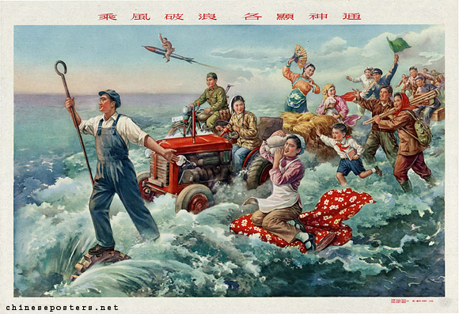
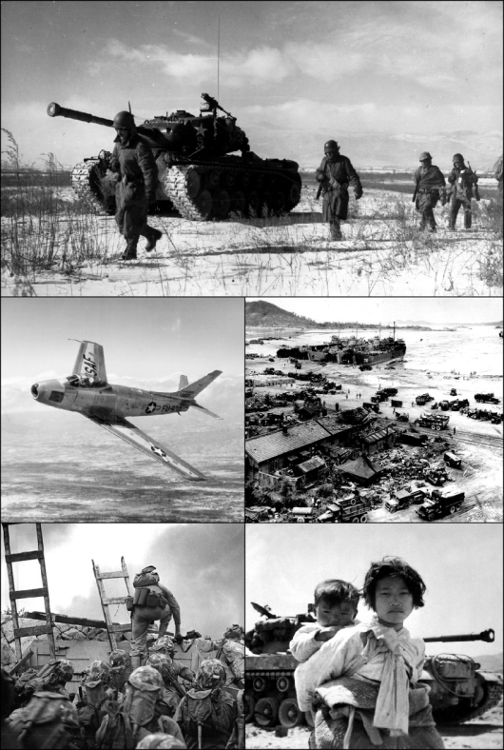
Cold War in Asia
China - Goes communist in 1949. Great Leap Forward and Cultural Revolution led by Mao Zedong
Korean war ends in stalemate at 38th parallel
India gains independence in 1947
Creation of Pakistan

Slide 12
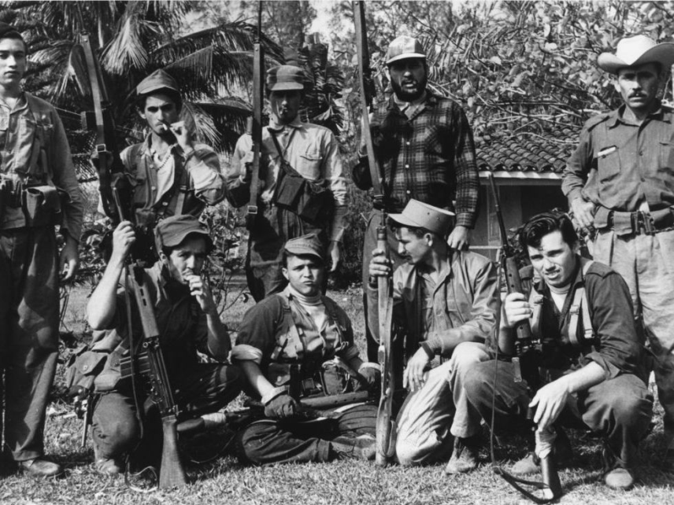
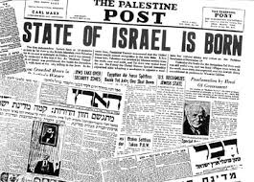
Cold War - Third World & Middle East
Cuba goes communist under Fidel Castro
US-led Bay of Pigs Invasion fails
After WWII, UN creates a Jewish state (Israel) in Palestine
OPEC embargos US for supporting Israel

Slide 13
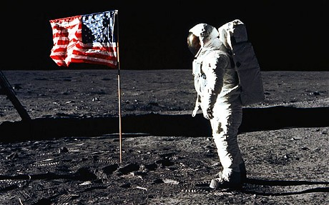
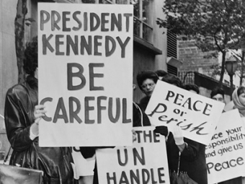
Cold War - Height of War
Space Race - US vs. USSR. Sputnik, then the moooon!
Arms Race - Who has more nukes?
MAD Theory (deterrence)
Cuban Missile Crisis - Soviets place missile launch pads in Cuba.

Slide 14
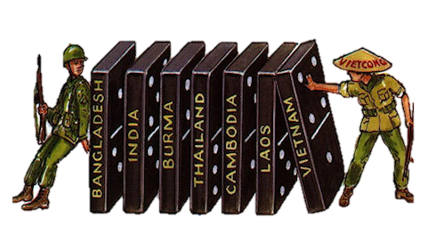
Cold War - Vietnam
US comes to the aid of S. Vietnam because of Domino Theory
US loses, Vietnam becomes communist

Slide 15
End of Cold War - “Détente”
Iranian Revolution - US Hostage crisis, damages US-Iranian relations
China - economic reform, protesters are killed during pro-democracy movement in Tiananmen Square (Tank Man!)
Soviet Union - Gives people more freedoms with glasnost and perestroika
Berlin Wall Falls in 1989
SU dissolved in 1991

Slide 16
Modern Era
Democratization - most countries in the world have embraced democracy since WWII
Elements of Democracy: Fair elections, competitive political parties, accountable leaders, personal rights, and independent court system
Globalization - reliance on other countries for ideas, trade, resources, etc.
NAFTA and the EU

Slide 17
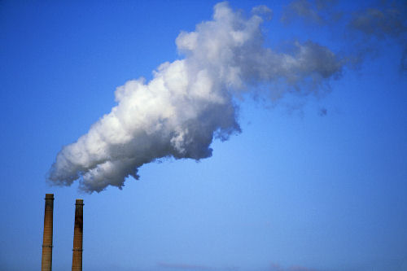
Modern Era
Developing Country: Low standard of living and poor economy
Apartheid, Rwandan Genocide, Darfur
Environmental Problems
Humans can do bad things to the earth. But you know this, you took Earth and Environmental

Slide 18
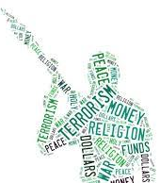
Modern Era
Terrorism - Using violence, fear and threats to promote a political, religious or ideological goal. 3 types:
Separatist
State
Religious
War on Terror
Afghanistan (2001-)
Iraq (2003-2011)

Slide 19
Modern Era
Technology

