Slide 1
NCFE Review
Day 1 - Units 1-3

Slide 2
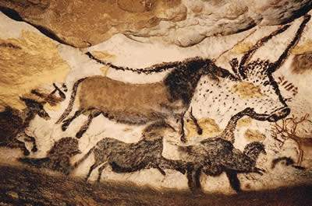
Prehistory & Neolithic Revolution
Prehistory: Time before human record (AKA writing)
People lived as nomadic hunter-gatherers
And then…..

Slide 3
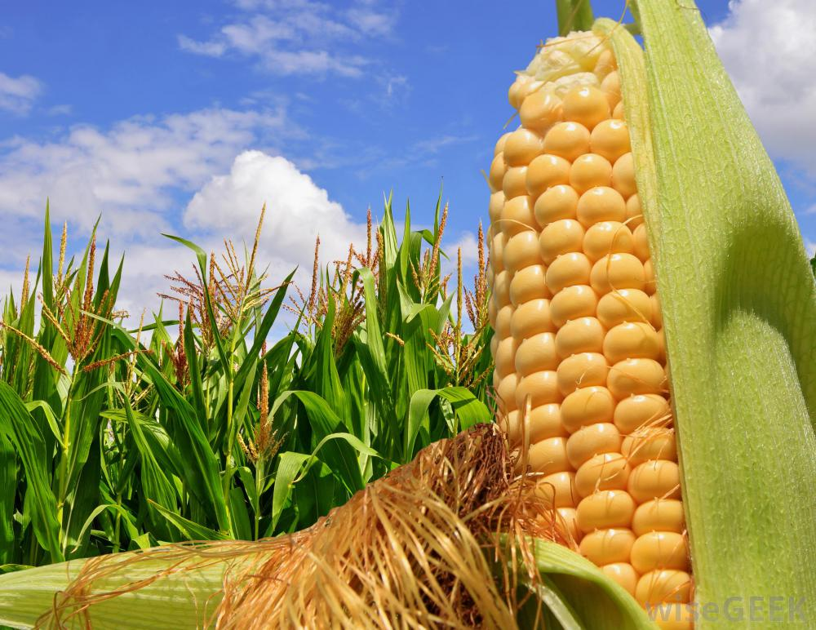
LET THERE BE FARMING!
Neolithic Revolution – when people went from nomadic hunter-gathering to settled civilizations

Slide 4
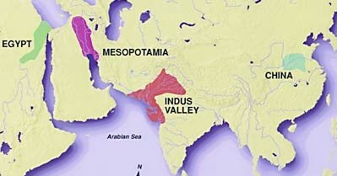
Four Early Civilizations
Mesopotamia, Egypt, India and China
All formed around rivers
Fertile land, animals and plants easy to domesticate

Slide 5
Early India and China
Hinduism – Polytheistic, goal to escape the cycle of reincarnation
Buddhism – Uses 4 Noble Truths and Eightfold Path to reach Nirvana
Confucianism – Emphasis on respecting authority and ancestor worshipping
Legalism – People are naturally bad and need a strong ruler to guide them (think Shi Huangdi)
Don’t forget the Mandate of Heaven!

Slide 6
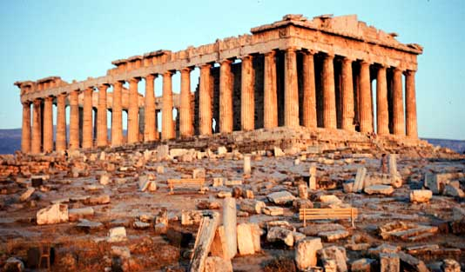
Ancient Greece
Made up of individual city-states, known as a polis
Athens - First Democracy
Sparta - War-like city-state. Military Oligarchy

Slide 7
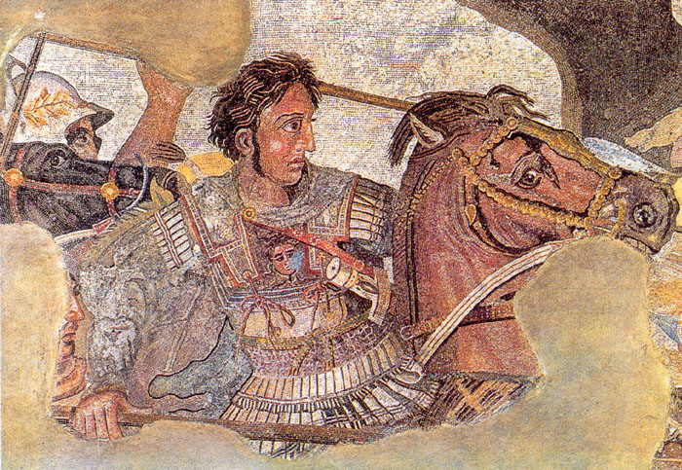
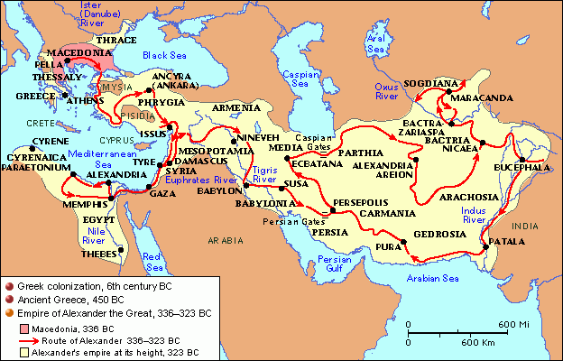
Ancient Greece
Greek Culture spreads through the conquests of Alexander the Great
Creates a Hellenistic World

Slide 8
Ancient Rome
Patricians - Elite landowning families, served in the senate
Plebeians - common people of Rome
Governed as a Republic until Augustus Caesar won a civil war and created the Roman Empire.
Pax Romana - “Peace of Rome”
Christianity spread throughout empire

Slide 9
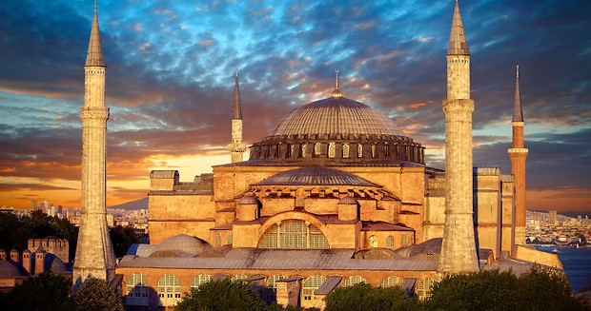
And then….
Weak Emperors, Bad Economy and BARBARIANS ruined everything.
But the Byzantines (E. Rome) were still pretty chill...making Justinian’s Code and stuff

Slide 10
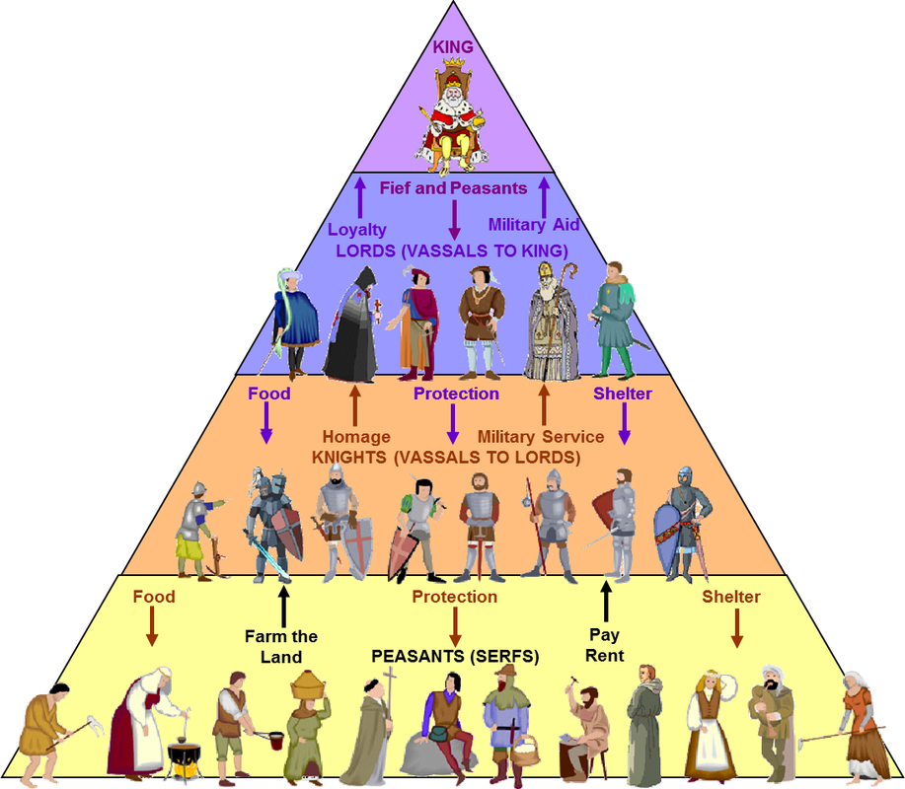
The Middle Ages
Territories in the W. Roman Empire had no government after fall of Rome
Peasants need protection, so the Feudal System is formed
Don’t forget the Battle of Tours and Charlemagne!

Slide 11
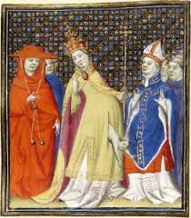
The Middle Ages
Christianity is made uniform, the Catholic Church gains power the Pope oversaw all Kings
Pope Urban II launches the Crusades to recapture Jerusalem for Christianity
Reconquista: Christians in Spain push out Muslim invaders

Slide 12
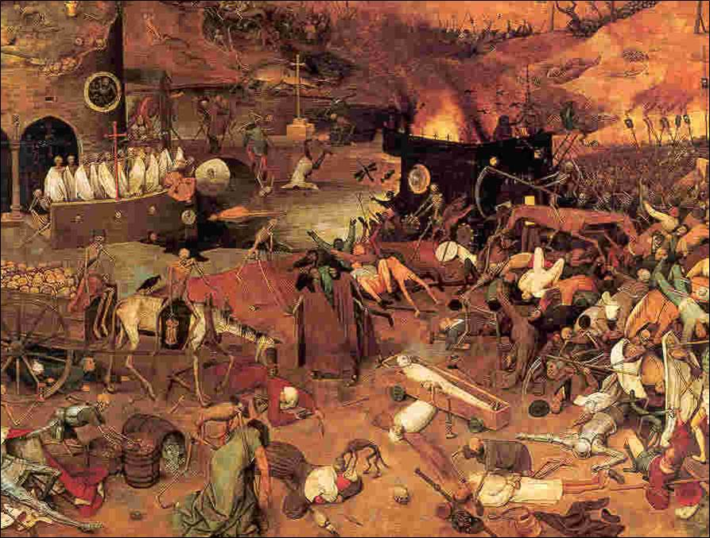
And then….
THE BLACK PLAGUE ruined everything
…or did it? (Peasants who survived had more rights and better pay!)

Slide 13
The Renaissance
Renaissance - “Rebirth” of learning and culture. Centered around Italy, based off the works of Greeks and Romans.
3 steps to humanism
Classical (greek and roman) education
Belief that individuals can achieve greatness
Secular/non-religious movement
Don’t forget Machiavelli!

Slide 14
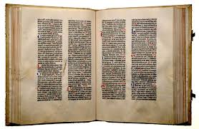
The Renaissance
Johannes Gutenberg invents the Printing Press with moveable type
Books can be produced cheaply, literacy increases, ideas spread quicker and more access to classic texts

Slide 15
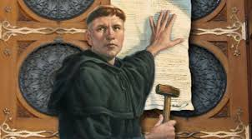
And then….
Martin Luther ruined everything
…or did he? (Writes 95 Theses, calls out the pope for being corrupt and starts the Protestant Reformation)

Slide 16
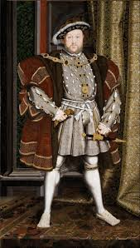
Protestant Reformation
Henry VIII makes England the first major country to join the Reformation (makes Church of England. Gets another wife. Chops her head off)
Catholics respond with the Counter-Reformation. Eliminated some of the corruption, but maintains core catholic beliefs

Slide 17
Africa and Aztecs/Incas
Africa - very few farmable lands. Leads to development of Pastoralist Clans
Aztecs - Capital was built inside a lake…so they built farms ON THE LAKE! (they’re called Chinampas)
Incas - Settled in Andes Mountains, built Terrace farms to compensate for rocky geography.
Oh, and the Aztecs practiced human sacrifice and the Incas had quipu. Don’t forget that.

Slide 18
Islamic Empires
Ottoman Empire: centered around Turkey, strong military with Janissaries, reformed and expanded by Suleiman the Magnificent
Conquers Constantinople
Safavid Empire: located in Persia, SHI’IA
Mughal Empire: First Islamic empire in India, Built Taj Mahal. Sikhism (blend of Hinduism and Islam) develops under their rule

Slide 19
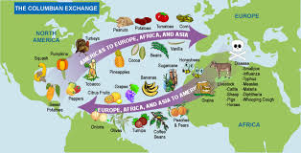
Exploration
Columbus opens up trade between the New World (Americas) and Old World (Europe) called the Columbian Exchange
New food in Europe = Population increases
Scary diseases in America = Native American population destroyed

Slide 20
Colonization
Mercantilism = More Money, More Power
Countries used colonies to extract gold, silver and raw materials for $$$
Joint-Stock Companies: Spread the risk, spread the reward
Triangular Trade
Europe to Africa: Manufactured Goods
Africa to Americas: Slaves
Americas to Europe: Raw materials
Repeat Process

Slide 21
Later Chinese Dynasties
Tang/Song Dynasties - Golden Age. Invention of porcelain, paper money, printing press, etc.
Mongolians - conquered using horse-back archers and creating Tributary States
Pax Mongolia
Ming Dynasty: overthrew the Mongols, restored Confucianism and traditional Chinese culture
Zheng He’s exploration…and then ISOLATION

Slide 22
Feudal Japan
Emperor’s power overshadowed by the Shogun (supreme military leader)
Tokugawa Shogunate - Restored stability and central rule to Japan after years of chaos
Japanese Feudal System:
Shogun
Daimyo
Samurai
Peasant

