Slide 1
The “Interwar” Period

Slide 2
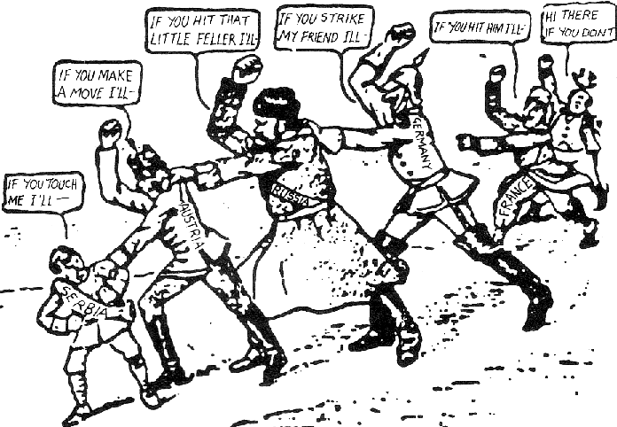
Bell-Work
Describe the “cause of WWI” seen in this picture.
What exactly is going on?

Slide 3
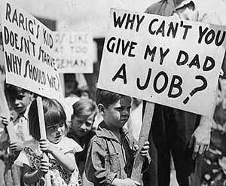
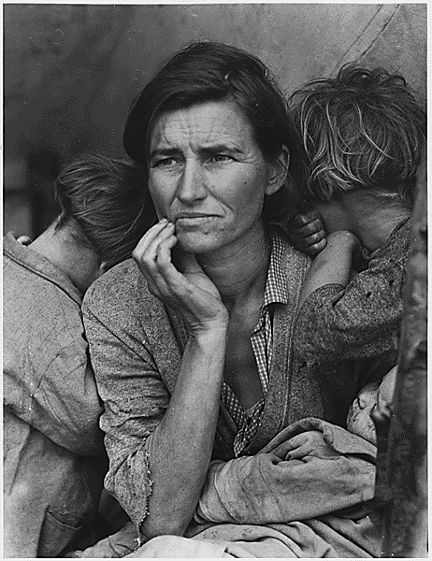
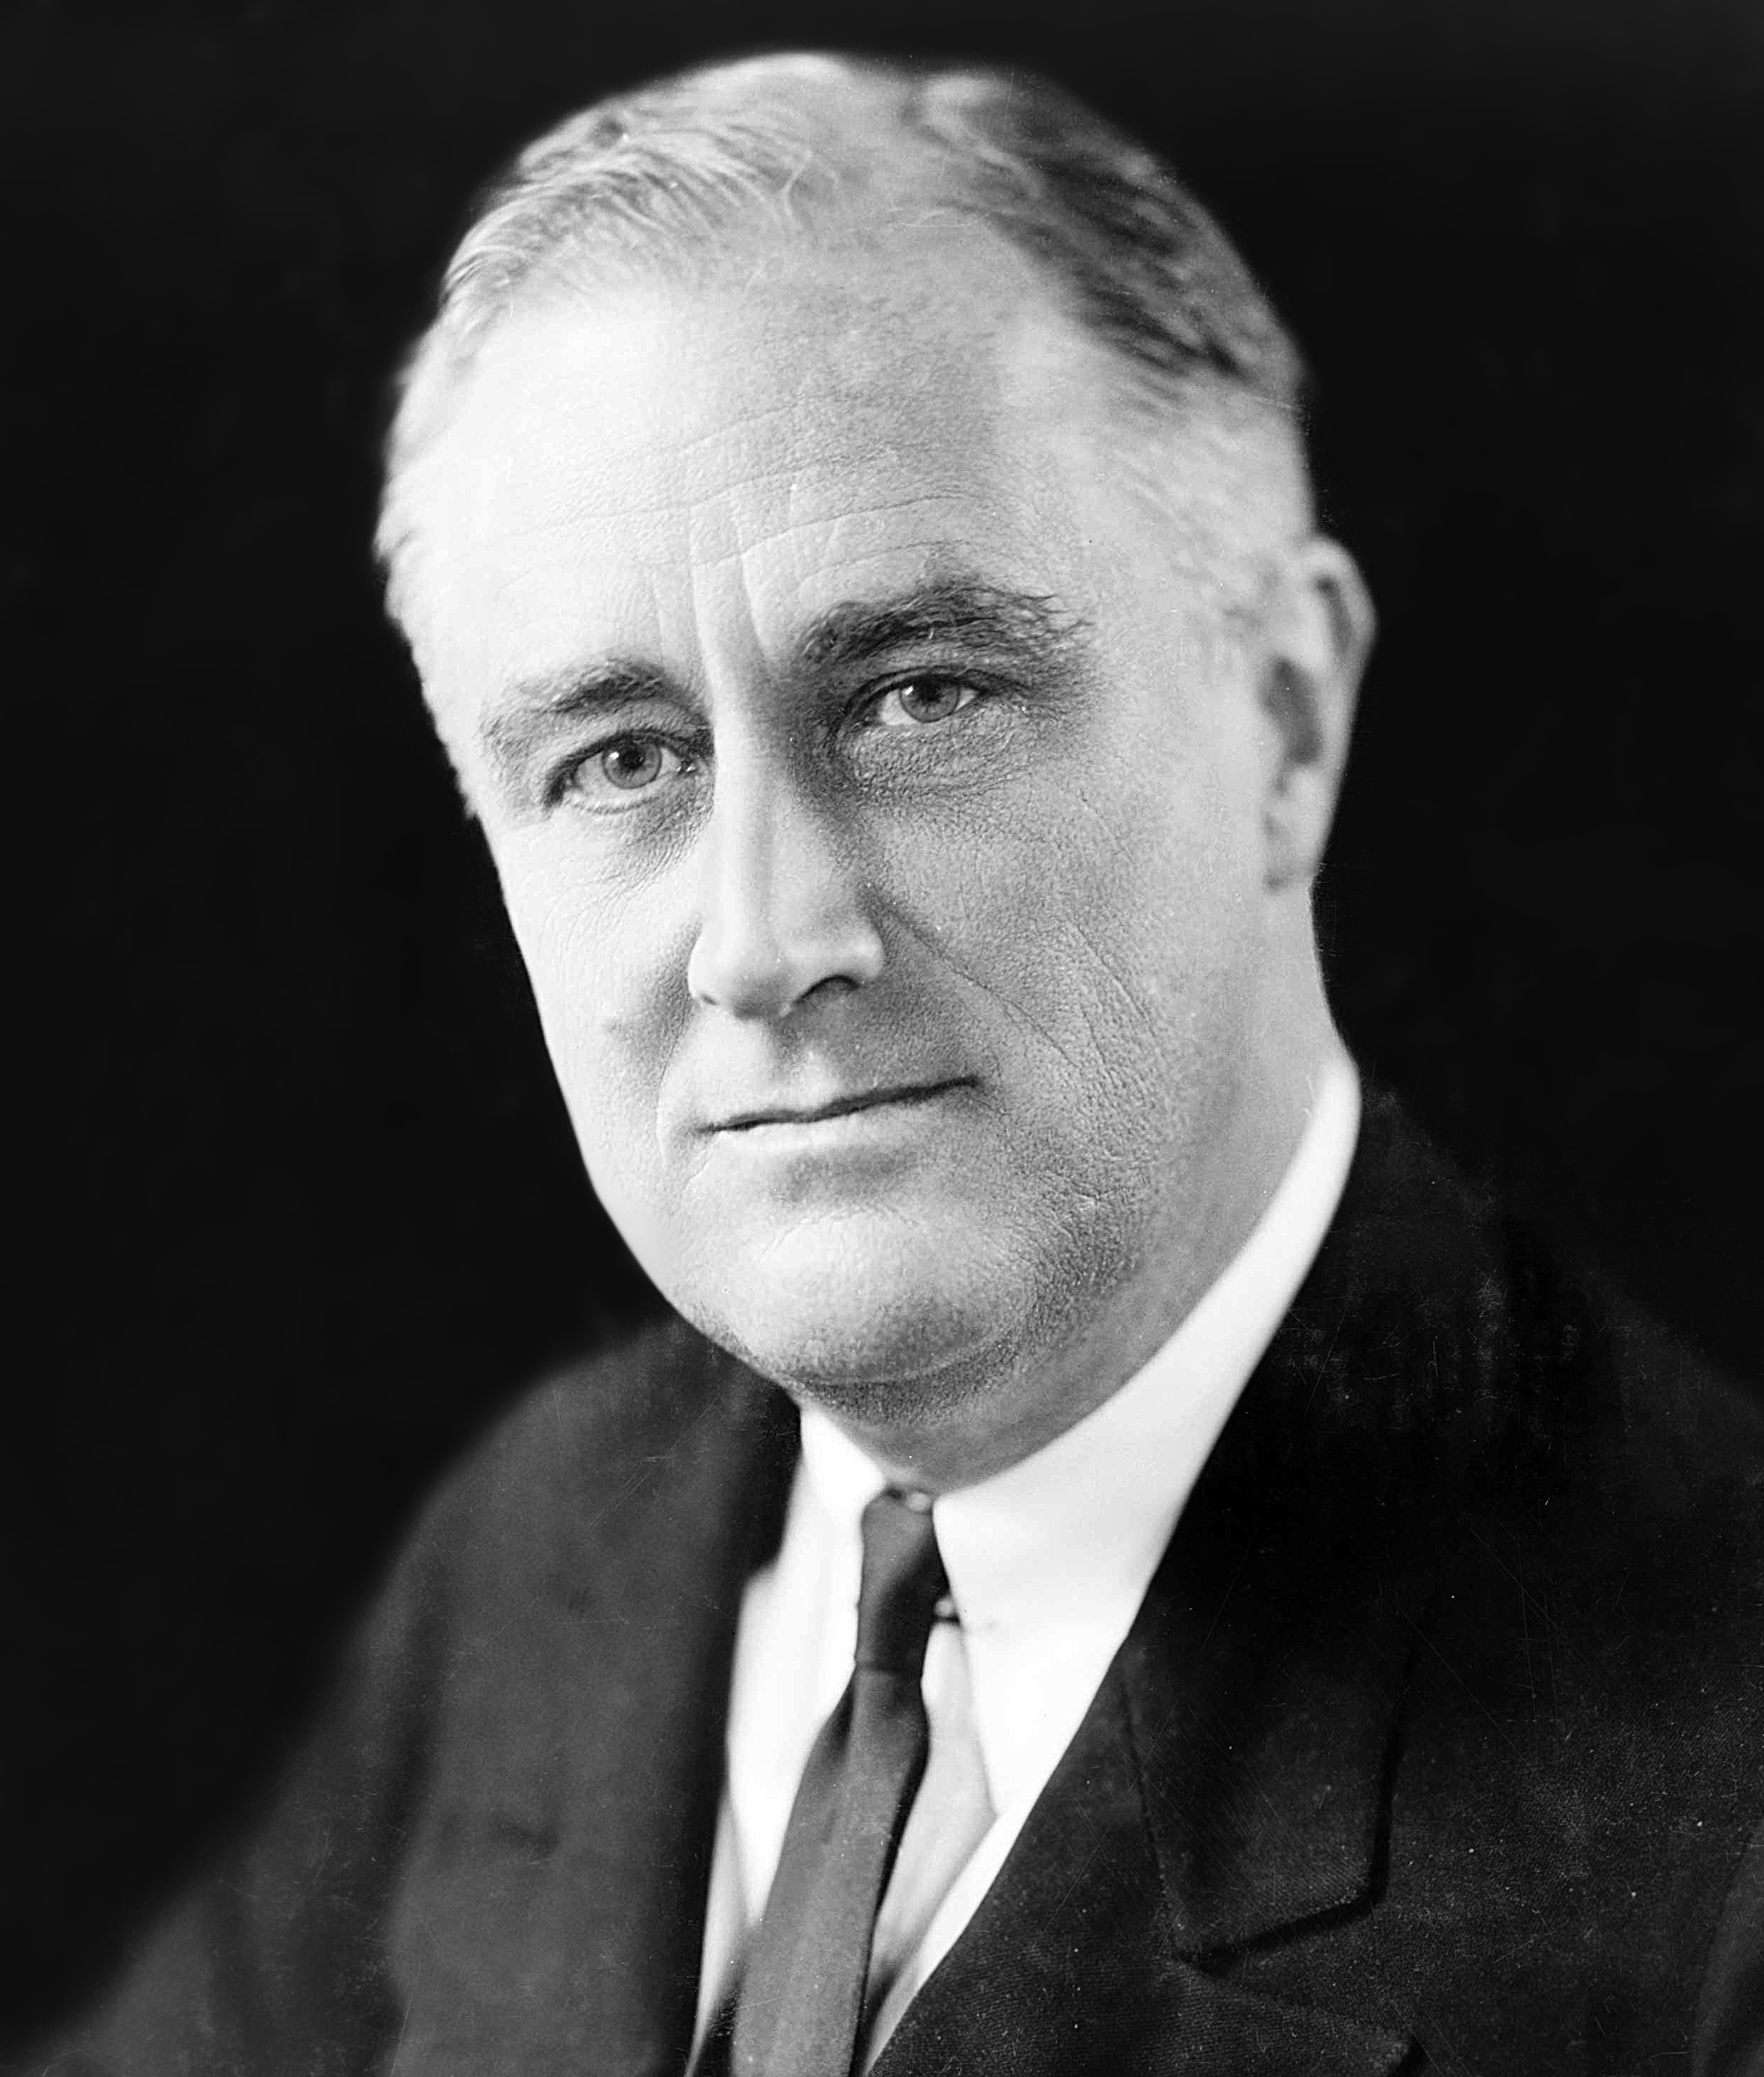
I. Global Depression
A. American Economy
1. After WWI, US lead manufacturer and lender
2. Great Depression- American economy began to fail in 1929 when the stock market crashed
3. Franklin Roosevelt was elected President and increased gov’t spending but decreased foreign trade

Slide 4
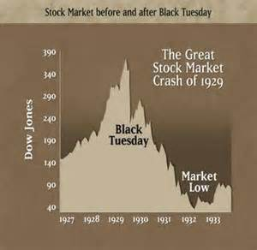
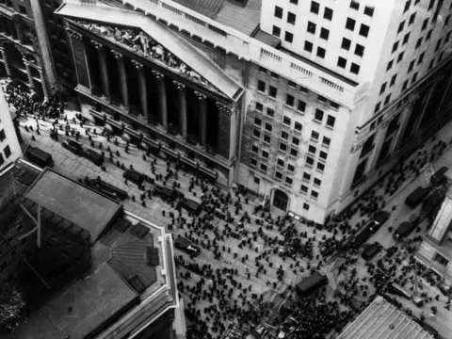
America the Story of Us
https://www.youtube.com/watch?v=fFu7us6bNSQ
http://www.dailymotion.com/video/xwivt2_america-the-story-of-the-us-bust-9-12_people

Slide 5
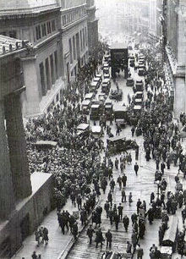
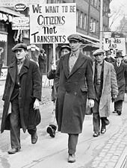
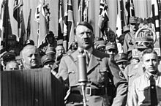
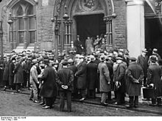

Slide 6
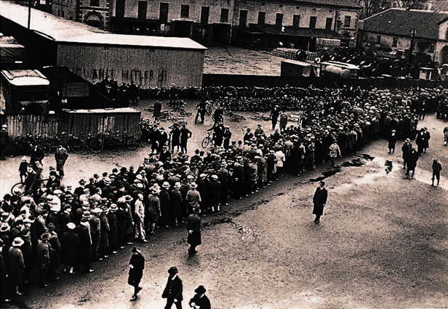
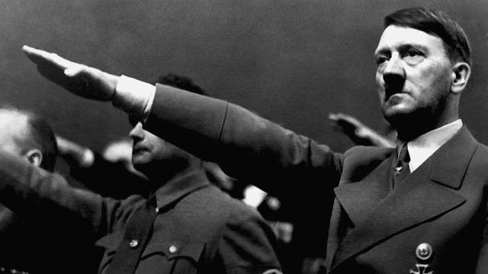
D. The global depression helped pave the way for dictators
US loaned to Germany. Germany paid Allies. Allies paid US.

Slide 7
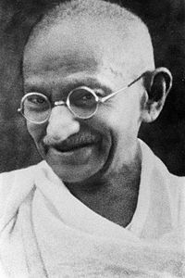
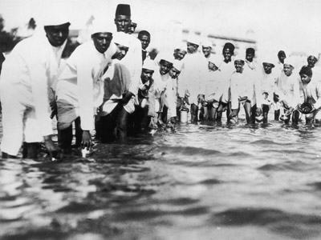
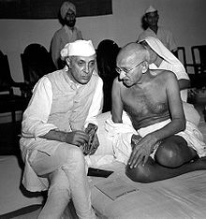
II. Changes in Asia
After WWI, Europeans started losing control of their imperial colonies
India
1. Gandhi led a nonviolent movement of civil disobedience

Slide 8
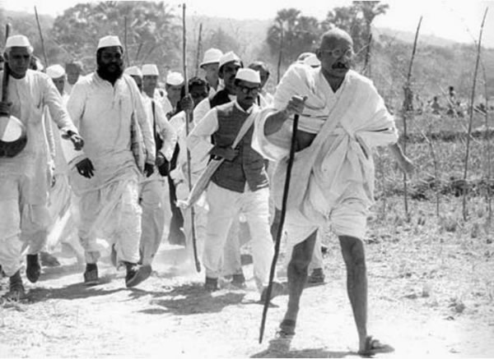
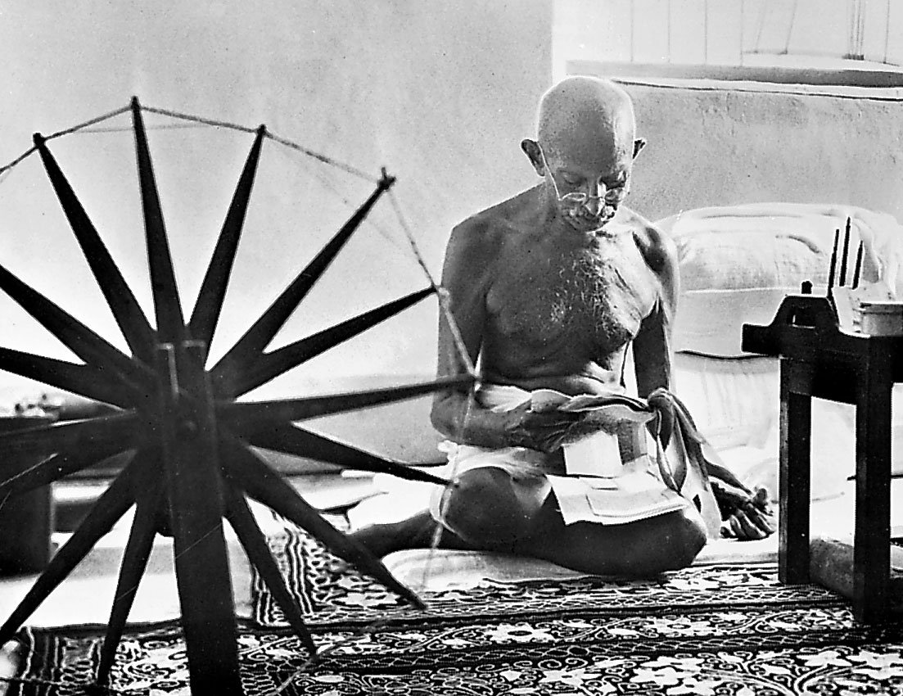
2. He promoted India industries through a salt march and boycott of British textiles

Slide 9
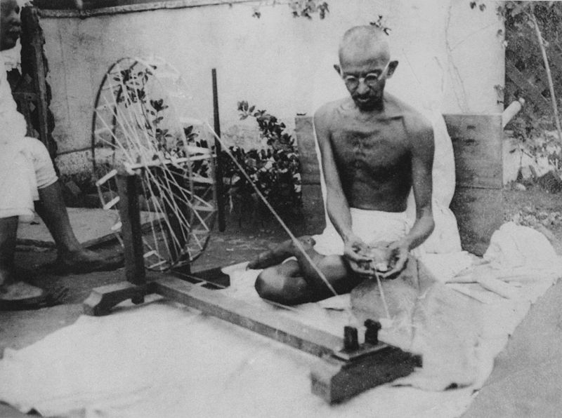
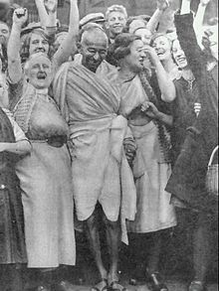
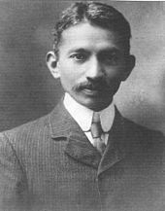
Gandhi

Slide 10
Civil Disobedience Jallianwalla Bagh Massacre
https://www.youtube.com/watch?v=3GG_4UaCD8E
https://www.youtube.com/watch?v=XE9_zB8k_lk

Slide 11
Gandhi’s Example…
Partner up with someone close to you.
One partner will read the article on the front of the sheet and the other partner will read the article on the back side.
Each partner needs to read their own article and then summarize it for their partner. After reading/summarizing, both partners can help each other answer the questions
Answer the questions on the worksheet and then place on a new sheet of paper in your notebook. This will be graded.

Slide 12
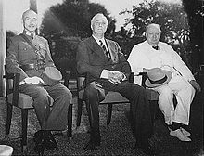
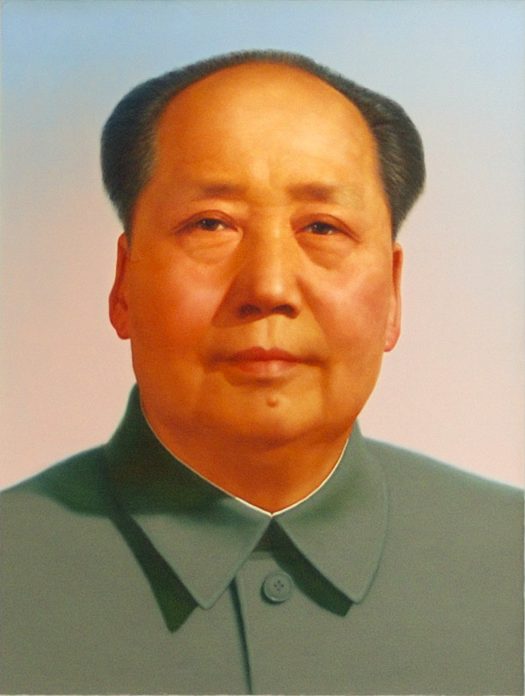
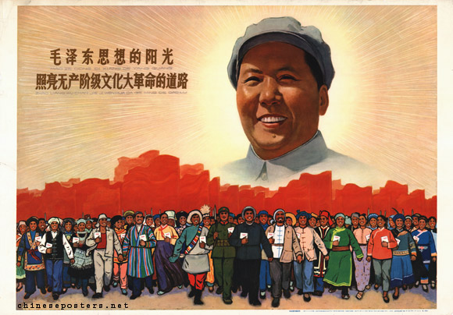
C. Chinese Civil War (1934-1949)
1. The weak Qing Dynasty ended in 1911 and
Nationalists gained power led by Chiang Kai-shek
2. The communists, led by Mao Zedong, were forced to retreat

Slide 13
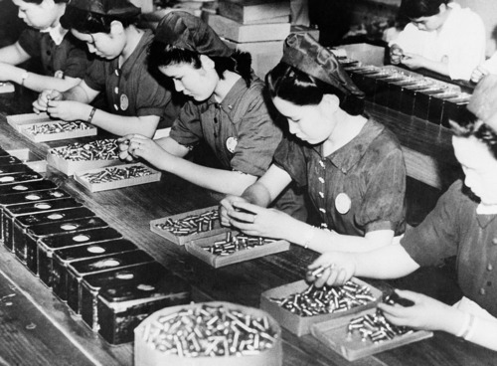
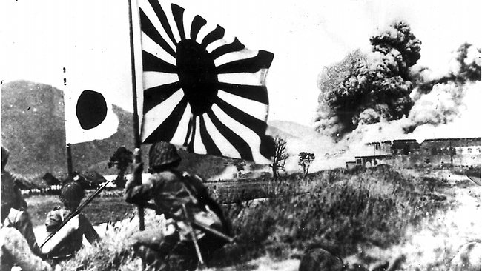
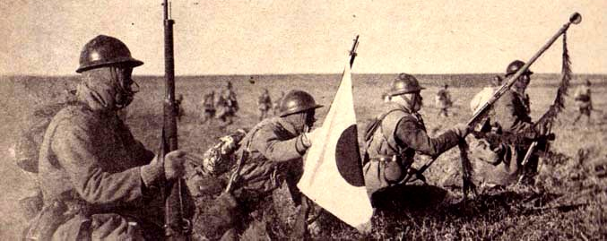
D. Japanese Militarism
1. Japan needed to expand outward to industrialize its economy
2. Japan conquered Korea and Manchuria

Slide 14
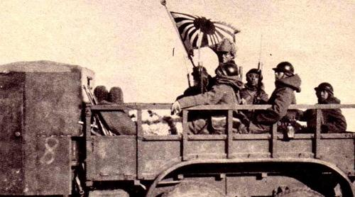
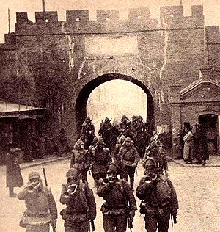
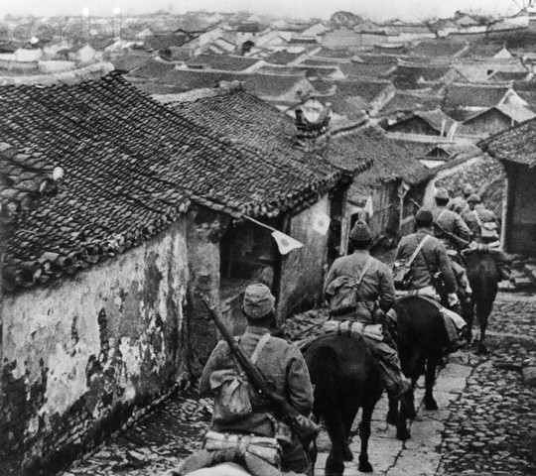
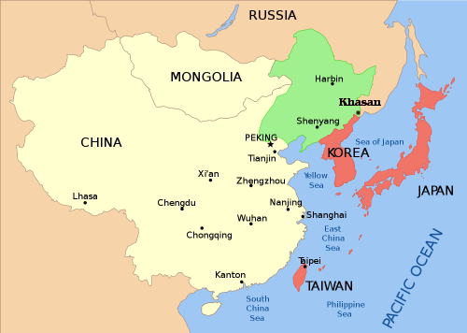
3. Japan invaded China in 1937
a. Nanking Massacre- over 100,000 killed in capitol
b. war and occupation in China cost the lives of millions of civilians

Slide 15
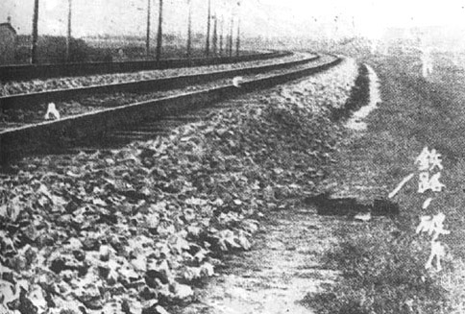

Slide 16
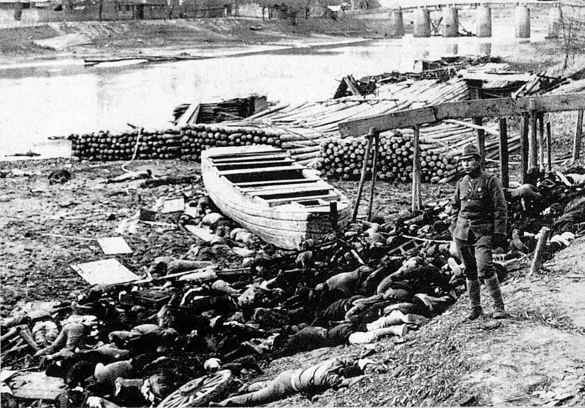
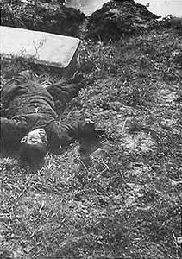

Slide 17
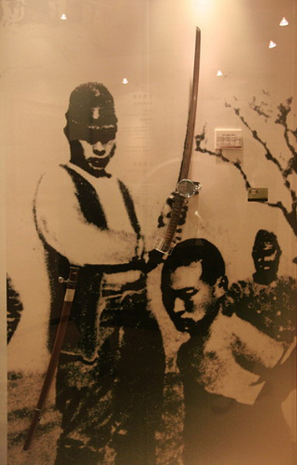
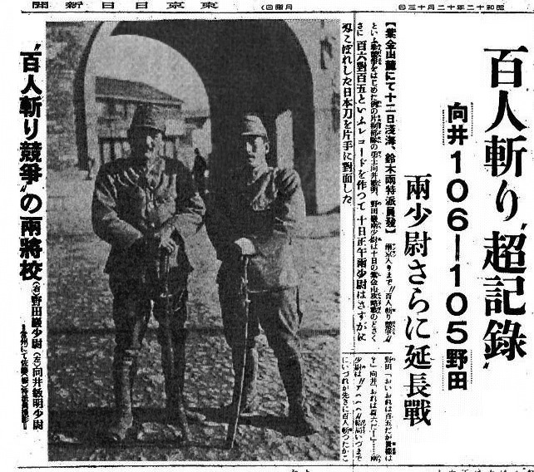

Slide 18
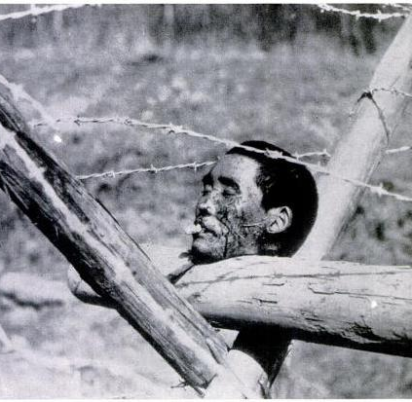
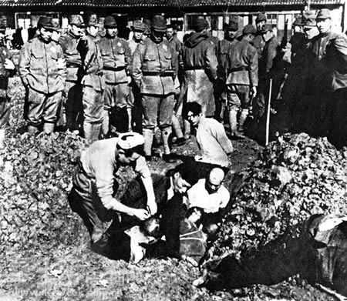

Slide 19
Day 2 – The Rise of Dictators

Slide 23
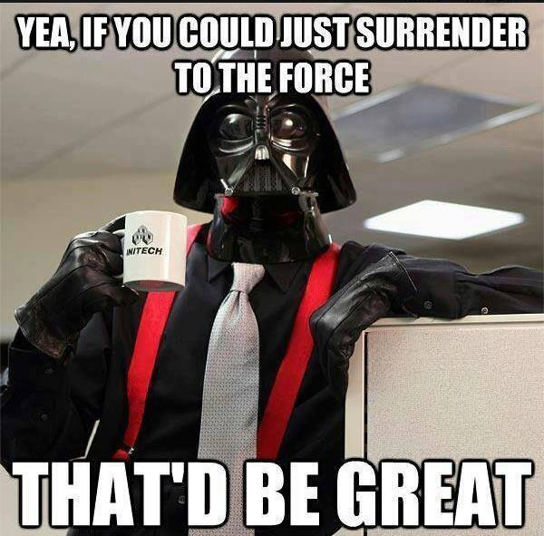

Slide 25
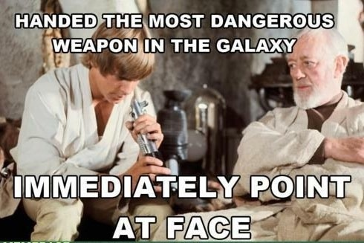

Slide 27
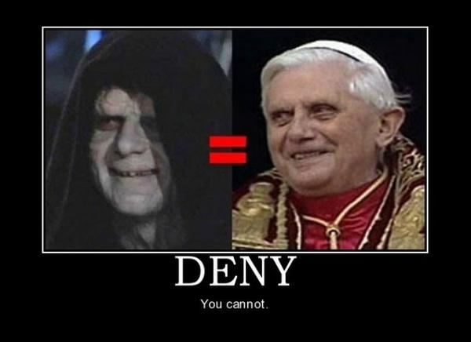

Slide 29
Warm Up…
1. How will Japan’s invasion of China lead to their eventual participation in WWII?
2. How will the Great Depression lead to WWII?
3. Did Gandhi’s platform of non-violence work?

Slide 30
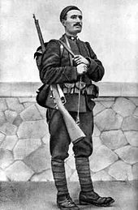
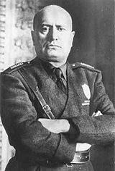
III. Rise of Dictators in Europe
A. Italy
1. Benito Mussolini- took over the Italian gov’t w/out force in 1922
2. His political philosophy was fascism- powerful gov’t, control over society, and nationalism
3. Introduced totalitarianism- when gov’t tries to control all aspects of life
“Everything within the state, nothing outside the state, nothing against the state” – Benito Mussolini

Slide 31
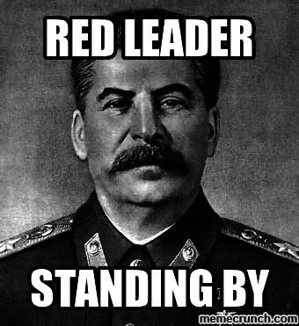
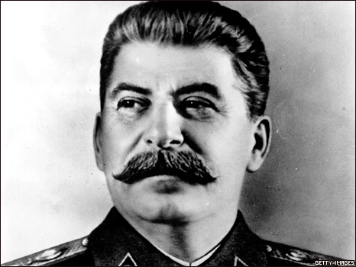
B. Soviet Union
1. After Lenin died, Josef Stalin came to power and controlled all aspects of life
2. He industrialized through central plans to govern every element of the economy

Slide 32
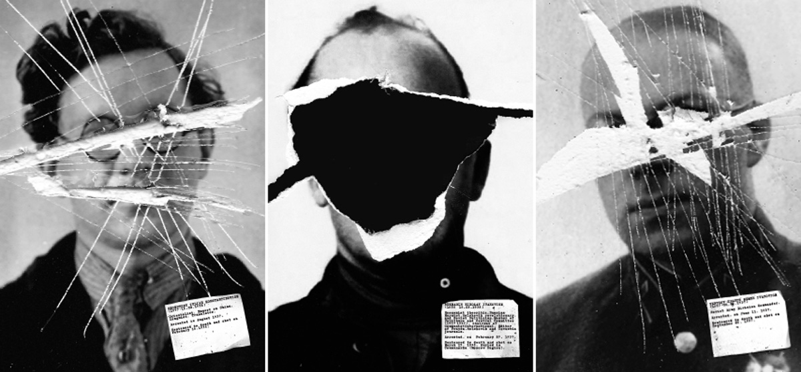
I CLEANED UP MY FRIENDS LIST
BEFORE IT WAS COOL
3. Great Purge- Stalin killed up to six million of his own people that he believed were plotting against him

Slide 33
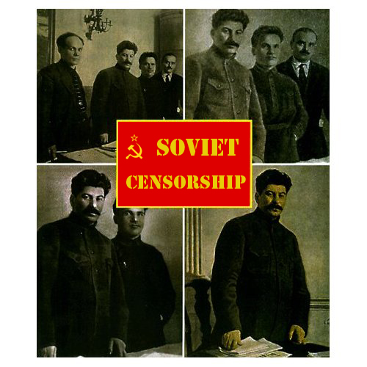
Spot the Difference: Stalin’s Purge Edition

Slide 34
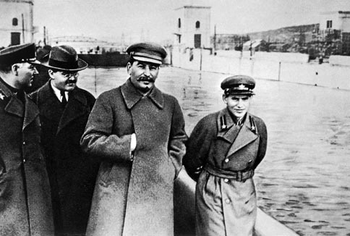

Slide 35
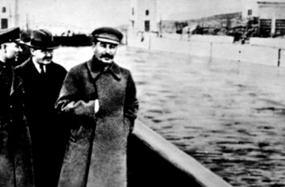

Slide 36
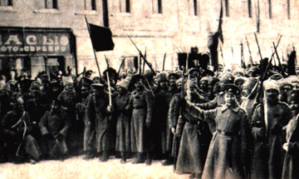

Slide 37
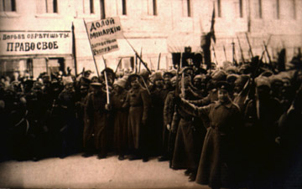

Slide 45
TOO SOON?

Slide 46
C. Germany
1. Germany was humiliated by the Versailles Treaty
2. Adolf Hitler gained power with his fascist party (Nazi Party) through public speaking
3. Hitler was elected chancellor and used his position to stop any opposition
4. Jewish rights were restricted in Nazi Germany

Slide 48
Versailles Conference
Countries: 1. Austria-Hungarian Empire, 2. Germany, 3. Ottoman Empire, 4. France, 5. United States of America, 6. Great Britain, 7. Minor nations of Eastern Europe, 8. Italy, and 9. Japan.
Your Task:
What is the major thing your country wants from this meeting?
Figure out your country’s answer to the resolutions.
which issues are the most important and which issues are you willing to exchange a vote for in order to get what you want.

Slide 49
Resolutions: (Be sure to put your “country” at the top of your page)
1. Who is responsible for the war? Why?
2. What punishments (financial reparations, military, territory) should be given to those responsible?
3. What should be done with the multi-national states of Austria-Hungary and the Ottoman Empire?
4. Should European colonies remain as they are, be given independence, or should ownership be redistributed?
5. What must be done to prevent war in the future?
(Answer in complete sentences on a separate sheet of paper with names at the top)

Slide 50
Source Activity and Review
Though you will once again be allowed to work in partners, each person will be responsible for filling out the answers on their own Interwar Partner Source Activity sheet.
As a team, read through the articles and answer the respective questions on your sheet. Once you have finished one article, you may come to the front to exchange it for another. Keep the process going until you have answered ALL questions.

Slide 51
HEADS UP Review!!
Armenian Genocide

Slide 52
Bell-Work
How did Hitler come to power?
What was Mussolini's political philosophy?
What was the Sino-Japanese war? Who won?
Describe the Chinese civil war!
Why was our WHOLE WORLD in a GREAT DEPRESSION?!?!

Slide 53
AFTER THE TEST!
Make sure that you have answered at least ONE set of questions from the Gandhi sheet that I gave out yesterday.

