Slide 1
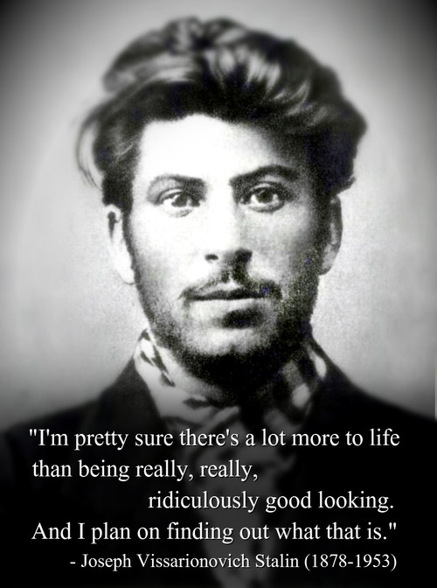
The Russian Revolution

Slide 2
Map-a-Moscas!

Slide 3
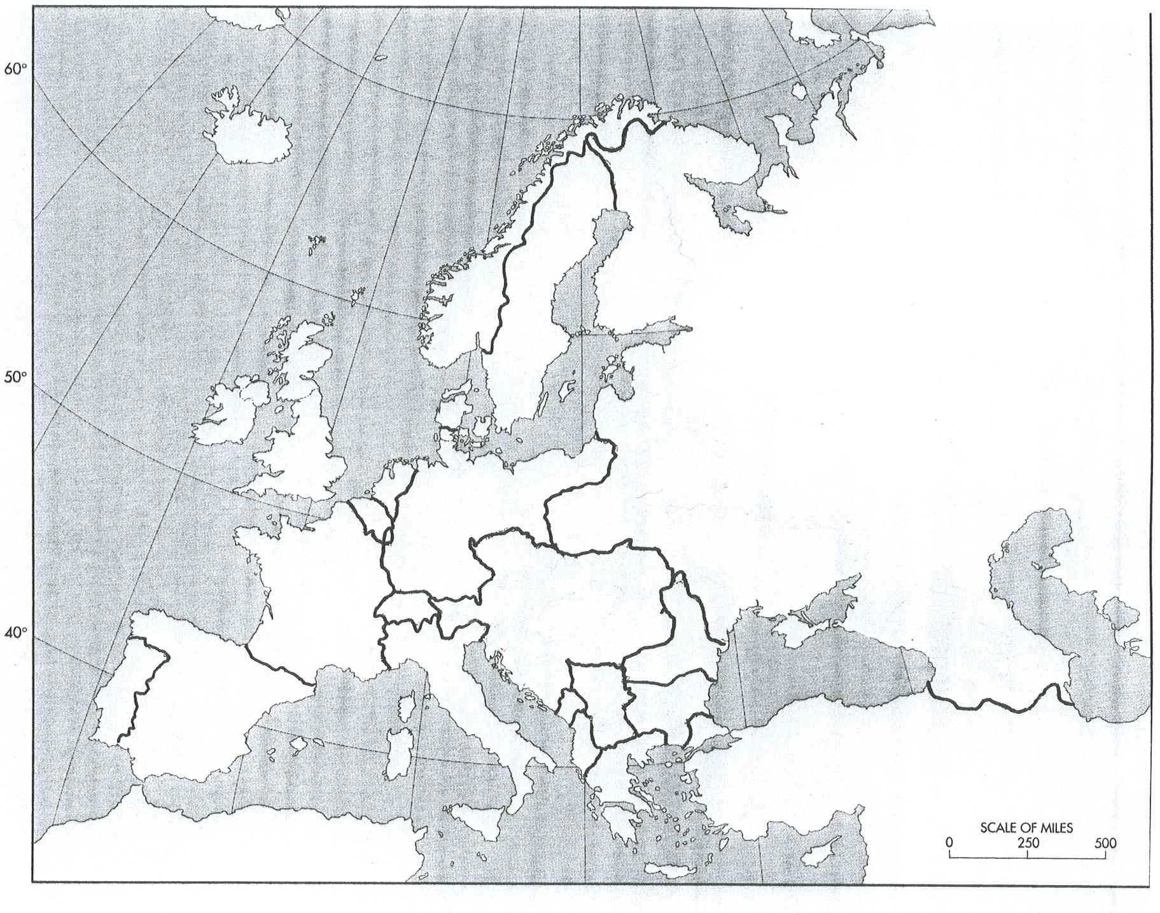

Slide 4
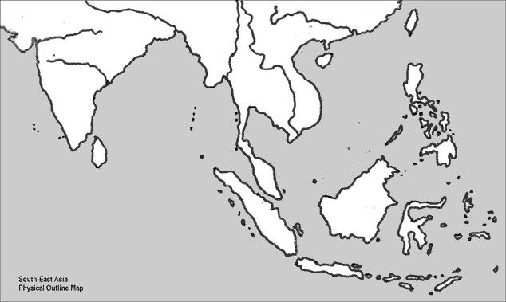

Slide 5
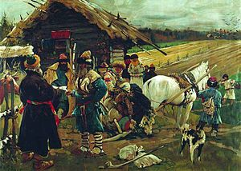
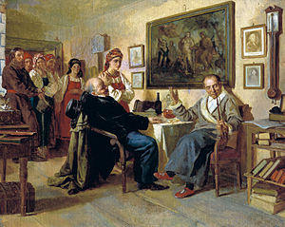
I. Causes
1. Citizen unrest- Russians had a previous Revolution in 1905
2. Social Inequality- Russia still had a feudal society where the workers were far below the nobles
3. Political corruption and failure of Parliament

Slide 6
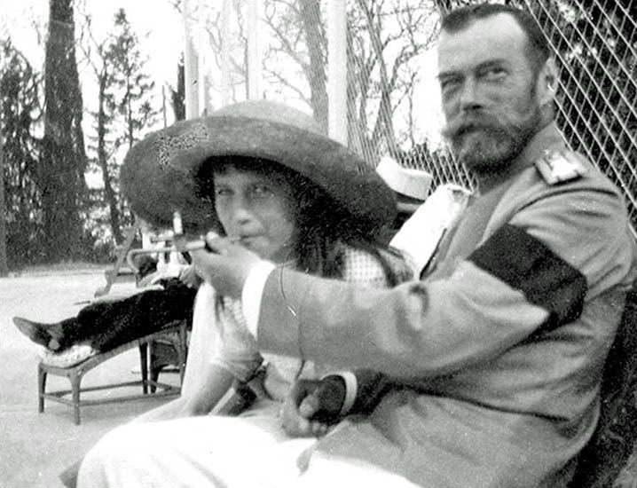
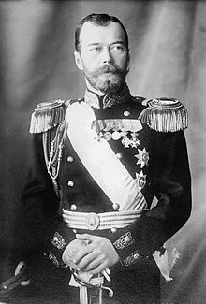
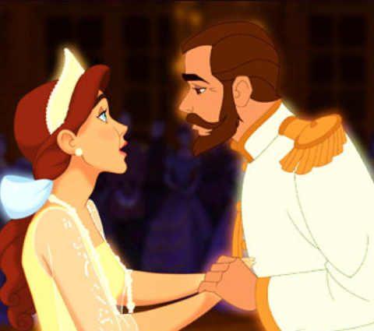
4. Wartime Failures
a. Tsar Nicholas II led the Russian army- failure
b. Rasputin, a Siberian holy man, gained great influence with the royal family and corrupted the gov’t

Slide 7
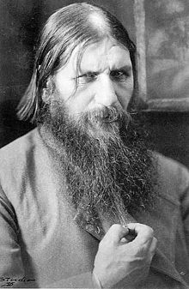
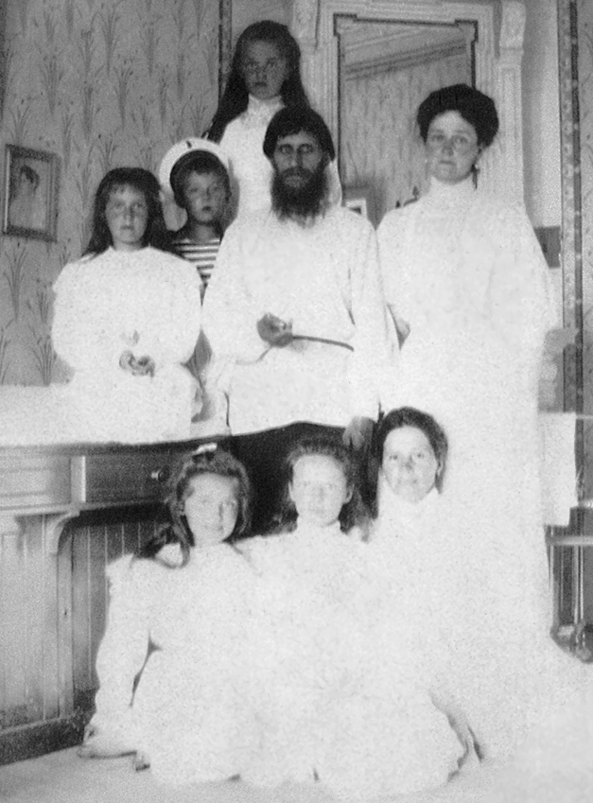
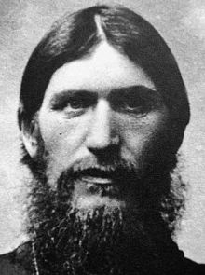

Slide 8
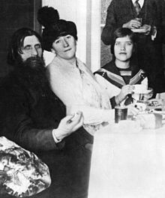
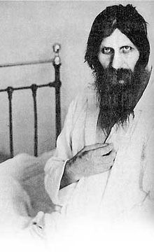

Slide 9
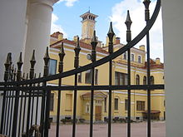
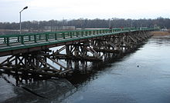
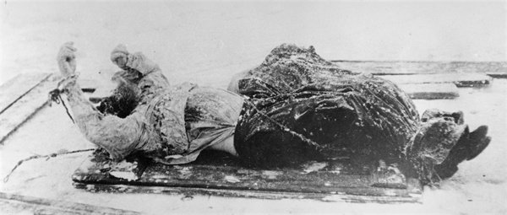
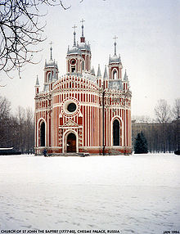

Slide 10
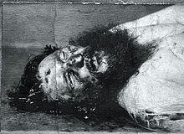
Just dance Rasputin Death
http://izismile.com/2014/01/27/incredible_sidebyside_just_dance_run_to_rasputin.html
http://www.youtube.com/watch?v=3Zz0sHu-m7s

Slide 11
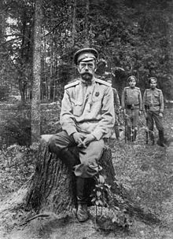
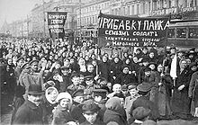
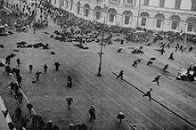
II. February Revolution (1917)
A. (Unhappy citizens took to the streets of St. Petersburg, looking for food)
1. Gov’t stopped following the tsar, Nicholas II abdicated the throne

Slide 12
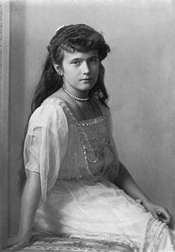
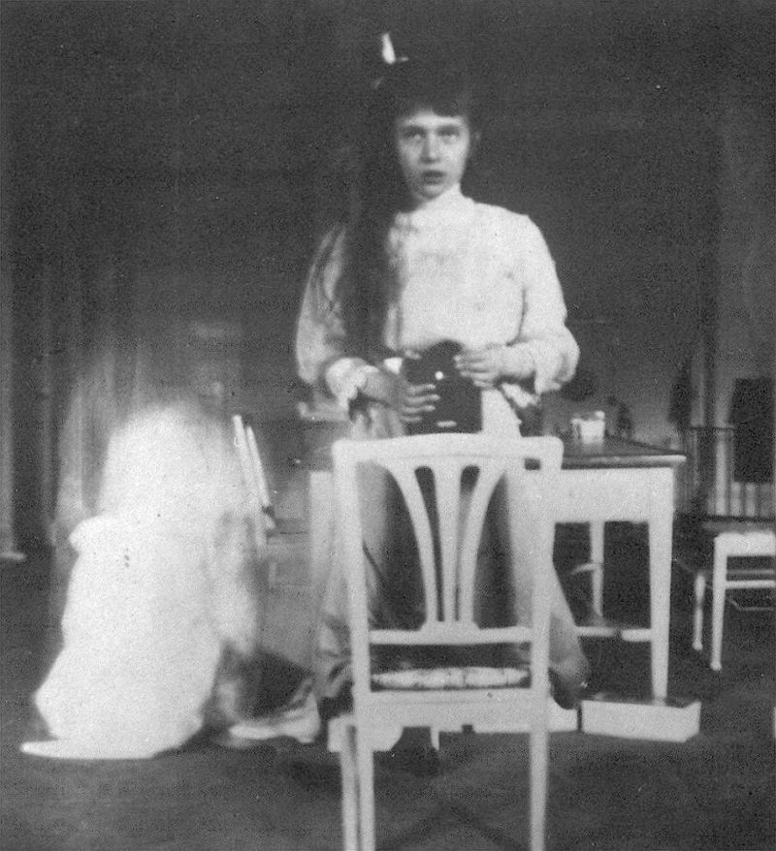

Slide 13
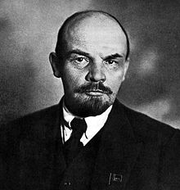
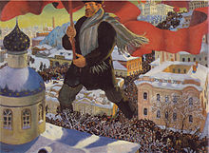
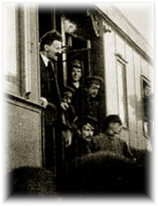
2. Provisional Gov’t – was a temporary gov’t was put into place to gradually move to a republic
2. The Marxist Bolsheviks (Marxists led by Vladimir Lenin) undermined the support for the gov’t

Slide 14
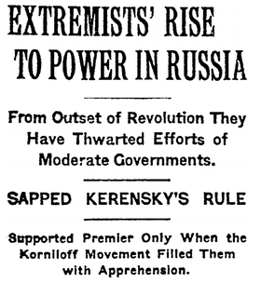
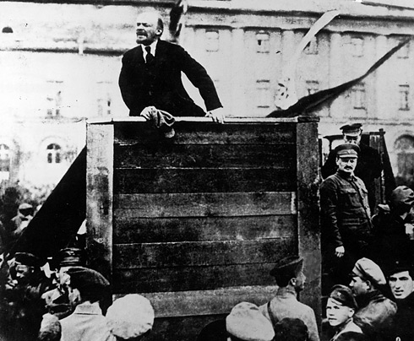
III. October Revolution
1. Lenin, leader of the Marxist-Bolsheviks, led a revolt and took over the provisional gov’t
*Bolsheviks controlled the gov’t through local councils (soviets)*

Slide 15
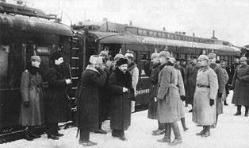
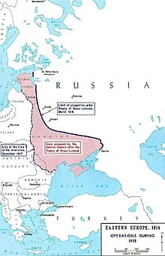
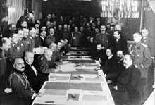
So now they’re Communist…
2. Lenin outlawed personal property and made Russia a communist country
3. Treaty of Brest-Litovsk- made peace with Germany but gave away lots of territory

Slide 16
WWI VirtuAL Source Experience (now gluten free!)
With your Chromebooks, head on over to my website (mrmarwitz.weebly.com)
Once there, click on World History and then on Classwork.
Under Unit 6, click on the PDF file “WWI Gallery Walk”.
Read through the PDF, answering the questions about the sources on the worksheet in front of you! Please let me know if you have any questions!

Slide 17
End Notes…

Slide 18
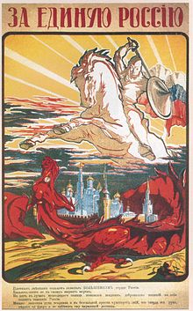
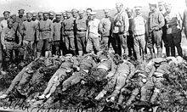
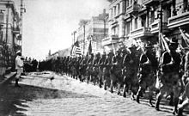
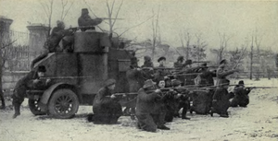
C. Russian Civil War (1918-1921)
1. Reds (communists) vs Whites (those opposed)
2. 15 million died as a result of the fighting
3. Reds won but faced economic collapse

Slide 19
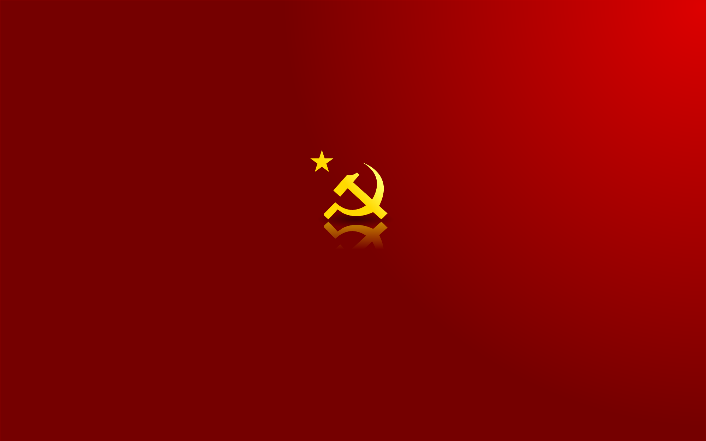
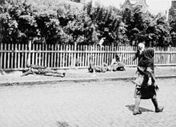
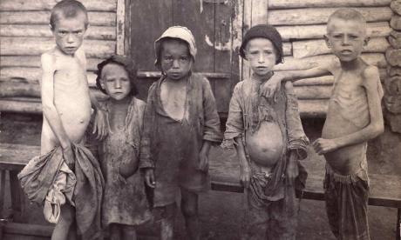
D. At the same time, a famine killed many Russians
E. Communist Russia was renamed the Soviet Union (USSR)

Slide 20
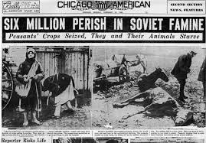

Slide 21
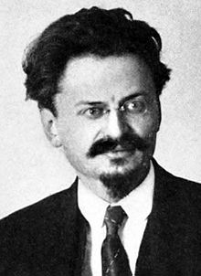
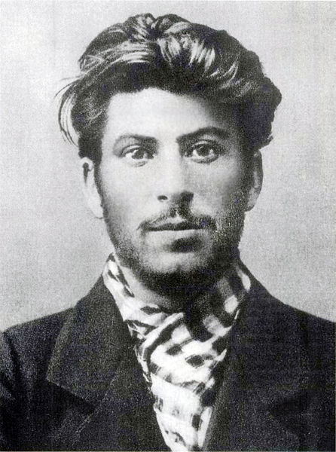
IV. Stalin’s Soviet Union
A. After Lenin died in 1922, two rivals fought for power
1. Leon Trotsky, leader of the Red Army
2. Josef Stalin, leader of the Communist party

Slide 22
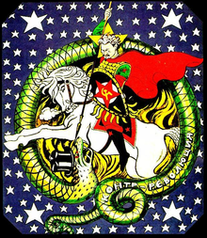
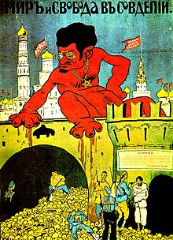

Slide 23
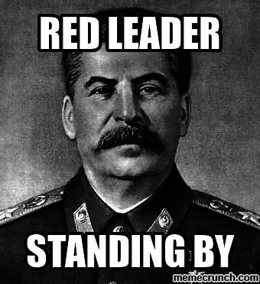
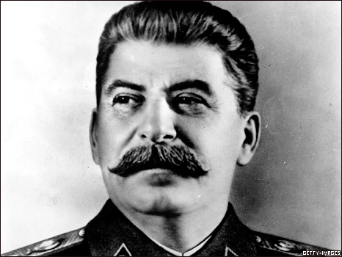
B. Stalin took power and tried to seize complete control of the USSR
C. He created central plans to govern every element of the economy

Slide 24
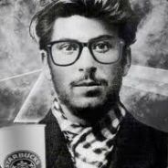
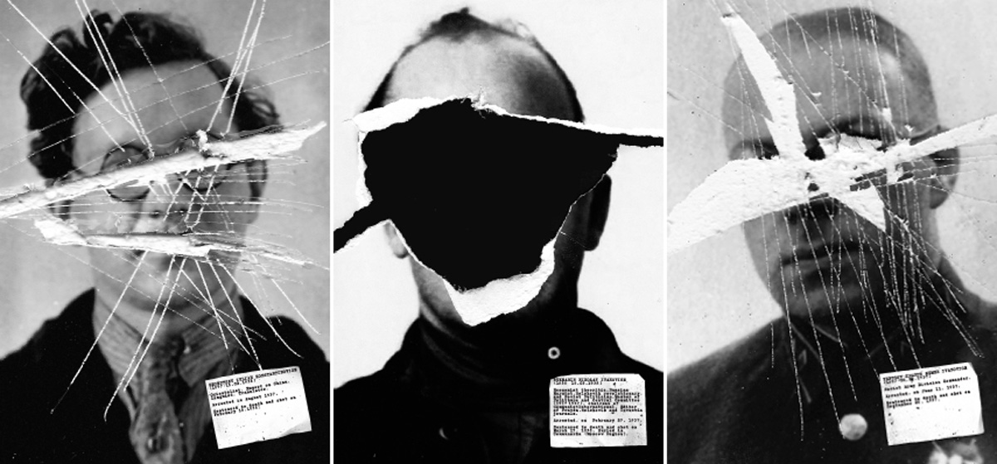
I CLEANED UP MY FRIENDS LIST
BEFORE IT WAS COOL
D. Great Purge- Stalin killed up to six million of his own people that he believed were plotting against him

Slide 25
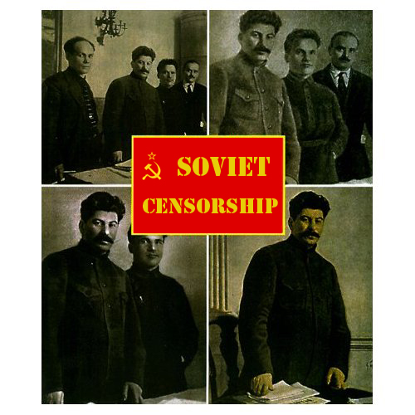
Spot the Difference: Stalin’s Purge Edition

Slide 26
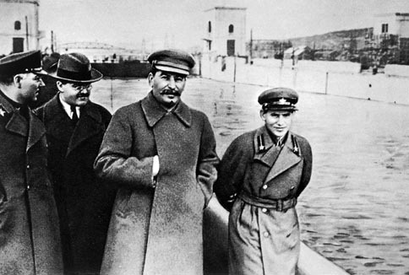

Slide 27
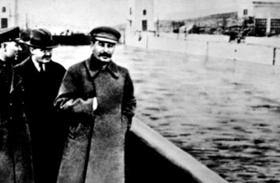

Slide 34
TOO SOON?

