Slide 1
Imperialism in Asia

Slide 2
Bell-Work
Name a country that touches Malaysia.
What is imperialism?
Where does opium come from?
Who, at some point in their life, was the leader of at least 32 different countries?
List one POSITIVE effect of imperialism.

Slide 3
Indonesia, Brunei, Thailand, and Singapore…kind of.
Jamaica (1962–present)
Trinidad and Tobago (1962–76)
Uganda (1962–63)
Kenya (1963–64)
Malawi (1964–66)
Malta (1964–74)
The Gambia (1965–70)
Guyana (1966–70)
Barbados (1966–present)
Mauritius (1968–92)
Fiji (1970–87)
The Bahamas (1973–present)
Grenada (1974–present)
United Kingdom (1952–present)
Canada (1952–present)
Australia (1952–present)
New Zealand (1952–present)
Pakistan (1952–56)
South Africa (1952–61)
Ceylon (1952–72)
Ghana (1957–60)
Nigeria (1960–63)
Sierra Leone (1961–71)
Tanganyika (1961–62)
Papua New Guinea (1975–present)
Solomon Islands (1978–present)
Tuvalu (1978–present)
Saint Lucia (1979–present)
Saint Vincent and the Grenadines (1979–present)
Belize (1981–present)
Antigua and Barbuda (1981–present)
Saint Kitts and Nevis (1983–present)

Slide 4
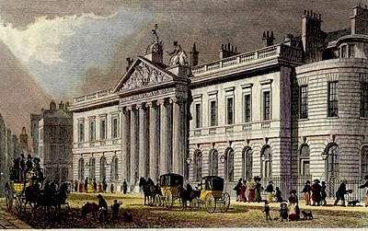
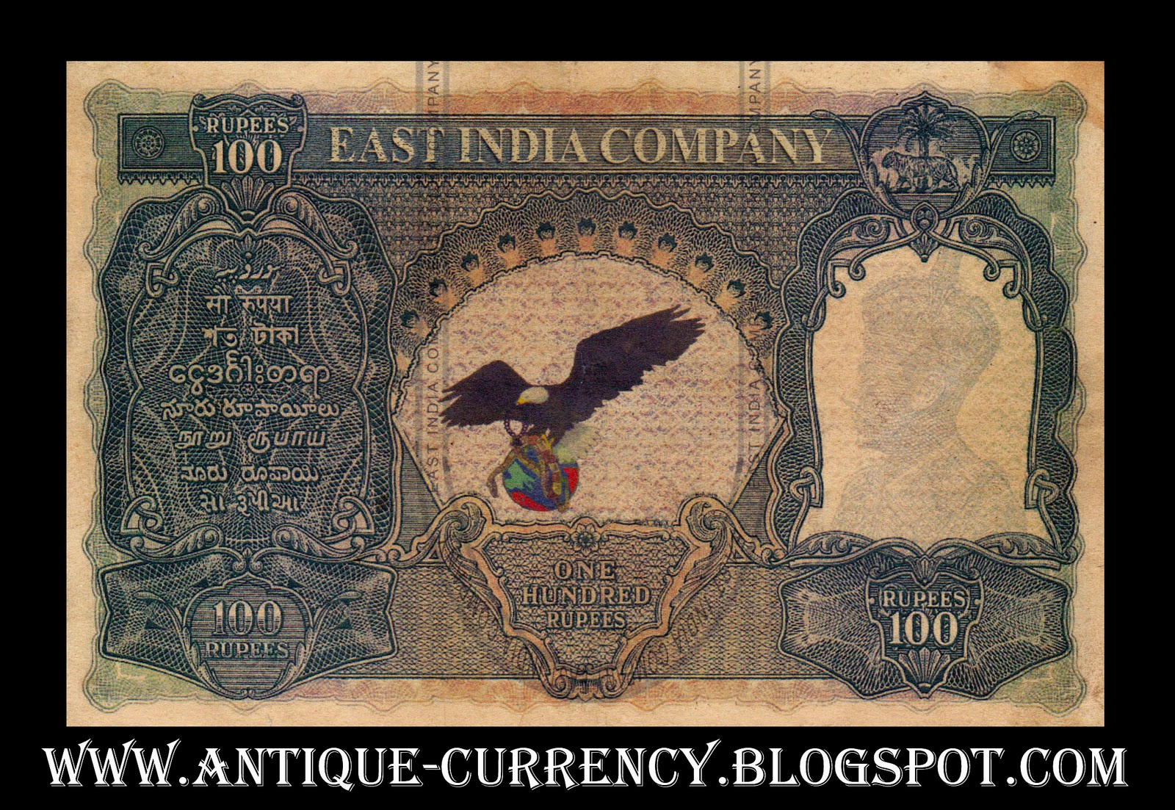
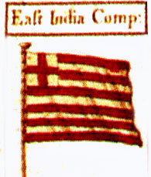
I. Imperialism in Asia
A. India- controlled by British
1. British East India Company controlled trade with India until the British government took control
a. Created to control trade between GB, India, and East Asia

Slide 5
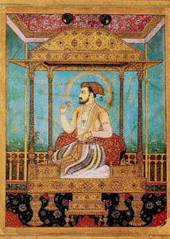
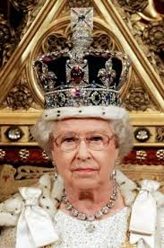
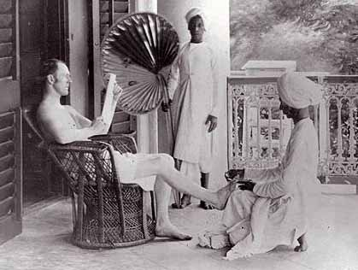
2. India had many people and raw goods- it was the “jewel” of the British Empire
3. British wanted to westernize India

Slide 6
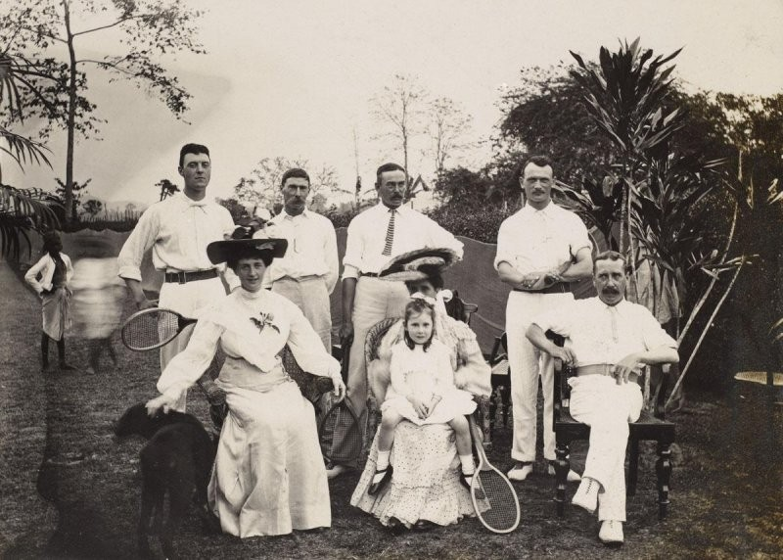

Slide 7
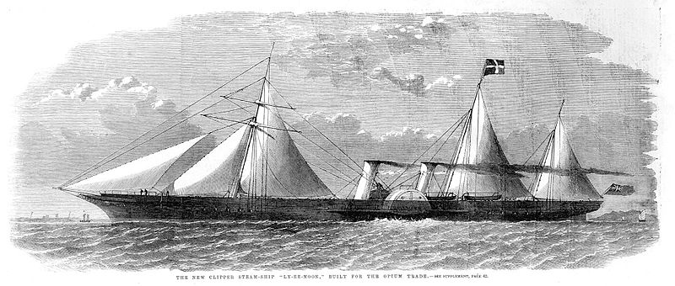
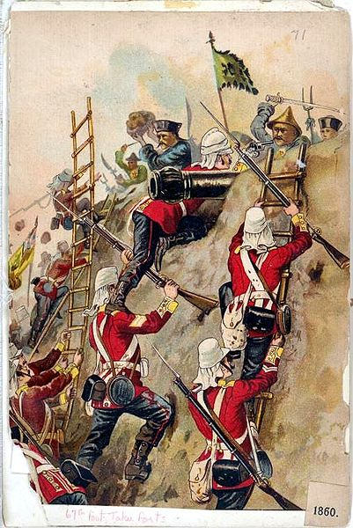
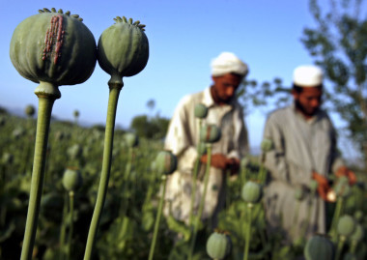
B. China
1. China was mostly closed to European traders
2. Opium War
British increased China’s opium addiction
When the trade stopped, British sent in their navy

Slide 8
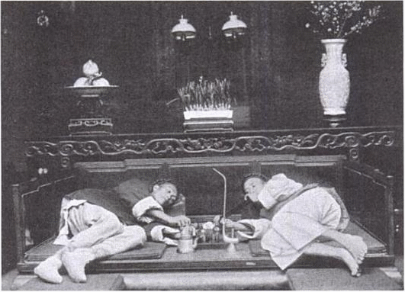
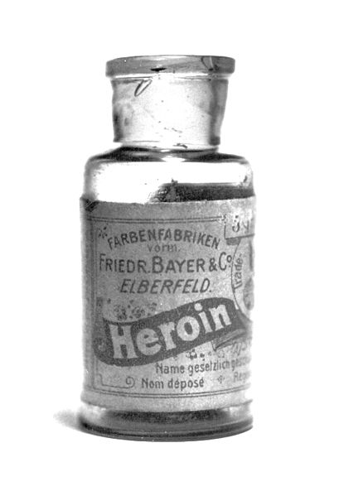

Slide 9
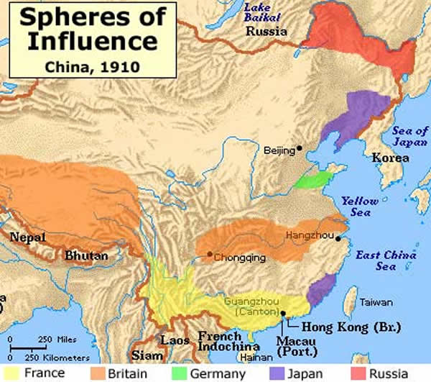
3. European countries divided China into Spheres of influence- areas of economic dominance
4. Taiping Rebellion
Civil war in the 1850s against the corrupt Qing dynasty wanting to end the feudal system
Over 20 million people died

Slide 10
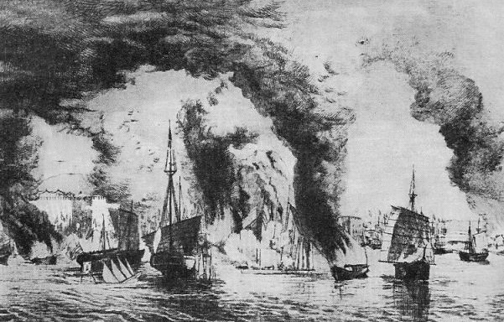

Slide 11
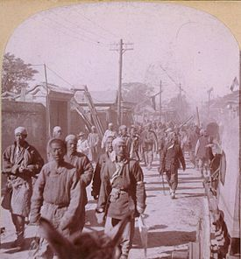
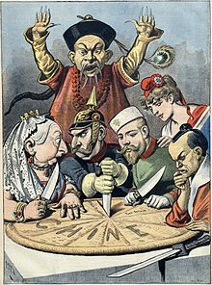
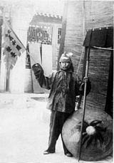
5. Boxer Rebellion (1899)- Nationalist movement to end European imperialism in China
50,255 vs. approx. 400,000

Slide 12
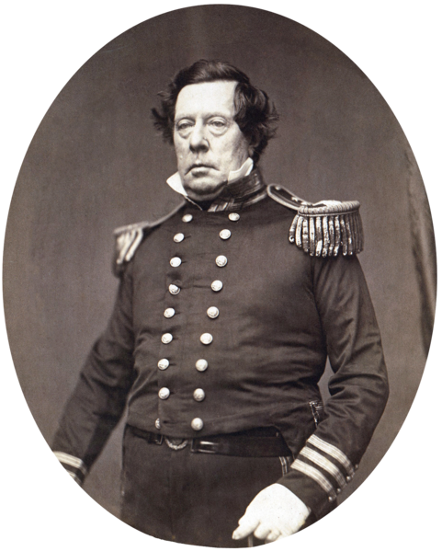
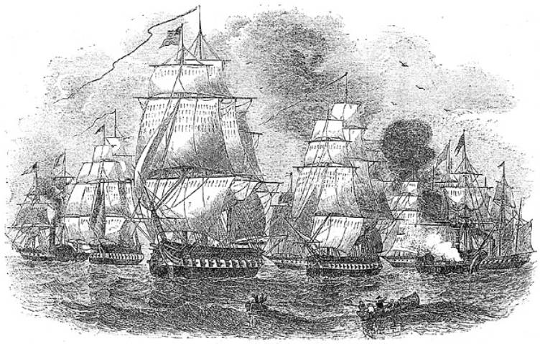
C. Japan
1. Japan severely restricted foreign influence
2. In 1854, US Commodore Perry forced Japan to open itself to foreign trade
Could I BE any more intrusive?

Slide 13
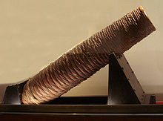

Slide 14
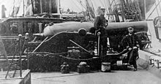

Slide 15
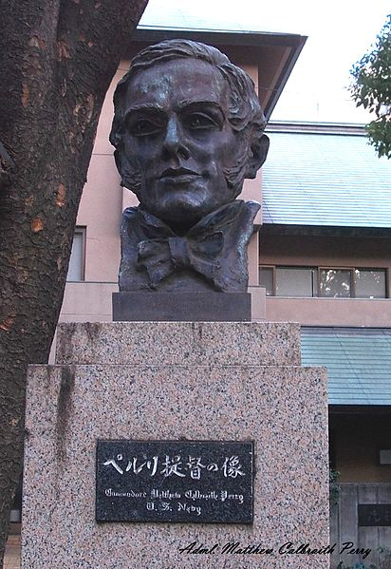
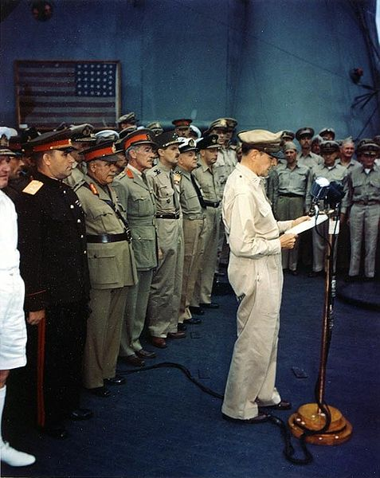

Slide 16
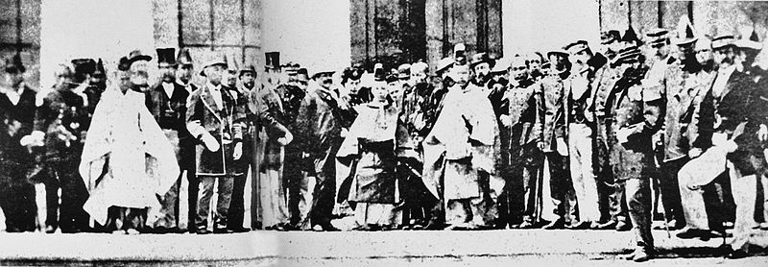
3. Meiji Restoration (1868-1912)
a. A young emperor believed the best way to keep independence was to modernize and reform
b. Japan became the most industrialized and powerful Asian country
c. Embraced education and western technology while keeping Japanese culture

Slide 17
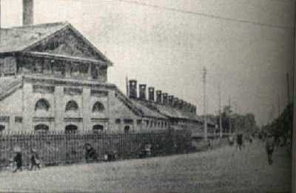

Slide 18
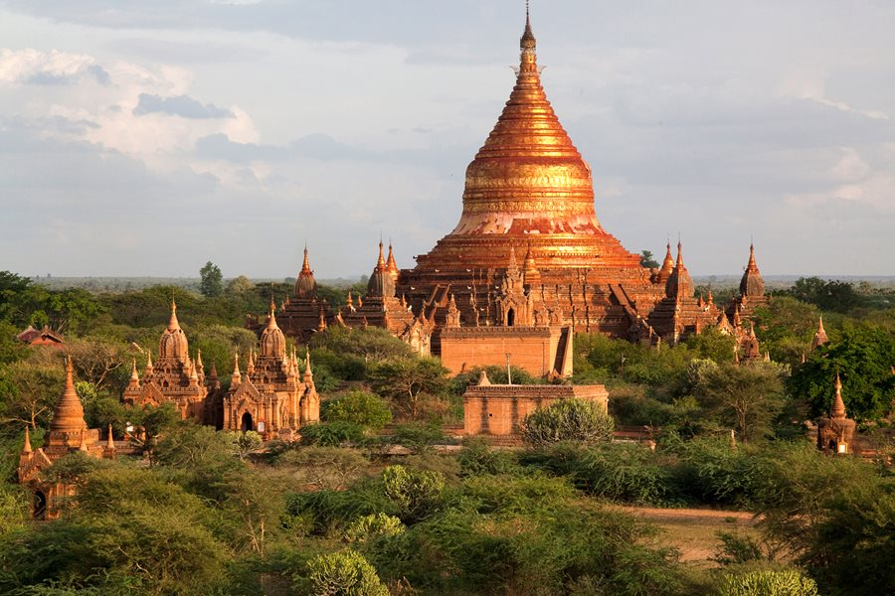
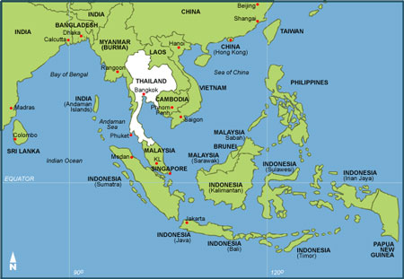
D. Southeast Asia
1. British- Burma and Malaysia: built Singapore and dominated trade
2. French- Indochina (Vietnam): used resources to benefit France

Slide 19
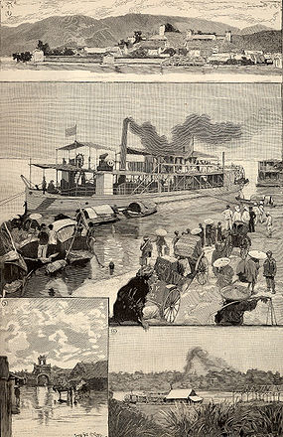
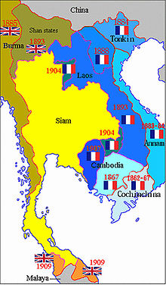
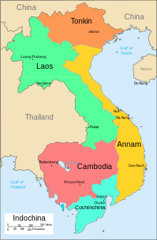

Slide 20
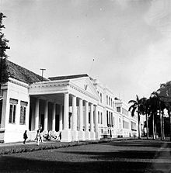
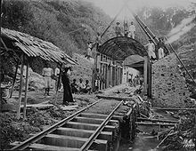
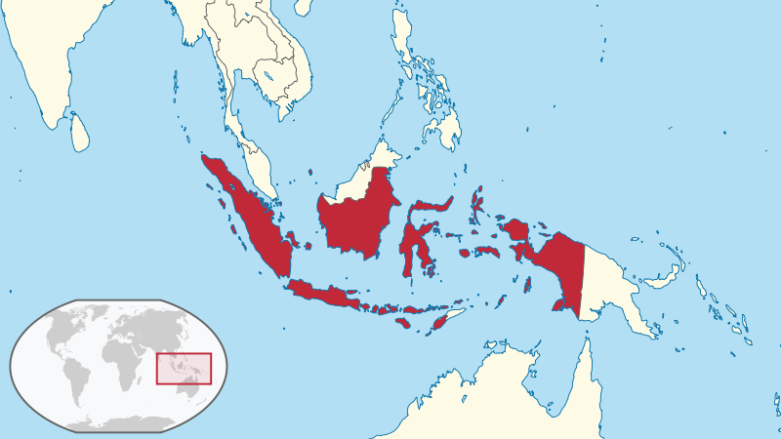
3. Dutch- Indonesia: controlled most of spice trade until British took control
4. Spain, United States- Philippines: America fought a war to control and to become imperialist

Slide 21
