Slide 1
The French Revolution

Slide 2
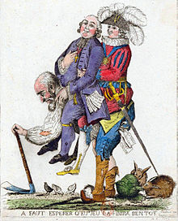
Bell - Work
Describe this picture in your warm-up section.
What do you see? What stands out? What does this picture represent?

Slide 3
French Revolution Documentary
https://www.youtube.com/watch?v=FeZodR1pEak
Using the sheet provided for you, answer the following questions about the documentary film as you watch. You must complete 20 out of the 25 questions. We will be watching this all in class, but you MUST watch it yourself if you miss class this week.

Slide 4
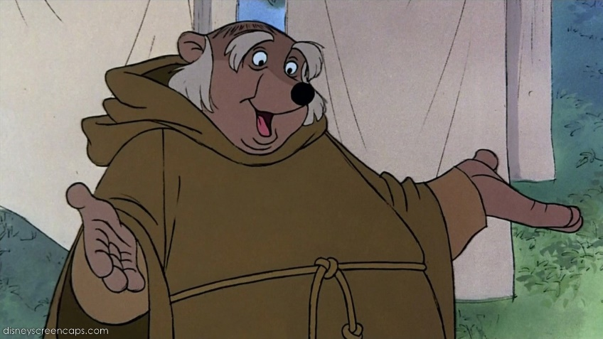
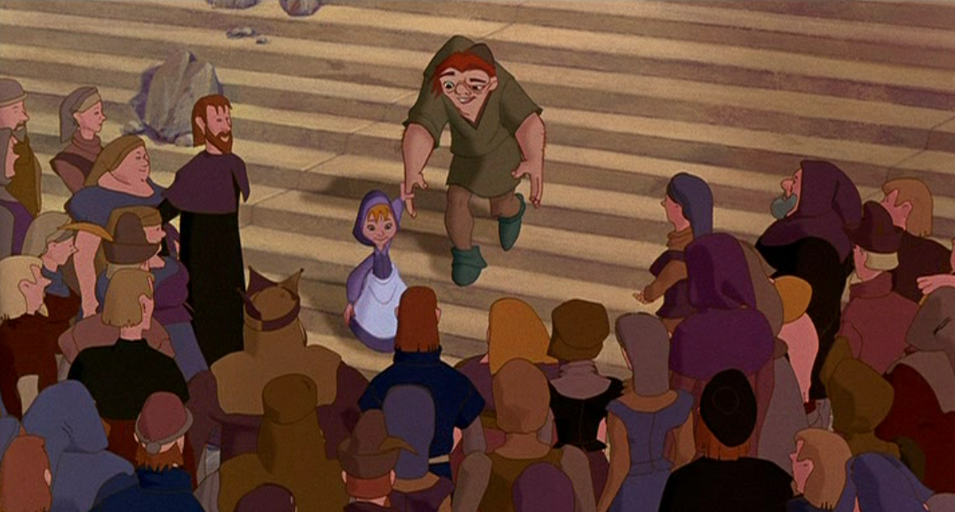
I. Long-term Causes
A. Three Estates
1st Estate: Clergy
(Catholic Church)
0.5% of people, 10% of land
2. 2nd Estate: Nobility
1.5% of people, 25% of land
3. 3rd Estate: Everyone Else
98% of people, 65% of land
Paid over 95% of taxes
Bourgeoisie- wealthy middle class

Slide 5
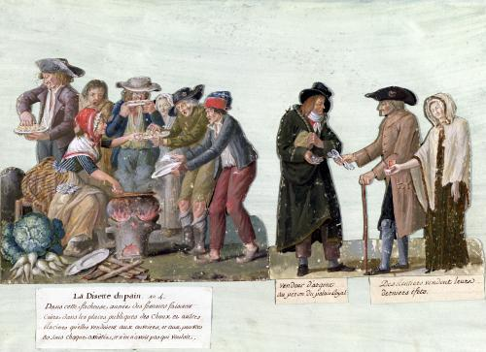
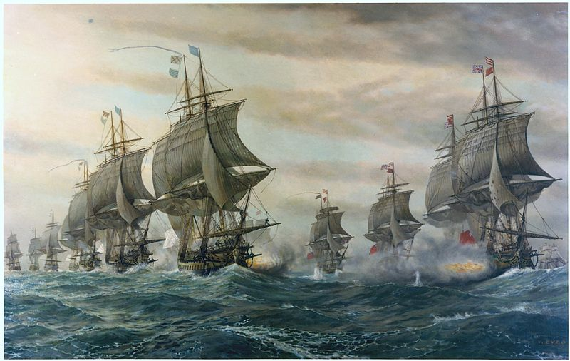
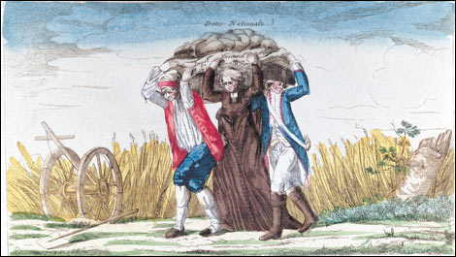
B. Economic Crisis
1. Famine and inflation in France
2. Large war time debt
3. The first and second estates were not taxed much

Slide 6
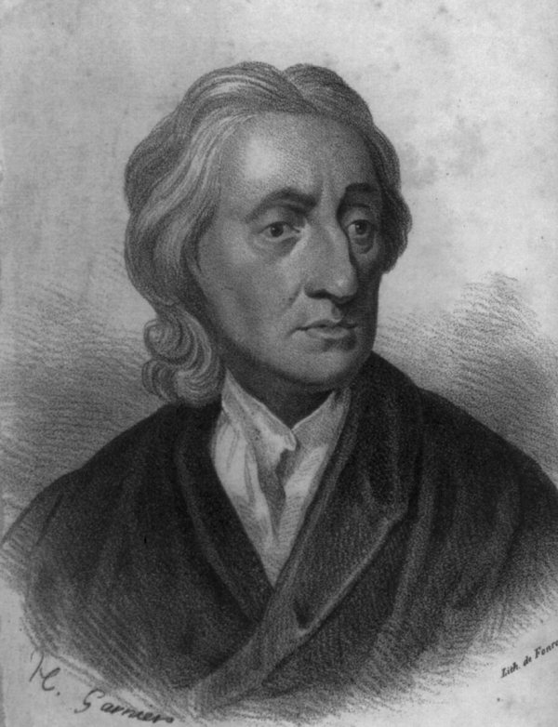
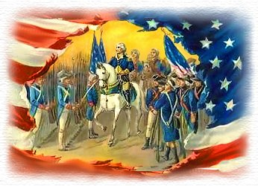
C. Enlightenment Ideas
1. Ideas of Locke, Rousseau, and Montesquieu were influential and contrary to the absolute government
2. American Revolution successfully used the ideals

Slide 7
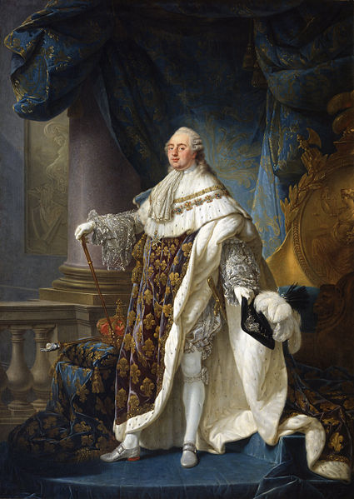
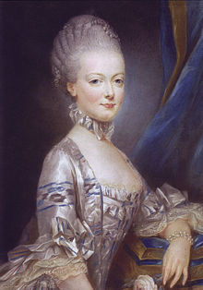
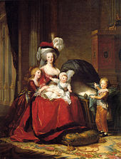
D. Weak Monarchs
1. Louis XVI was a weak king
2. His Austrian wife Marie Antoinette was unpopular for spending too much money

Slide 8
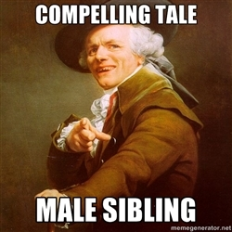

Slide 10
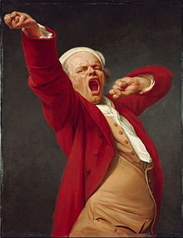
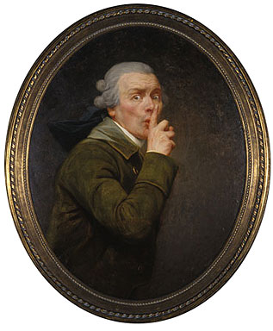

Slide 11
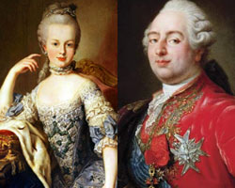
Things you didn’t know…okay, maybe you did…
They knew each other for 1 day before marriage.
It took 7 years to “consummate” the marriage.
50,000 Parisians greeted Marie. 30 died.
She had a town built so she could play “poor”
Let them eat brioche.

Slide 13
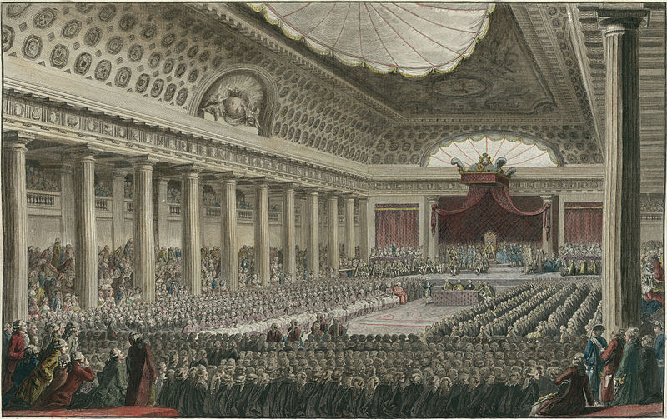
II. Short Term Causes
A. Estates-General
1. The king needed money so he called the elected legislature, Estates-General
2. Each estate had one third of votes

Slide 14
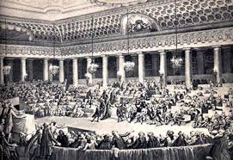
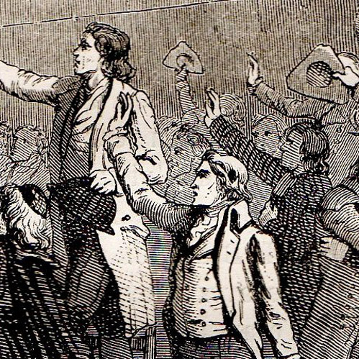
3. June 17th, 1789- 3rd Estate called itself the National Assembly to establish and representative government

Slide 15
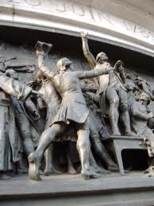
B. Tennis Court Oath
1. June 20th, 1789: The National Assembly was locked out and so went to a local tennis court
2. Made the Tennis Court Oath: they would not stop meeting until they wrote a new constitution

Slide 16
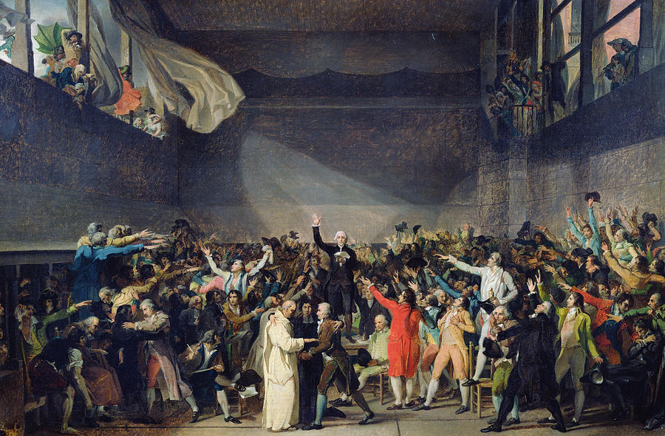

Slide 17
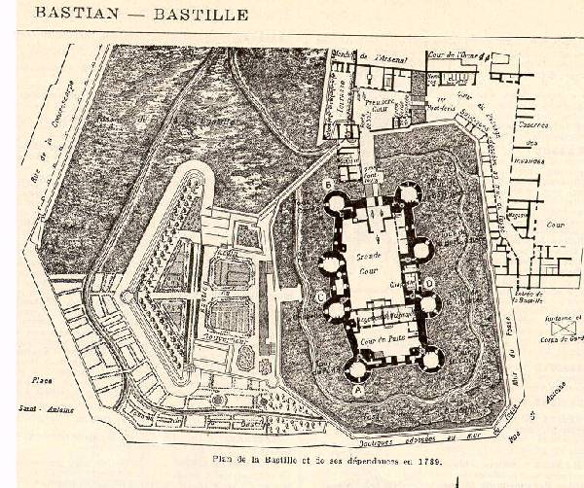
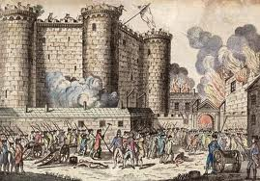
C. Storming of the Bastille
1. July 14th, 1789- people of Paris attacked the Bastille (prison and armory) to get gunpowder.
2. Marked the beginning of the French Revolution

Slide 18
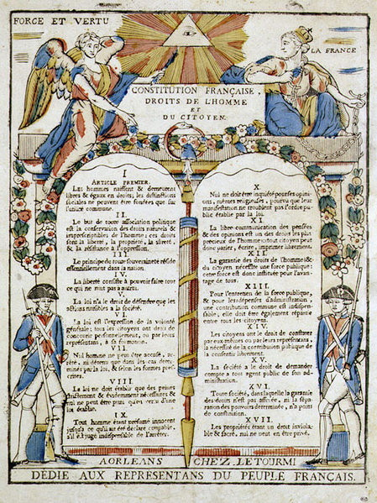
III. Birth of a Republic
A. National Assembly took over the government
B. They wrote the Declaration of the Rights of Man and of the Citizen to give men equal rights

Slide 19
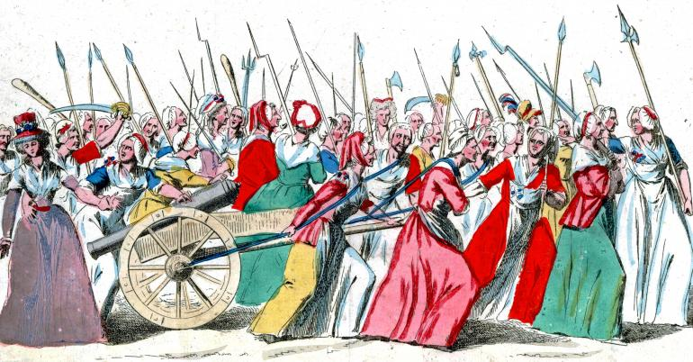
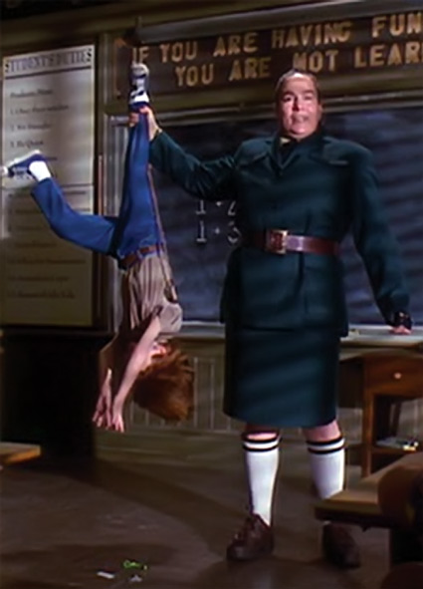
C. The slogan of the Revolution was: Liberty, Equality, Fraternity (Brotherhood)
D. End of the Monarchy
7000 women marched to Versailles demanding bread- royal family moved to Paris
Paris mob eventually put them in prison

Slide 20
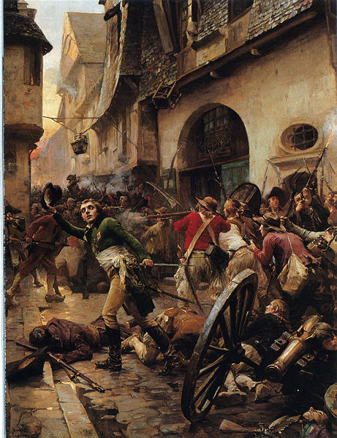
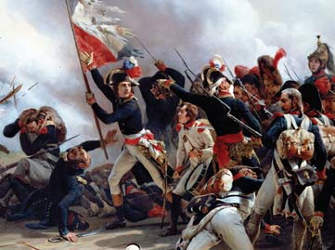
E. France went to war because it wanted to spread the revolution

Slide 21
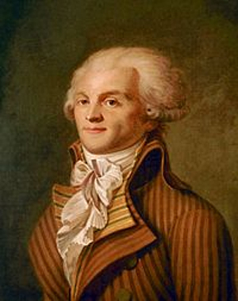
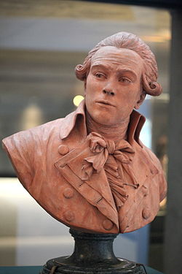
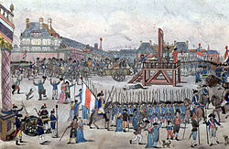
IV. Radical Republic
A. Maximilien Robespierre was leader of the radicals and eventually led the National Assembly
B. The radicals tried to change society by getting rid of religion and forcing loyalty to the Revolution

Slide 22
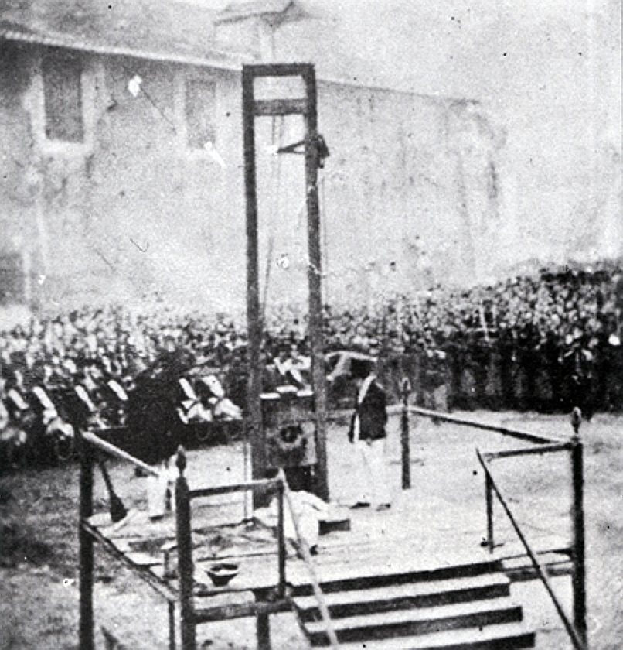
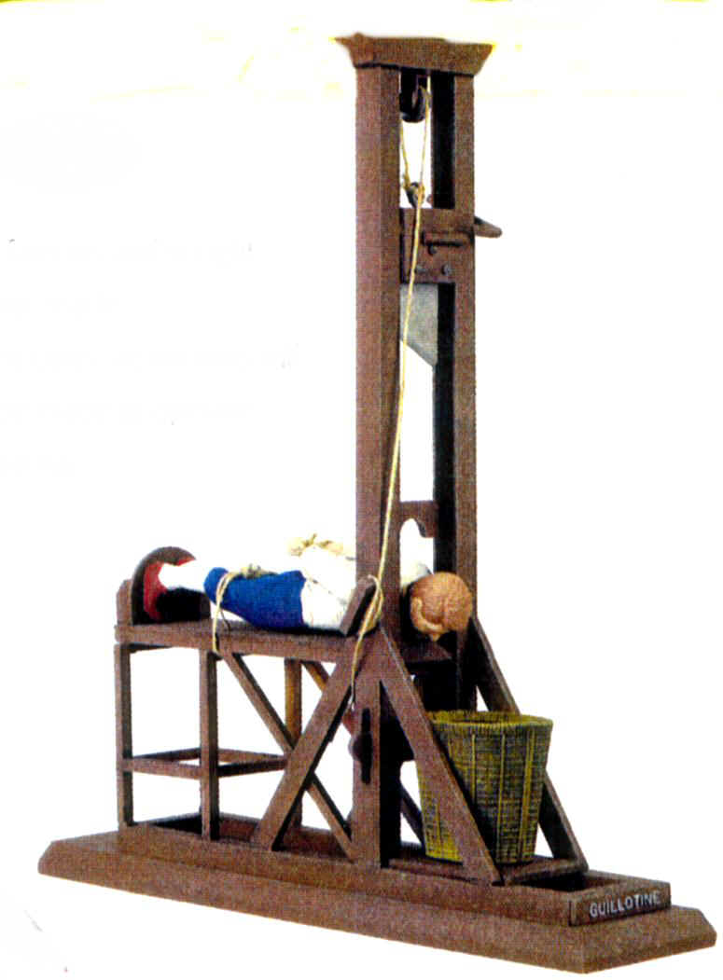
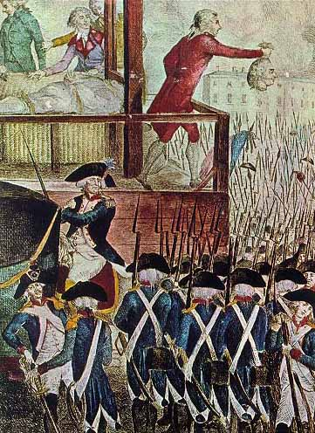
C. Guillotine- decapitation machine designed to give clean equal deaths
D. January 21, 1793, Louis XVI was publicly executed

Slide 23
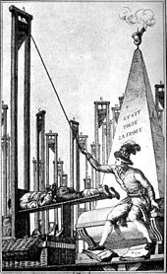
V. Reign of Terror
A. Robespierre spread fear to protect the Revolution
B. Anyone accused of disloyalty were put on trial
C. 300,000 arrested, 17,000 killed by guillotine
D. Ended when Robespierre was executed himself
E. New gov’t weak and corrupt

Slide 24
Short Term Causes

Slide 25
Long Term Causes

Slide 26
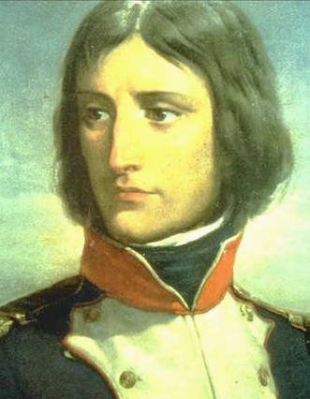
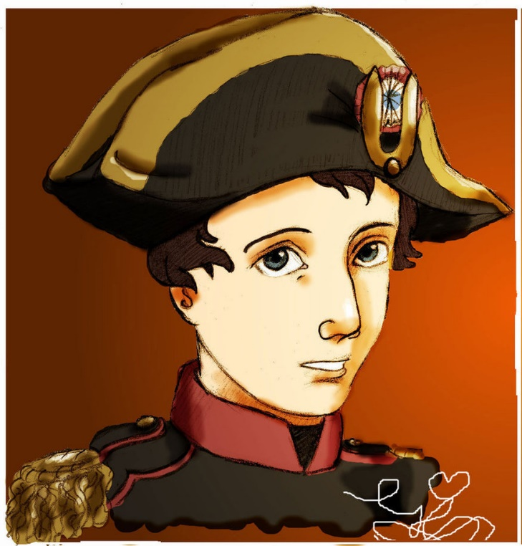
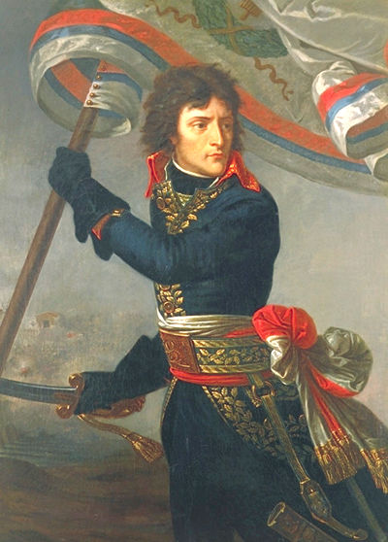
I. Rise of Napoleon
A. Napoleon Bonaparte was born a minor noble on the island of Corsica
B. Showed brilliance as a military commander against the Austrians and Italians at a young age

Slide 27
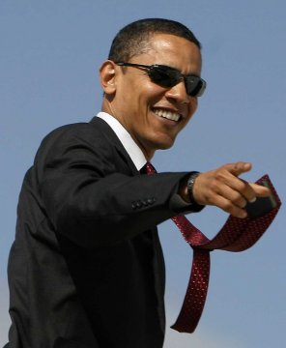
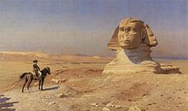
C. Had a defeat against the British in Egypt but covered it up when he returned to France
D. Used his status as a national hero to take over the government in a coup d’etat (forceful takeover)
E. The people allowed him to be a dictator because they were tired of the chaos of Revolution

Slide 28
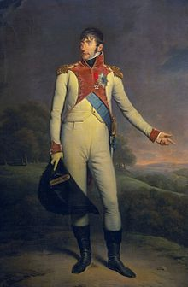
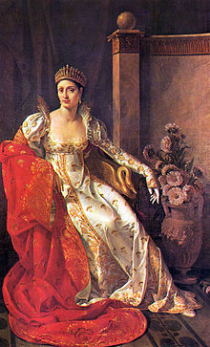
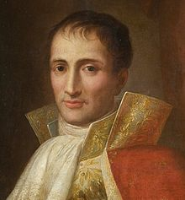
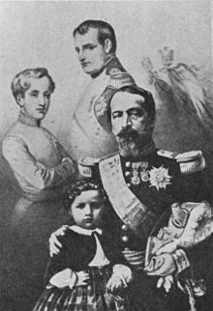
II. Creation of an Empire
A. The people voted for France to become an Empire, so Napoleon crowned himself Emperor
1. Napoleon used his military genius to defeat other European nations
2. Almost all of Europe was allied or under his control
3. He put his family members in charge of important countries

Slide 29
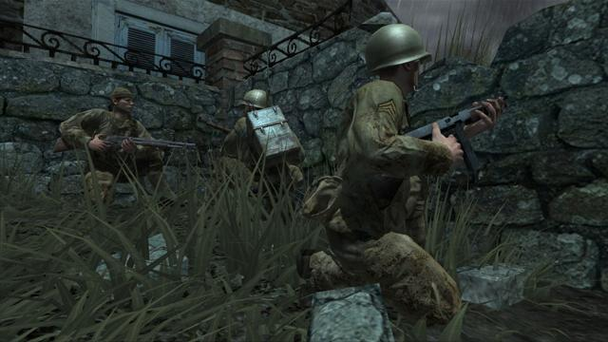
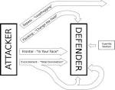
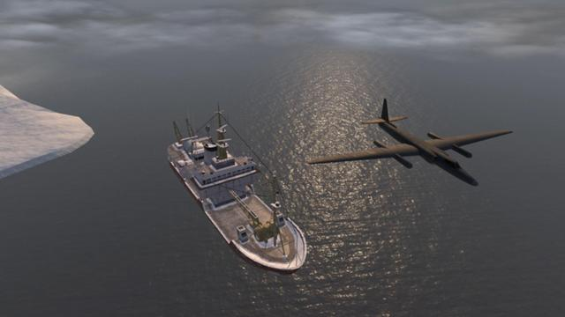

Slide 30
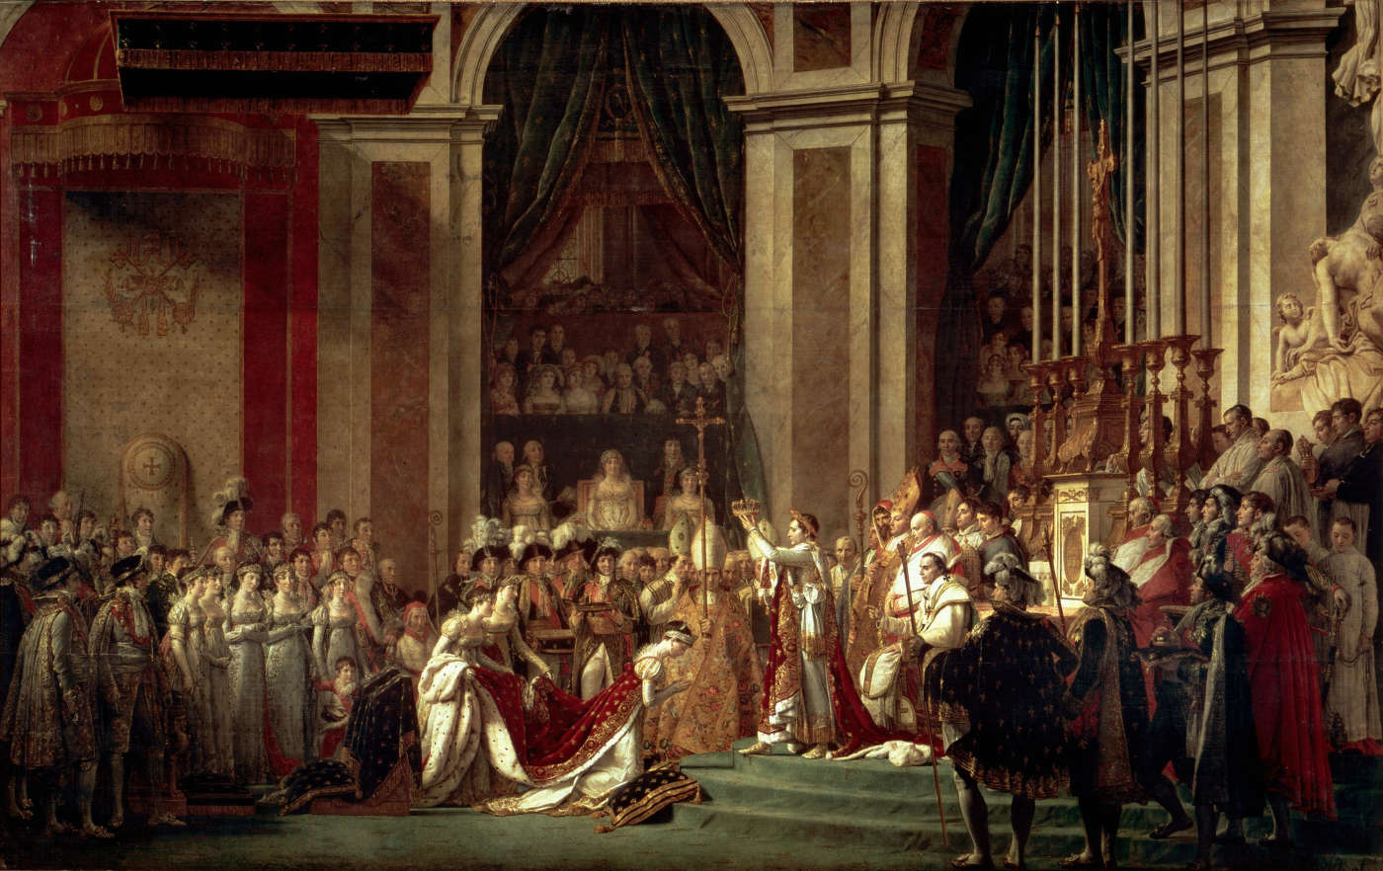

Slide 31
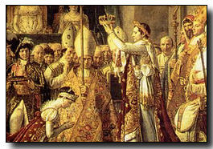

Slide 32
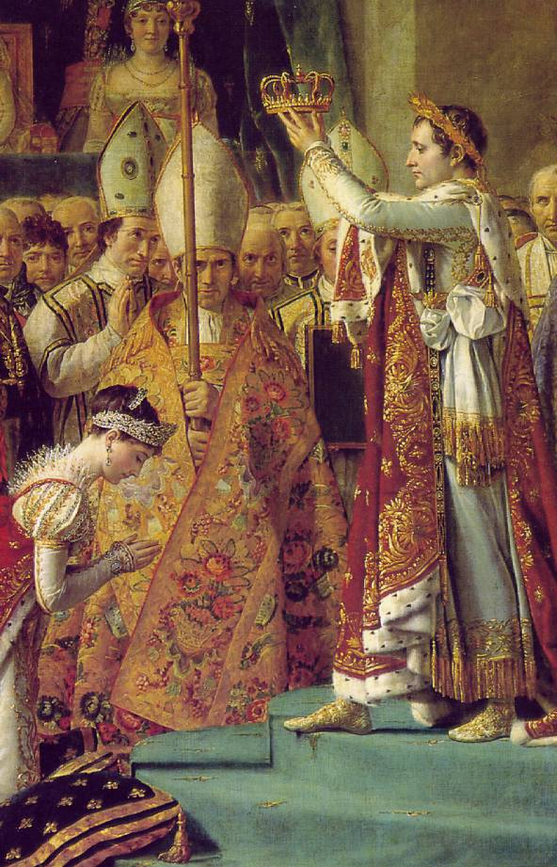
TPS
In just a few short minutes, turn to your neighbor and discuss this picture.
Based on what you know about Napoleon, is this painting accurate?
What should be added or taken away?

Slide 33
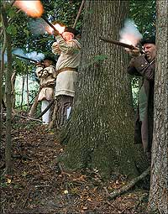
B. Peninsular War
1. France invaded Spain and put his brother on the throne
2. Portuguese held off French with GB help
3. Spanish rebels used guerilla warfare (hit and run tactics) to hurt French troops

Slide 34
\
C. Rivalry with Great Britain
1. Napoleon wanted to conquer Great Britain but was defeated at sea by Lord Horatio Nelson
2. Developed the Continental system- no nation in continental Europe could trade with Great Britain

Slide 36
III. Napoleon’s Policies
A. Made peace with Catholic Church
B. Reformed education, economy, and government
C. Napoleonic Code- reversed feudal legal code, foundation for European law
D. Legacy of Nationalism- the love of one’s people over others

Slide 37
Louisiana Purchase (1803)
$15,000,000 (232, .42)

Slide 39
Napoleon’s Empire 1812

Slide 40
IV. Defeat of Napoleon
A. Russia defied the Continental System so Napoleon invaded with 600,000 troops
B. He had victories but the Russian army retreated
C. Napoleon took Moscow but had no supplies for the Russian winter

Slide 41
D. Napoleon retreated and lost all but 90,000 of his troops
E. After the defeat in Russia, Great Britain and allies defeated Napoleon and exiled him to the island of Elba

Slide 43
V. Return of Napoleon
A. Napoleon escaped from Elba and returned to power for a time called The Hundred Days
B. British and allies, led by Duke of Wellington defeated Napoleon at the Battle of Waterloo
C. Napoleon was exiled to the island of Saint Helena, near South America

Slide 46
VI. Effects of Napoleon
A. Congress of Vienna- first time major countries met to form a treaty
1. France became a monarchy again (under Louis XVIII) with pre-Revolutionary borders

Slide 47
2. Created a balance of power system- countries work together to prevent one country from dominating
3. Created peace for 99 years
I may or may not mess things up.
OK. I mess them up pretty bad.

Slide 48
B. Spread of Enlightenment and Revolutionary ideas throughout Europe and in the Americas
C. Nationalism spread among European nations

