Slide 1
Scientific Revolution

Slide 2
Warm - UP
What is Absolutism?
Name 2 Absolutist rulers and tell me how they were able to rule so effectively…

Slide 3
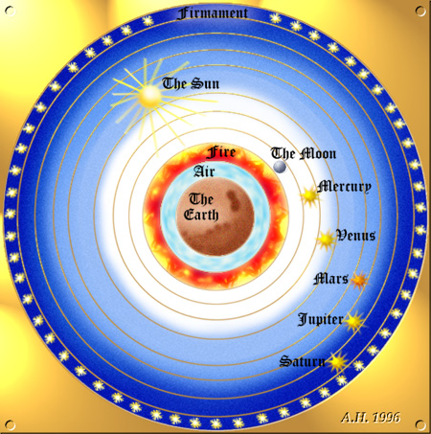
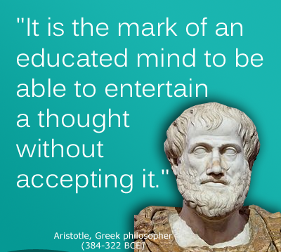
I. Development of Scientific Thinking
A. Medieval science based on classics, especially Aristotle
B. Aristotle first proposed the idea that the earth was at the center of the universe: geocentric theory (300s BC)

Slide 4
C. Scientific Revolution: (1500s) new way of looking at the world based on observation and questioning

Slide 5
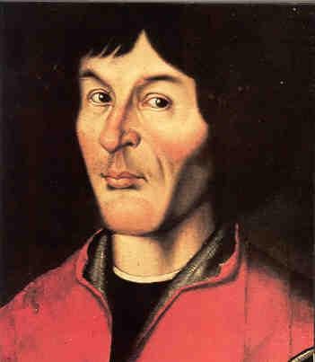
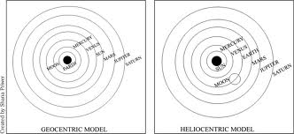
II. Astronomy
A. Copernicus- came up with the heliocentric theory- idea that the earth goes around the sun (1500s)

Slide 6
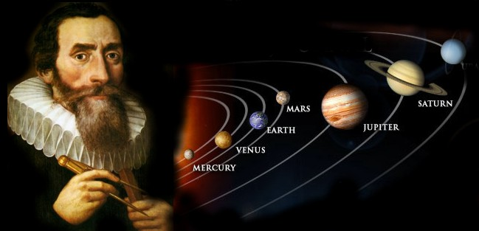
B. Kepler- used math to support heliocentric theory and that planets orbit the sun in an oval pattern called an ellipse

Slide 7
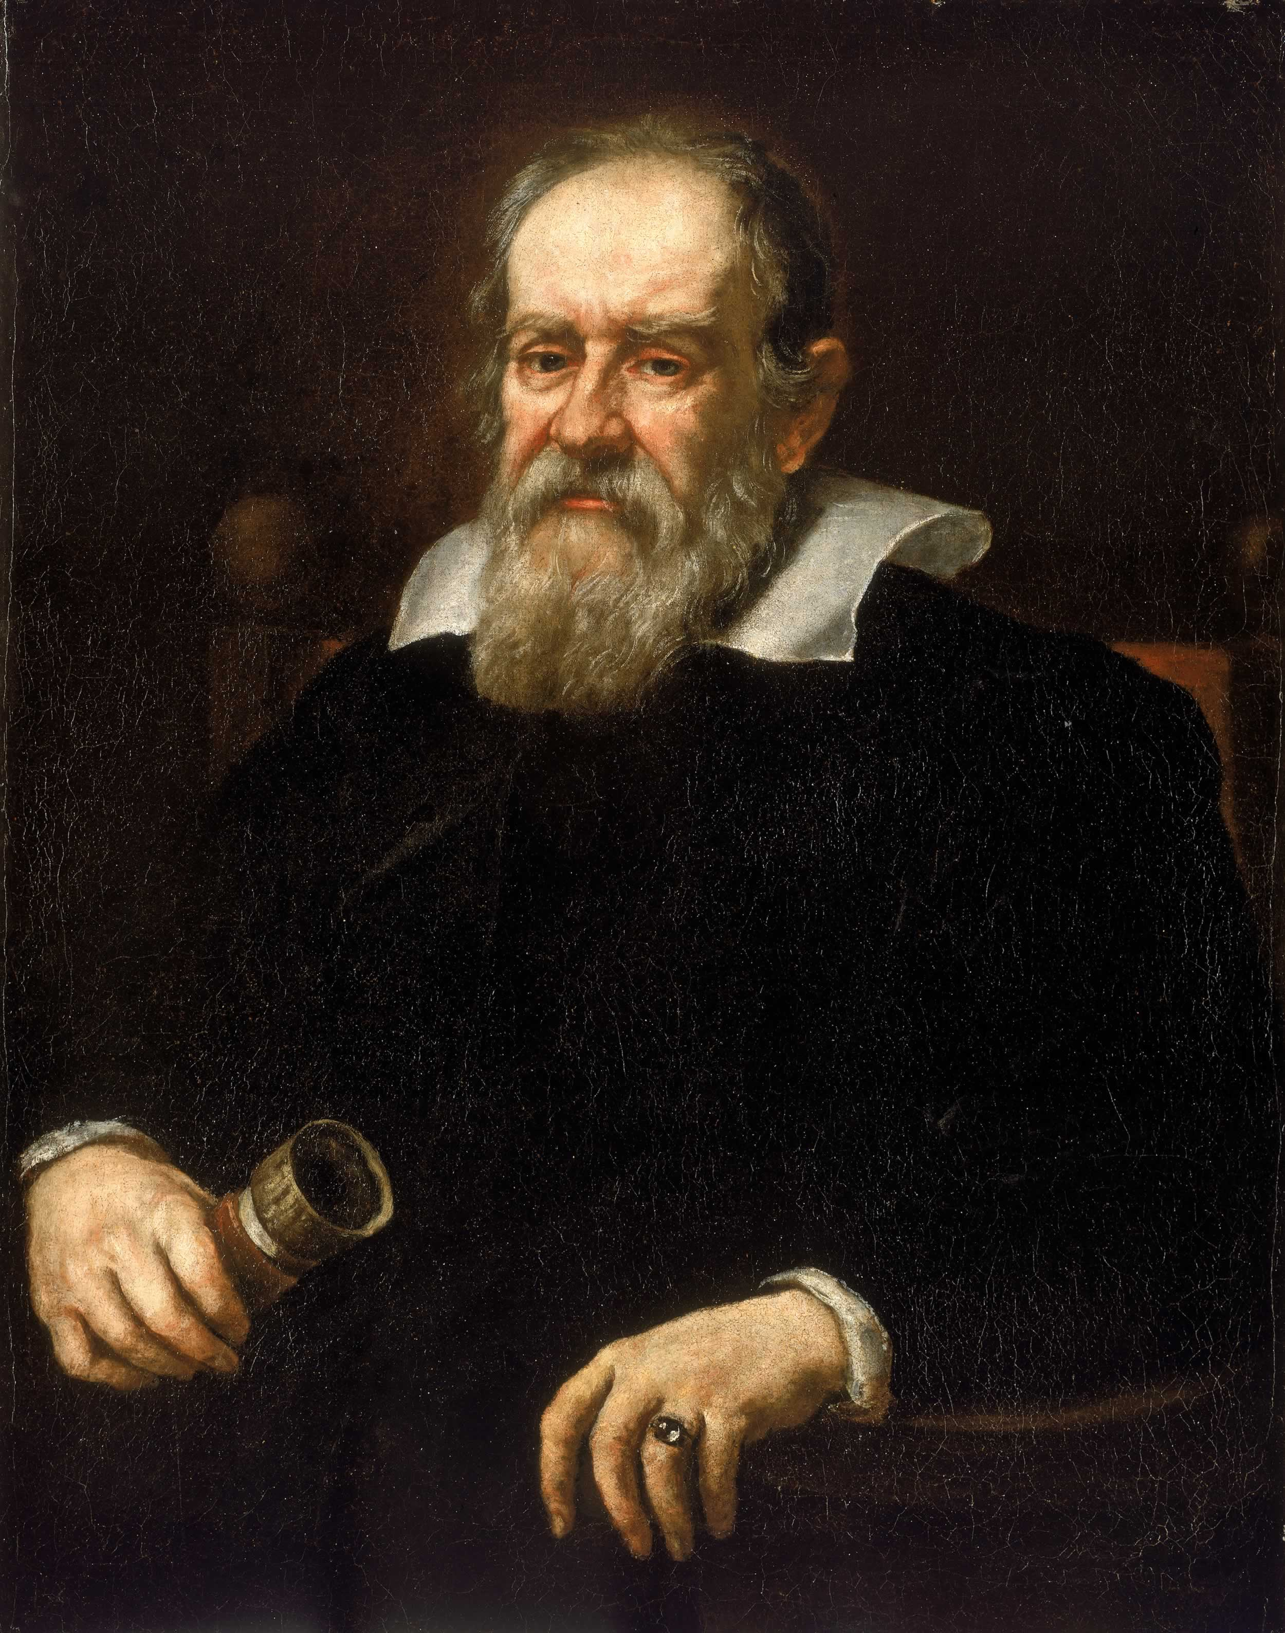
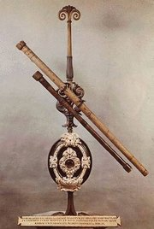
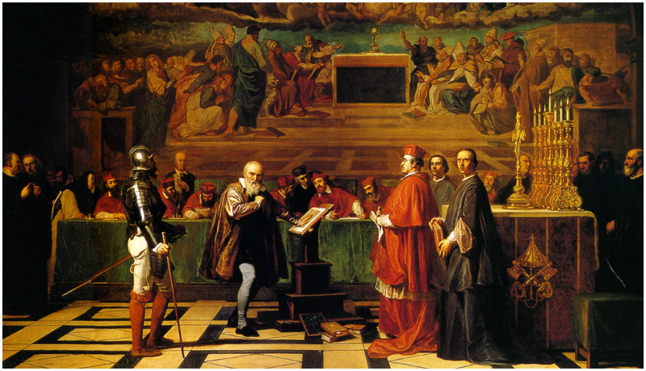
C. Galileo Galilei
1. Invented the telescope, proved heliocentric theory
2. Catholic Church forced him to say he disagreed with Copernicus

Slide 8
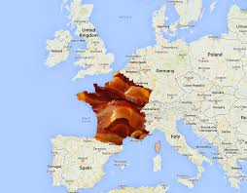

Slide 10
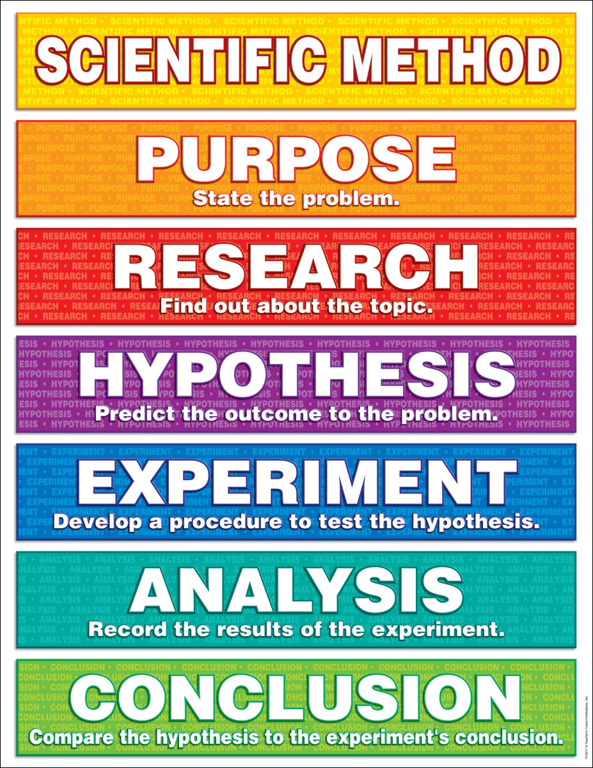
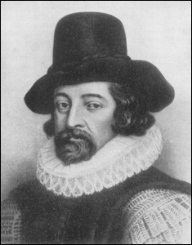
III. Scientific Method- step-by-step procedure of investigating and experimentation to prove a theory
A. Francis Bacon- English writer who encouraged scientists to use scientific experimentation to gain knowledge by using the scientific method

Slide 11
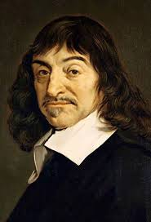
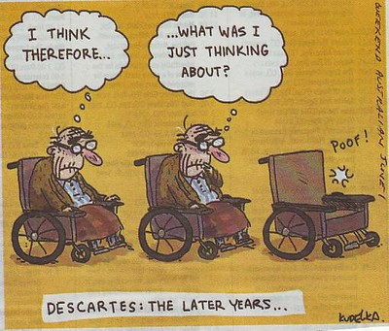
B. Descartes- Emphasized knowledge gained only from personal experience and logic

Slide 12
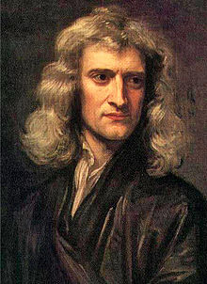
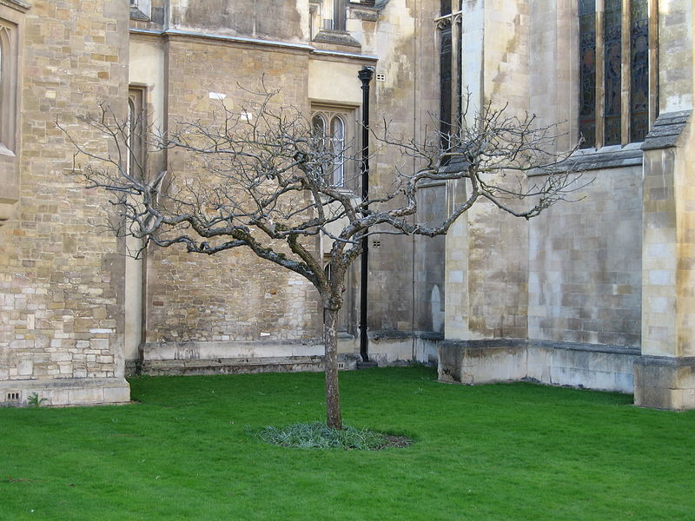
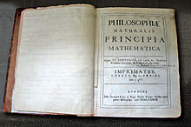
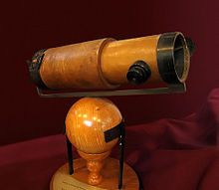
C. Sir Isaac Newton- “Father of Physics”
1. Developed Calculus
2. Law of gravity- all objects attracted to each other

Slide 15
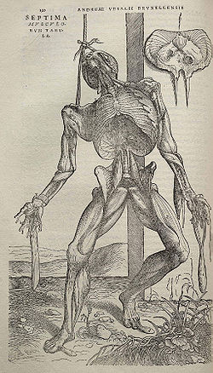
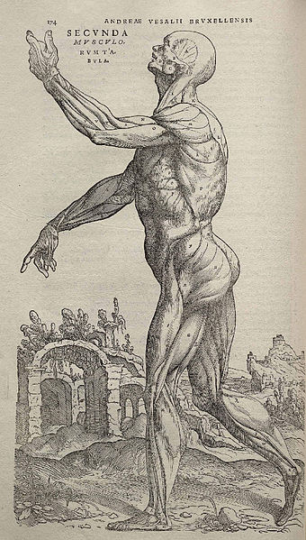
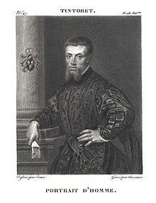
IV. Other important scientists
A. Andreas Vesalius- made drawings of anatomy

Slide 16
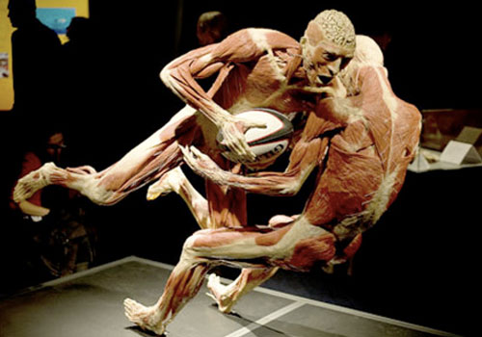

Slide 17
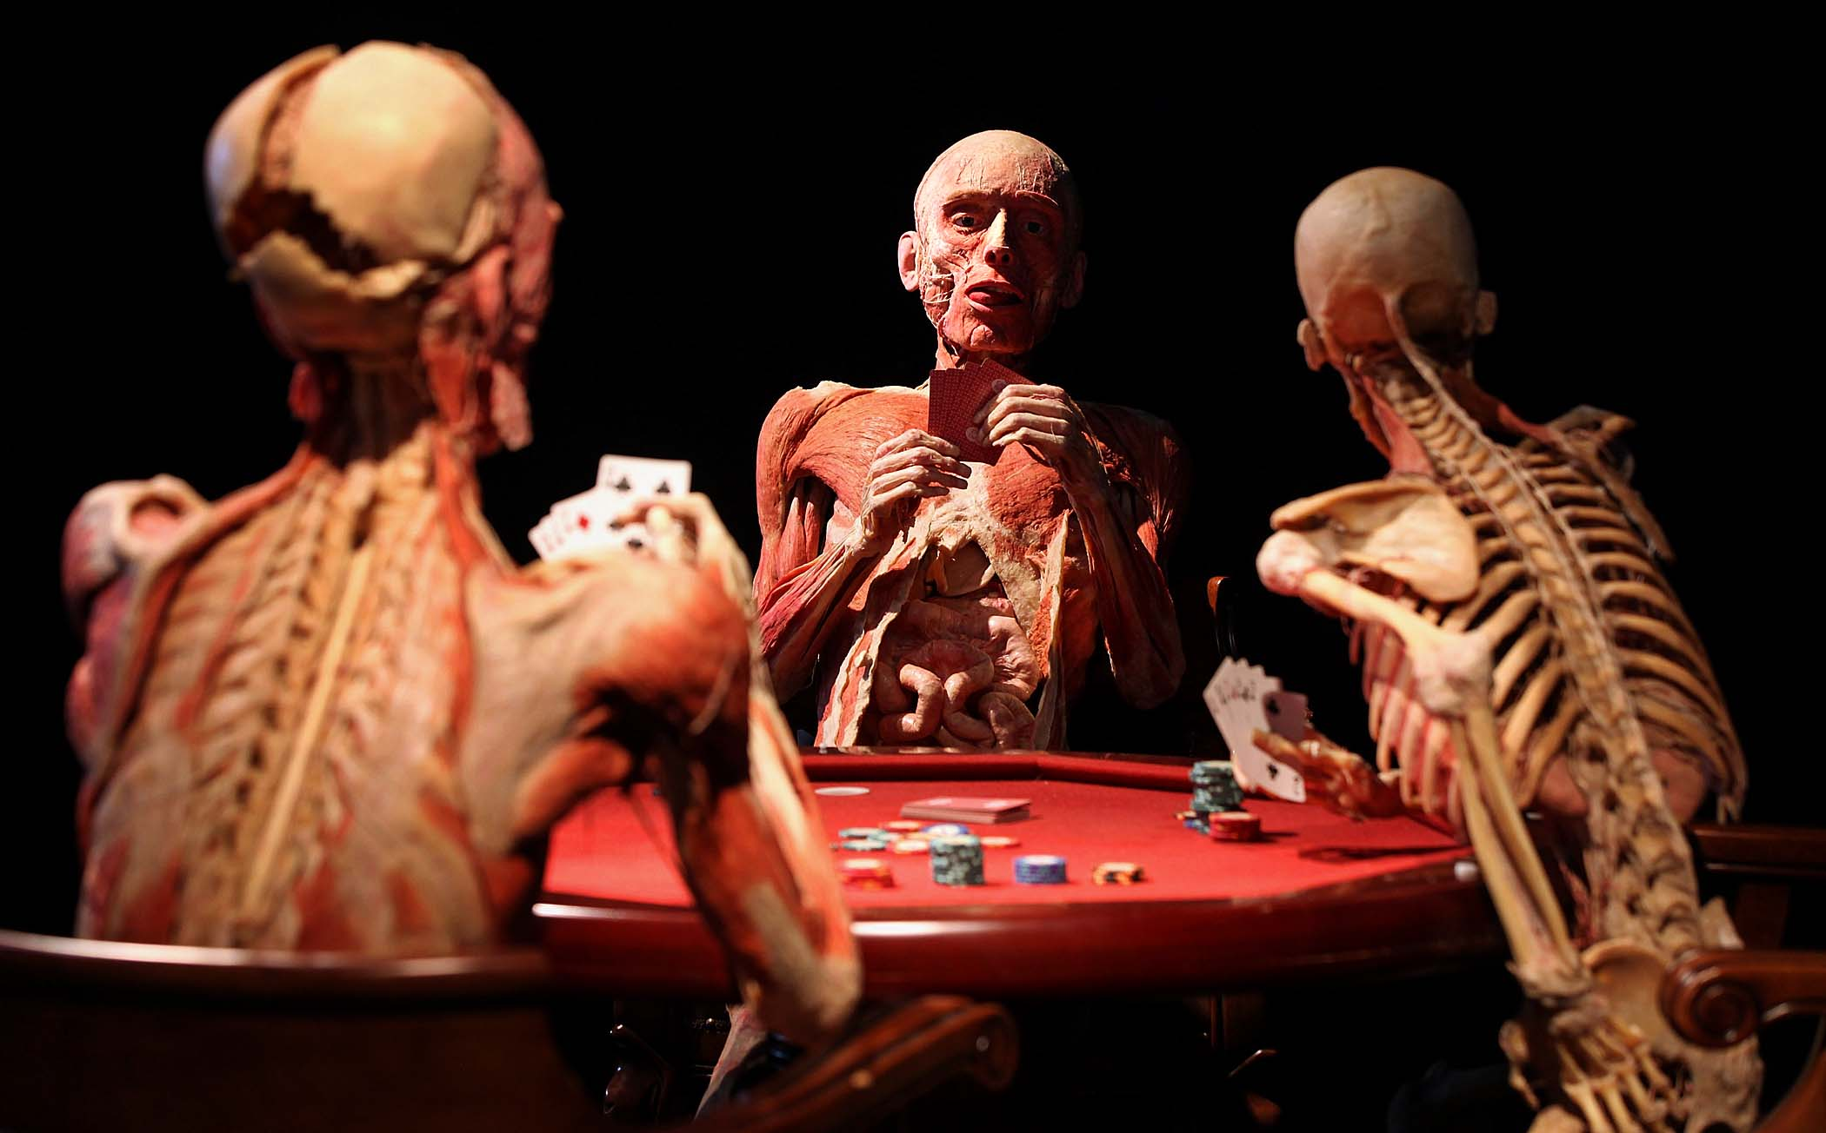

Slide 18
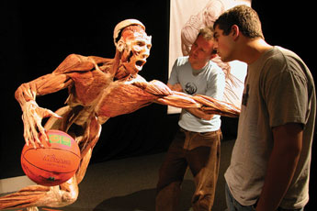

Slide 19
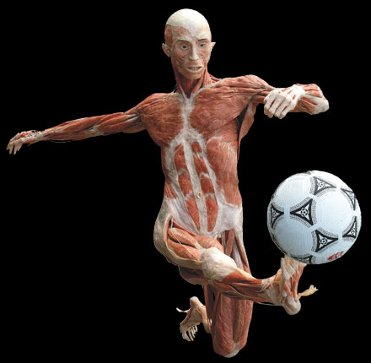

Slide 20
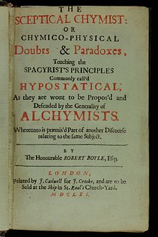
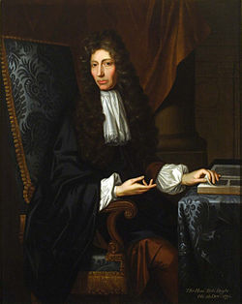
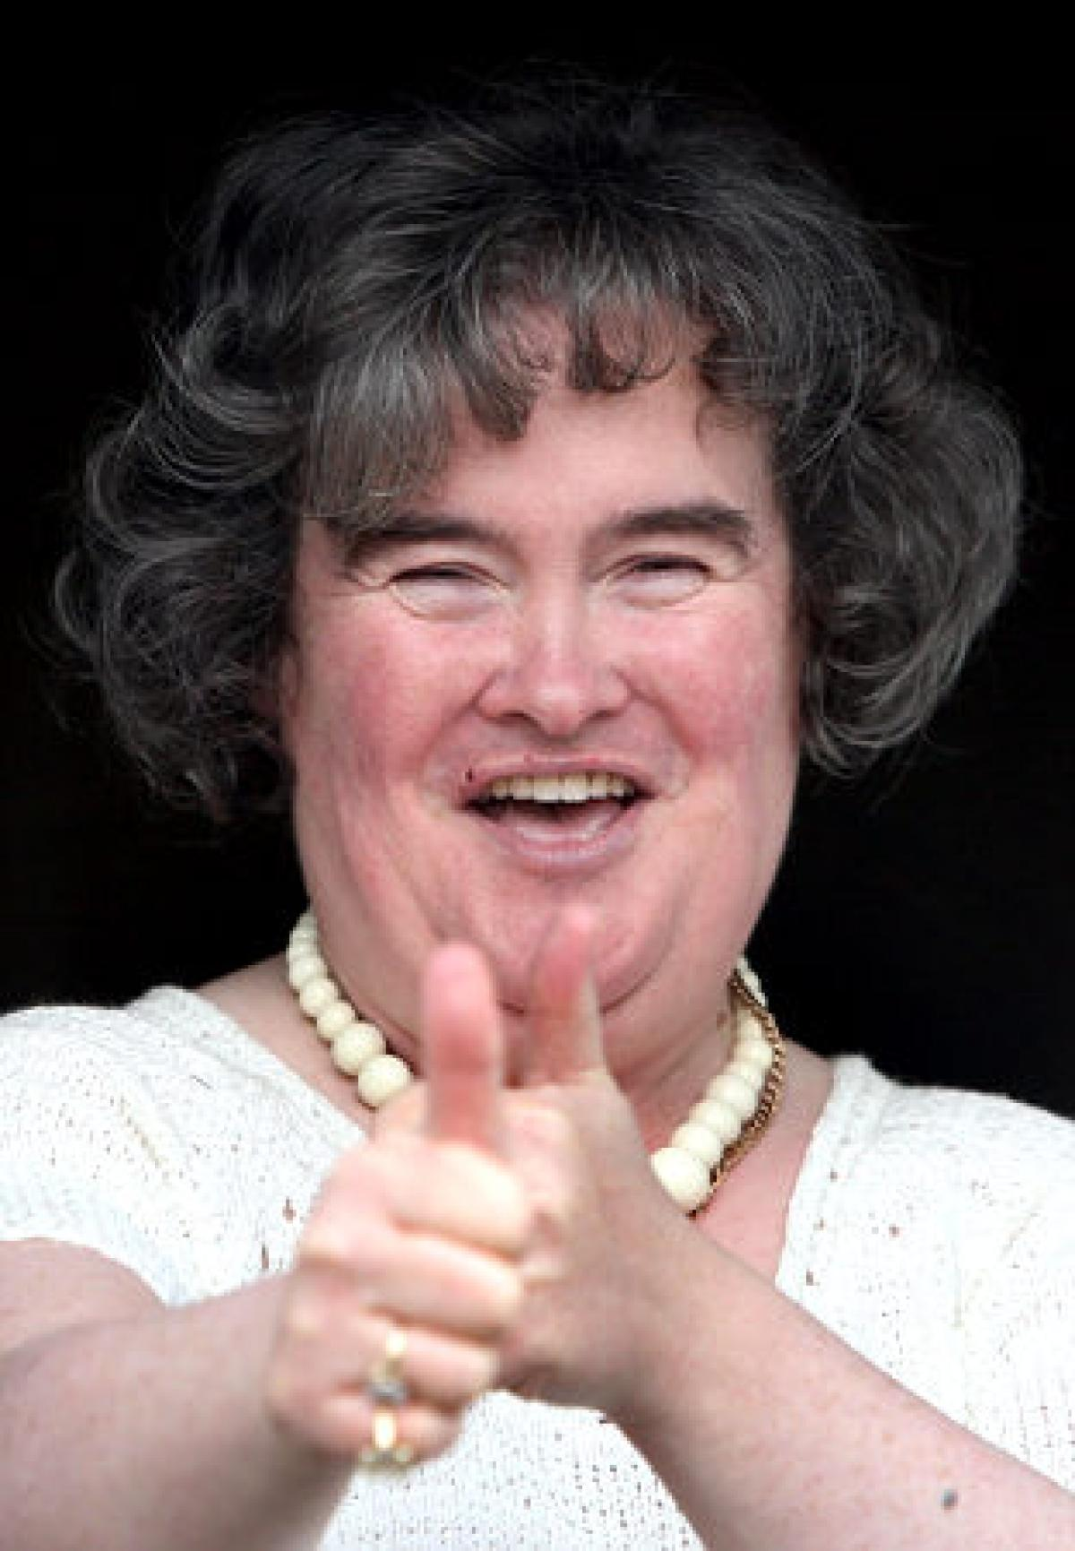
B. Robert Boyle- father of chemistry
C. Celsius- created a better temperature scale

