Slide 1
“Islamic Gunpowder Empires”

Slide 2
Review Topics
Pre-history
Four Early Civilizations
Early Chinese Dynasties (Qin Dynasty)
Monotheism (Christianity.Judaism.Islam)
Indian Religions
Early Indian Empires
Middle Ages
Renaissance
Reformation
Aztecs and Incas

Slide 3
Warm - Up
You have a quiz today.
Take everything off of your desk except a writing utensil. (Pencil/Pen)

Slide 4
Word Bank
Mercantalism
Conquistadors
De Gama
Joint-Stock
Creoles
Chinampa
Diaspora
Henry
Magellan
Tordesillas
French
Columbus
Cortes
Encomienda (Spelled ECOMIENDA)
Middle Passage
Quipu
Sacrifice

Slide 5
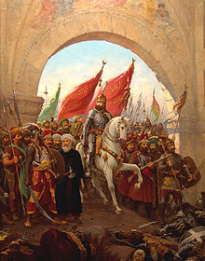
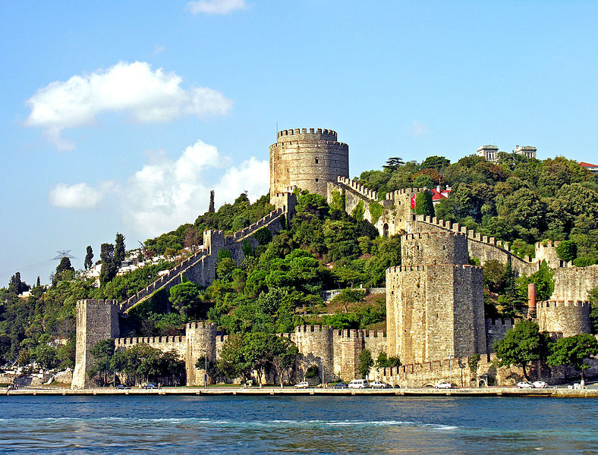
I. Ottoman Empire (1300-1918)
A. Sunni Muslim Turks from central Asia migrated into Asia minor (modern day Turkey)
B. Mehmet II, using cannons, took the Constantinople in 1453, renamed Istanbul

Slide 6
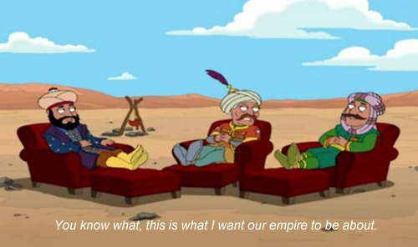

Slide 7
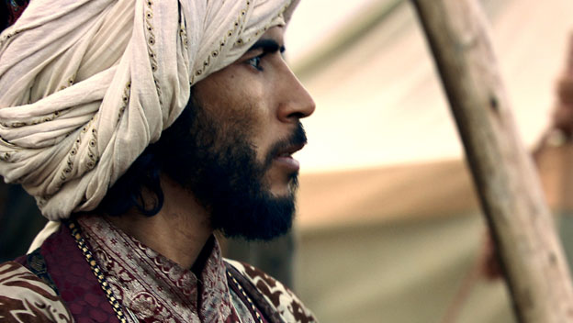
http://www.history.com/shows/mankind-the-story-of-all-of-us/videos/fall-of-constantinople

Slide 8
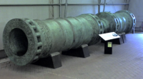
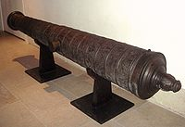
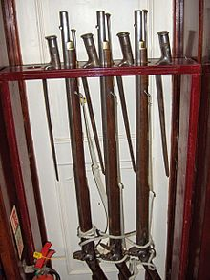
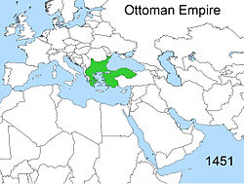
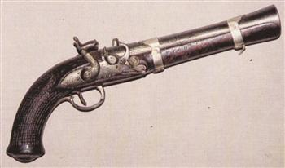
C. Expansion: eastern Europe, Middle East, North Africa
1. Gunpowder technology, strategy, and organization made it most powerful empire of the time
2. Controlled trade along Mediterranean Sea

Slide 9
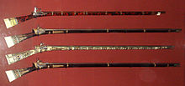
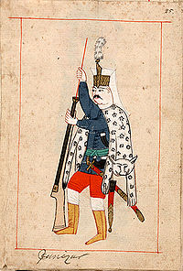
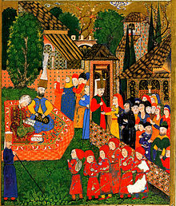
3. Religious freedom for Christians and Jews
4. Janissaries- enslaved Christian boys taken to be
enslaved and made elite soldiers loyal to the sultan

Slide 10
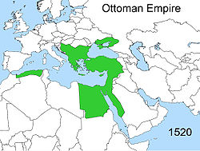
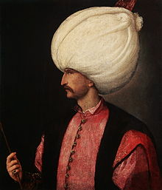
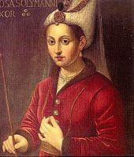
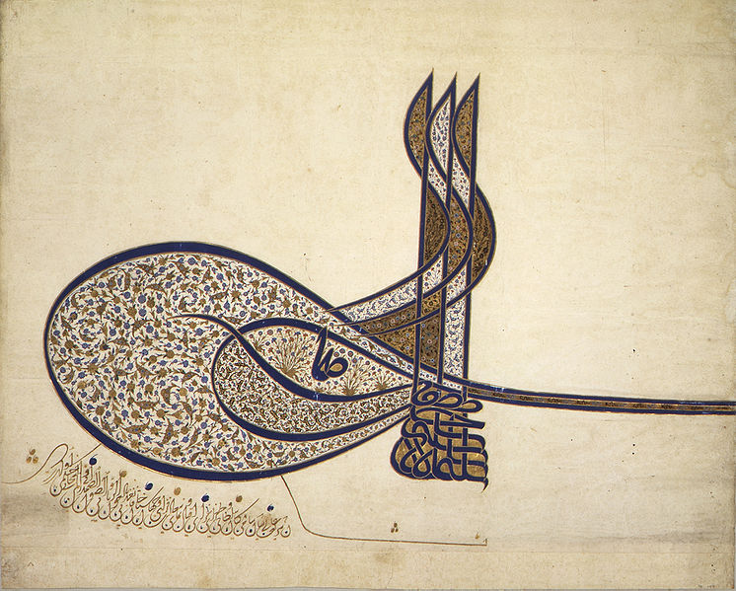
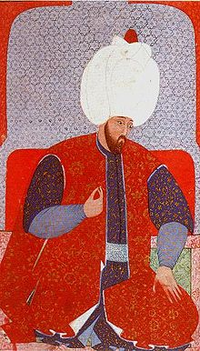
D. Suleiman the Magnificent (ruled 1520-1566)
1. Military expanded all the way to Vienna, Austria
2. Reformed taxes and bureaucracy
3. Improved the court system and legal code;
reduced corruption with new laws

Slide 11
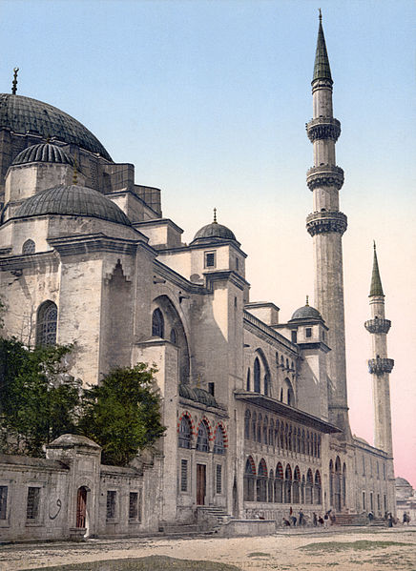
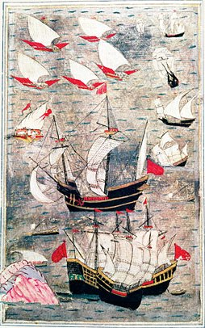

Slide 12
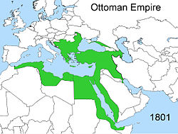
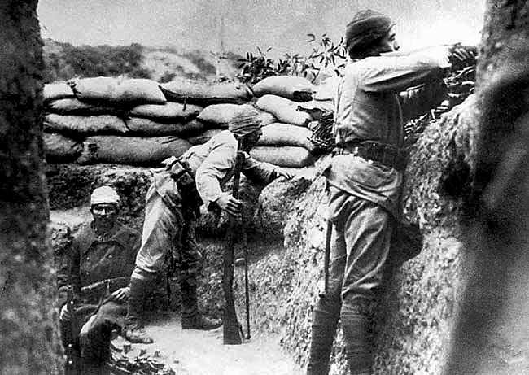
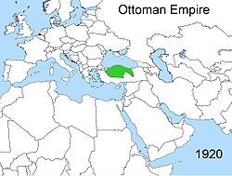
E. Decline:
1. too large to manage and had widespread corruption
2. Slow to adapt to Western manufacturing and technology (even banned the printing press)
3. Slowly lost territory but lasted until WWI

Slide 13
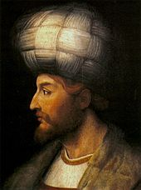
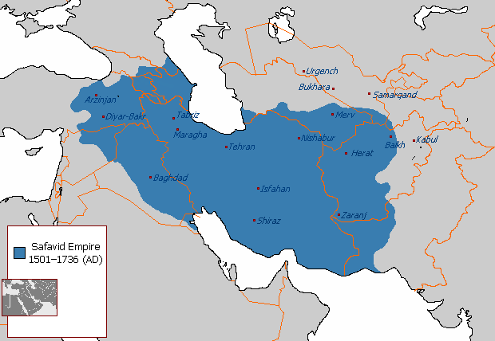
II. Safavid Empire (1500-1722)
A. Located: Persia (modern day Iran), Shi’a Muslim
B. Persecuted the Sunni, came into conflict with the Ottomans and other Muslims

Slide 14
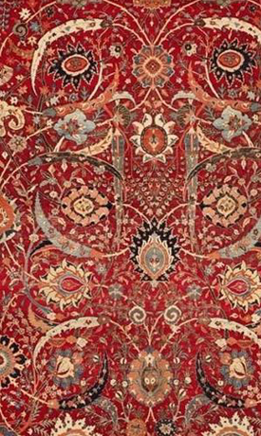
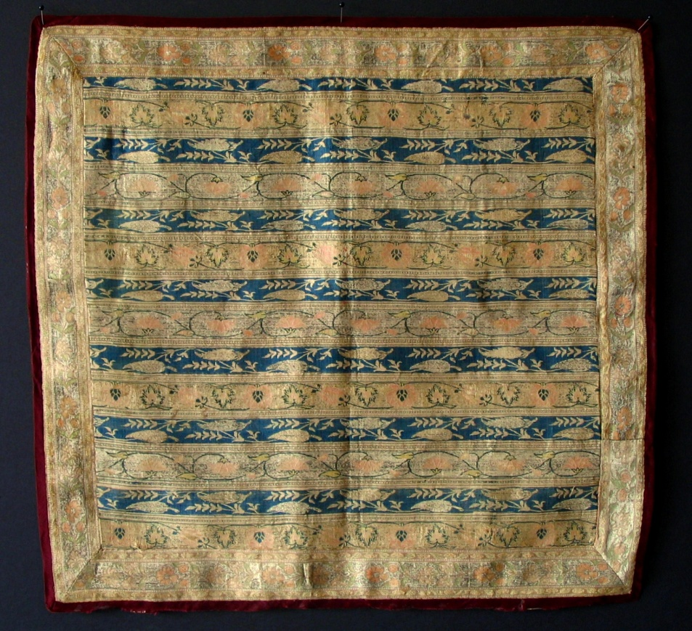
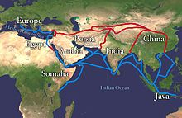
C. Traded silk, carpets, and ceramics along the Silk Road to the West
D. Decline: British and Dutch controlled Indian Ocean trade, raids from tribes along borders
This carpet is worth 33 million dollars!

Slide 15
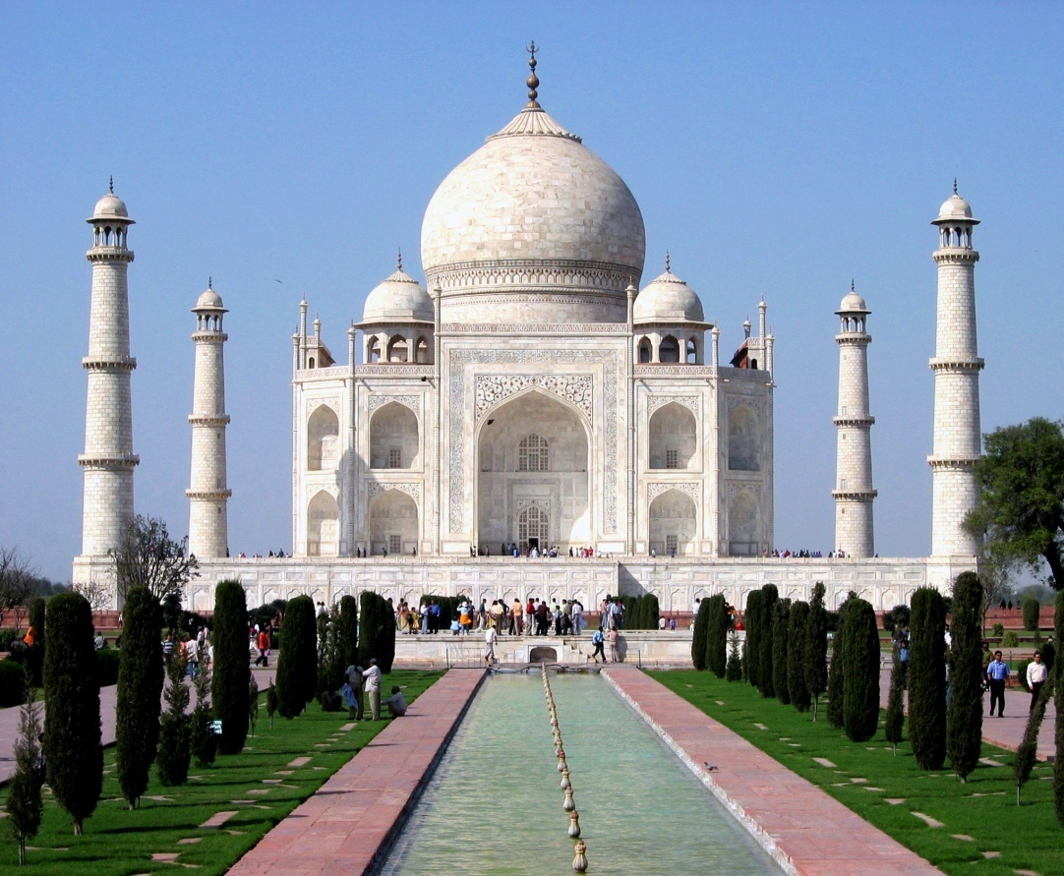
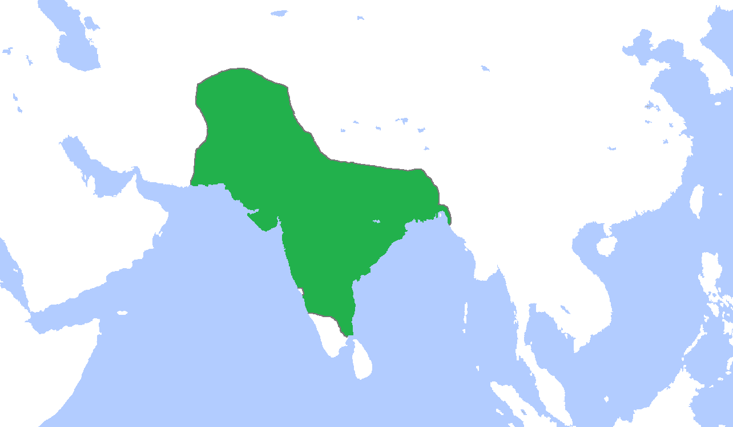
III. Mughal Empire (1526-1750)
A. Islamic conquerors (using gunpowder) took India
B. Achievements
1. Significant population growth with heavy agriculture
2. TajMahal- built by Shah Jahan as tomb in memory of his wife

Slide 16
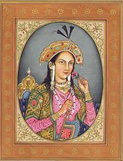
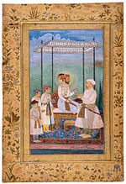

Slide 17
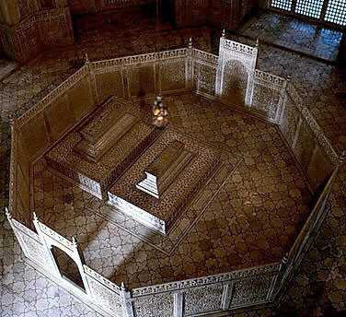

Slide 18
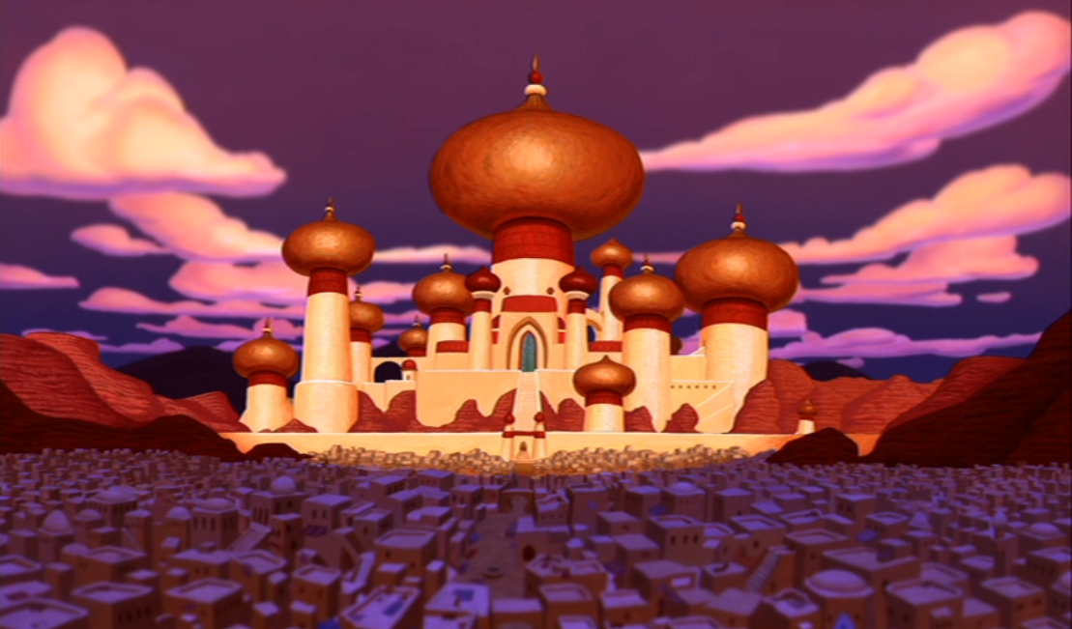

Slide 19
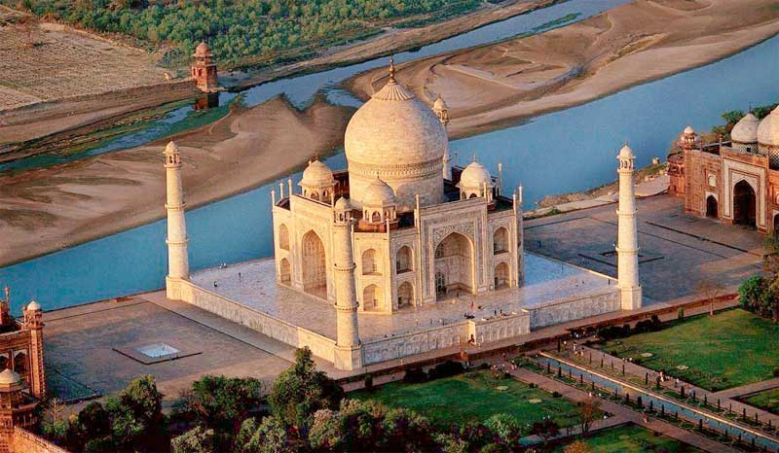

Slide 20
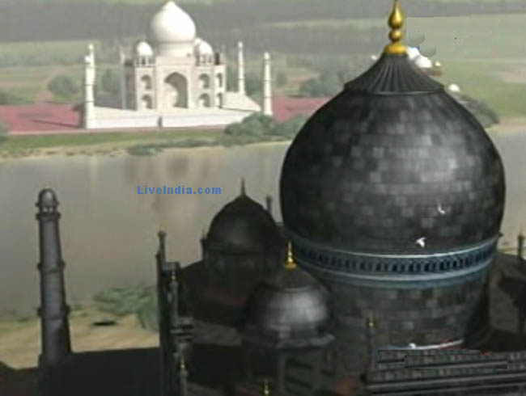

Slide 21
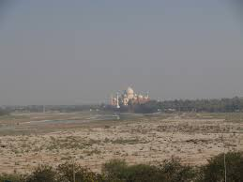

Slide 22
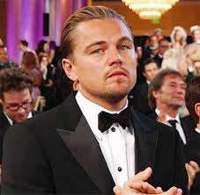

Slide 23
http://www.history.com/topics/taj-mahal/videos/deconstructing-history-taj-mahal?m=528e394da93ae&s=undefined&f=1&free=false

Slide 24
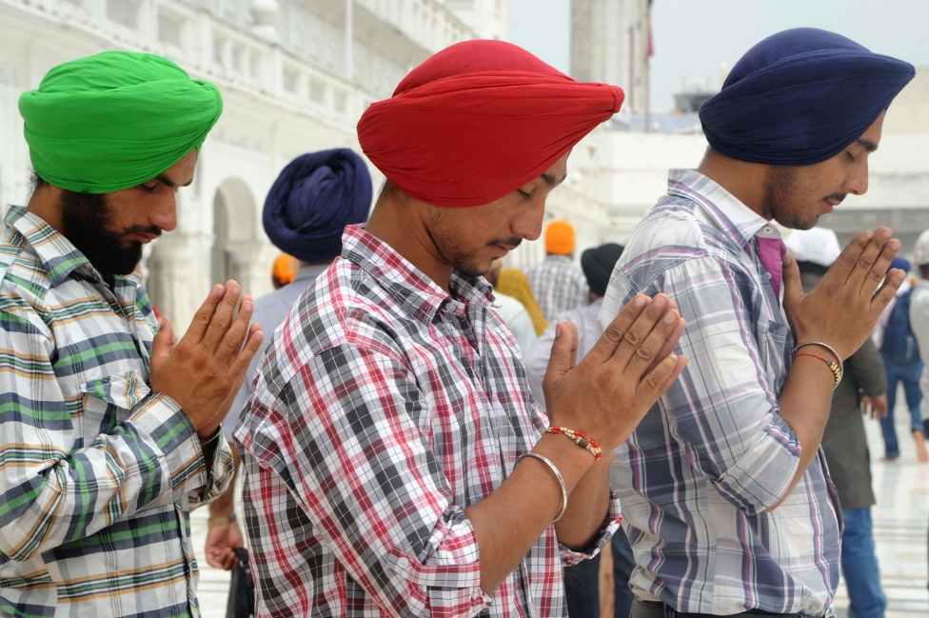
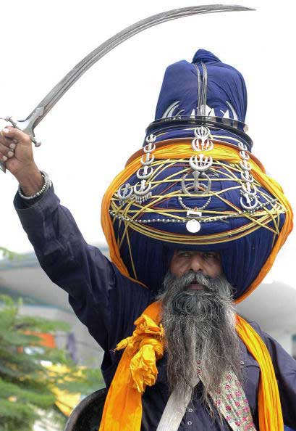
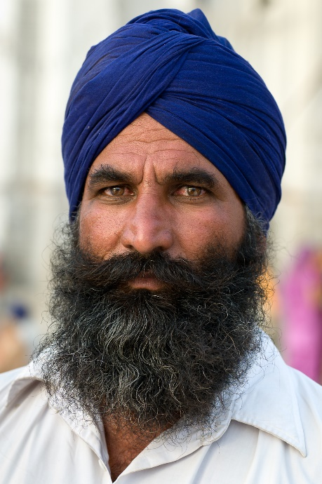
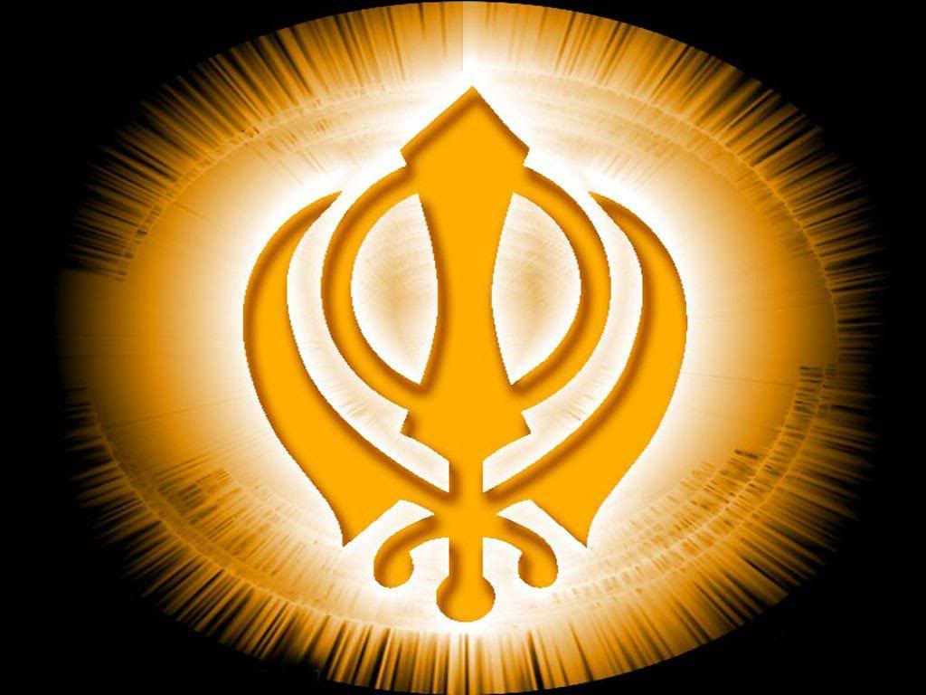
C. Religion
1. Muslims ran the government but Hindus were not forced to convert
2. Sikhism- religion that blended elements of both Islam and Hinduism

Slide 25
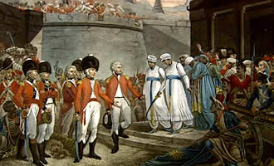
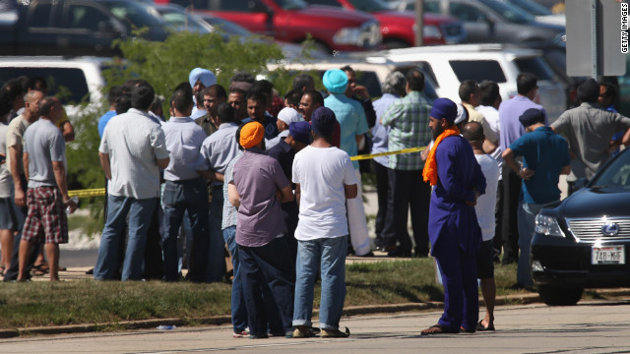
D. Decline
Later rulers persecuted Hindus and Sikhs leading to rebellion
European merchants (especially the British) gained more influence in India through local leaders

